Slide 1
ECE-777 System Level Design and Automation 3D integration. Reconfigurability and testing.
Cristinel Ababei
Electrical and Computer Department, North Dakota State University
Spring 2012

Slide 2
Outline
3D integration
Main idea
Pros and cons
Technologies
Example: IMEC
3D NoCs
Reconfigurability, FPGAs, and NoCs
Testing of NoCs

Slide 3
The communication bottleneck

Slide 4
3D integration: main idea

Slide 5
3D integration: pros and cons
Pros
Increased system integration, smaller form-factor
Enhances interconnect resources
Improved bandwidth and throughput
Reduced wirelength (WL)
Cons
Risk of losing performance gain if the increased heat density leads to degraded performance
Depending on the actual 3D technology, the yield may decrease
Cost

Slide 6
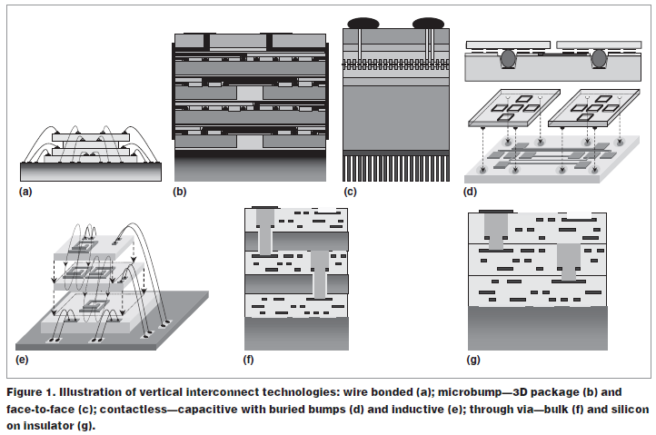
3D technologies

Slide 7
3D technologies
Wire bonded
Limited to the resolution of wire bonders
Difficult as the number of I/Os
Limited to the chip periphery
Microbump
Use solder/gold bumps on the surface of the die
Signals need to be routed to the periphery
Parasitic capacitances
Through silicon via (TSV)
Has the potential to offer the highest interconnect density
Alignment is difficult for many tiers
Risk of attaching a good die to a faulty one → yield drops
Heat inside the stack is limiting factor
Contactless
Capacitive coupling
Requires tiers to be face-to-face and hence is limited to two tiers
Inductive coupling

Slide 8
Basic requirements for a 3D Die stacking Technology
Electrical requirements:
Low inductance: mainly defined by interconnect length, requires short connections : favors thin die.
Low resistance: favors thin die and larger diameter, but is not very critical.
Low capacitance:
Causes RC-delay and increased fCV^2 power consumption!
Favors thin die, small diameters, small connection pads (high alignment precision) and thick dielectric isolation liner with silicon.
Most demanding and difficult requirement
Reliability and thermal requirements:
Low thermo-mechanical stress: metal via <-> Si
Low interface thermal resistance: thin gaps

Slide 9
Basic requirements for a cost-effective 3D Die stacking Technology
Minimize process complexity:
Minimize process number of steps
Minimize number of additional lithography steps
Single side wafer processing: lithography, etching, metallization.
High equipment throughput for each process step
Minimize TSV diameter: avoid loss of active Si area
Maximize a parallel processing

Slide 10
3D integration technology example: IMEC
3D-Wafer Level Packaging (3D-WLP)
WLP Trough-Si via and micro-bumping
Ultra-thin chip stacking and embedding
3D interconnects realized at wafer level
3D interconnects processed post IC passivation
3D interconnects realized at 0-level packaging interconnect
3D-Stacked IC (3D-SIC)
3D interconnects realized at wafer level
3D interconnects processed post Front End and prior to Back End local interconnects
3D interconnects at intermediate and global interconnect levels (3D-SIC) or local (3D-IC)

Slide 11
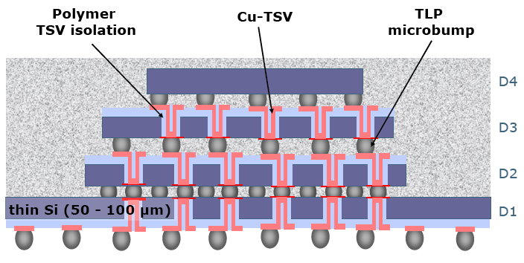
3D-WLP = 3D-Wafer Level Packaging WLP Trough-Si via and micro-bumping: Concept

Slide 12
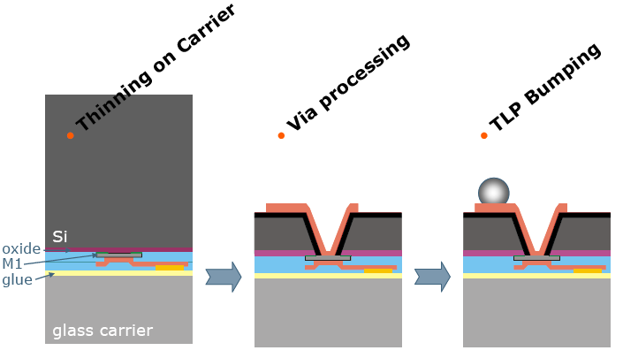
Key technologies

Slide 13
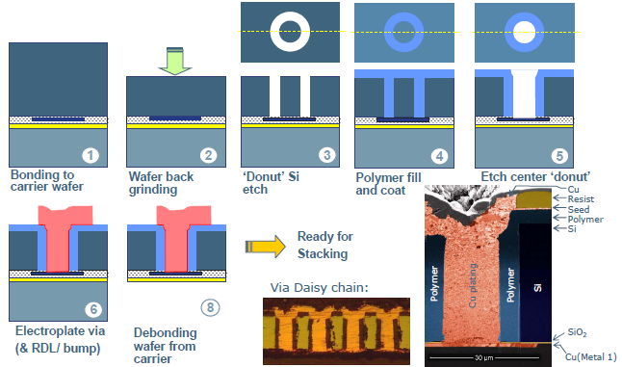
3D-Wafer Level Packaging (3D-WLP)

Slide 14
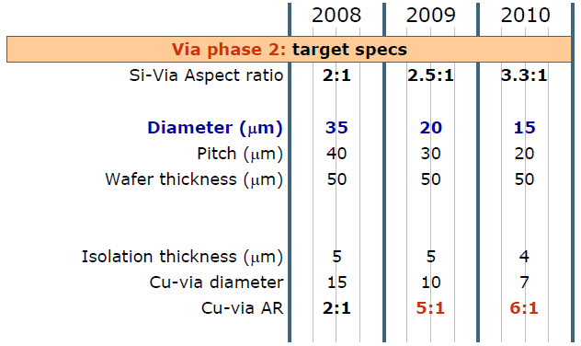
3D-WLP Via Technology Roadmap

Slide 15
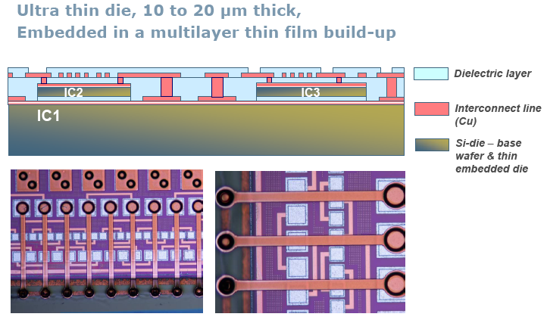
Ultra Thin Chip Embedding

Slide 16
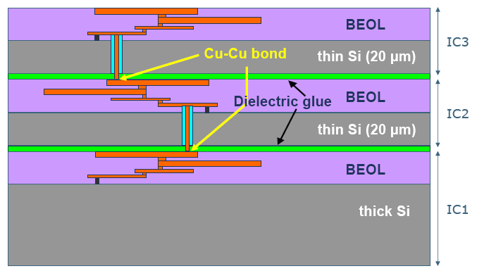
3D-SIC = 3D-Stacked IC: Concept

Slide 17
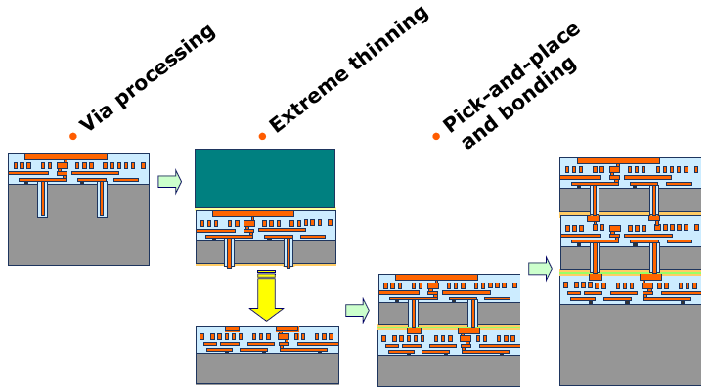
Key technologies

Slide 18
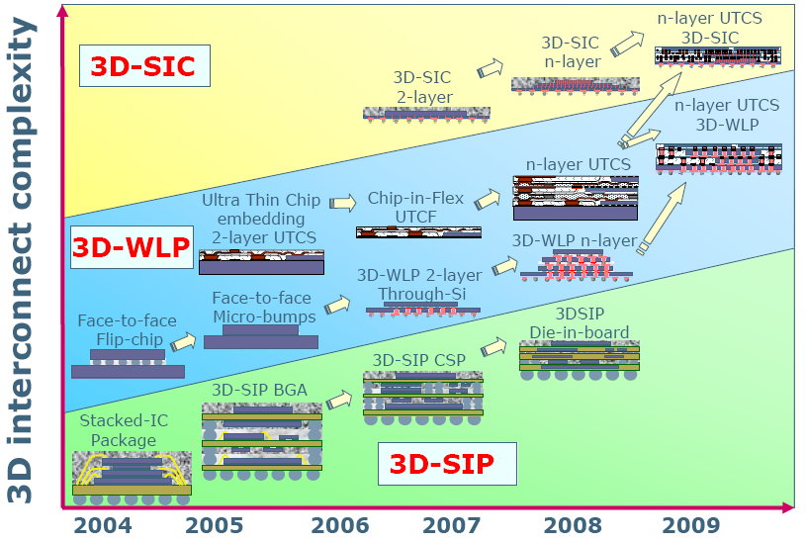
IMEC roadmap

Slide 19
3D TSV-based Integrated Circuits

Slide 20
Summing up…
Good power and speed
Area overhead is significant
Reliability not ideal (fabrication and aging)
Synchronization is hard (skew minimization across layers)
Therefore:
Cost and design effort are not trivial
Not just another dimension for wiring (as of today)
Need a sistematic way to deal with non-ideality

Slide 21
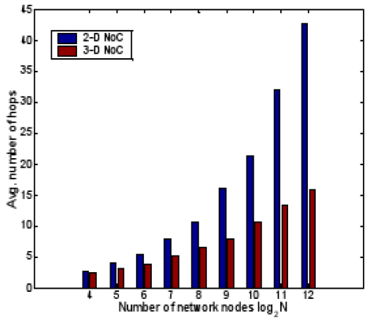
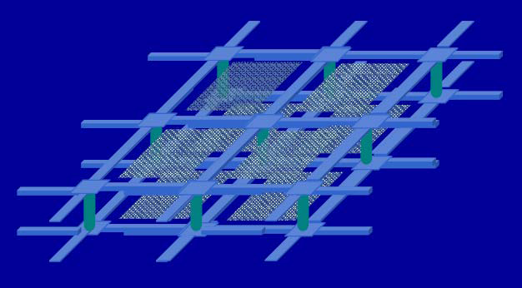
3D NoCs
Shorter channel length
Reduced average number of hops
Planar link
PE
PE
Router
PE
PE
TSV

Slide 22
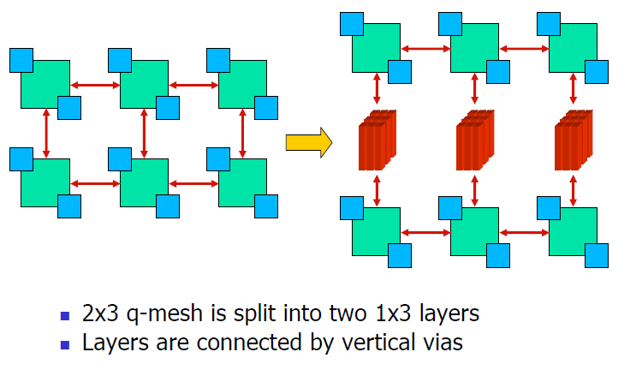
Example topology

Slide 23
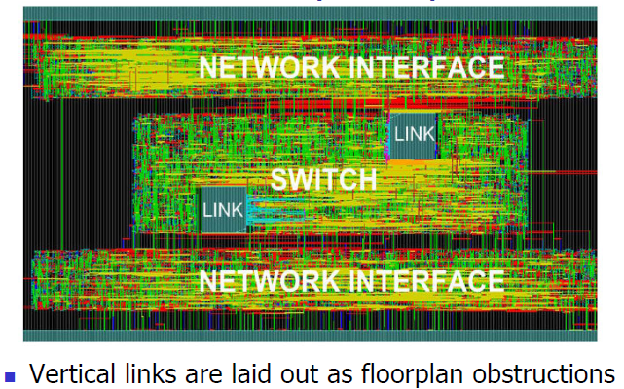
Bottom layer layout

Slide 24
Area overhead of TSV bundle

Slide 25
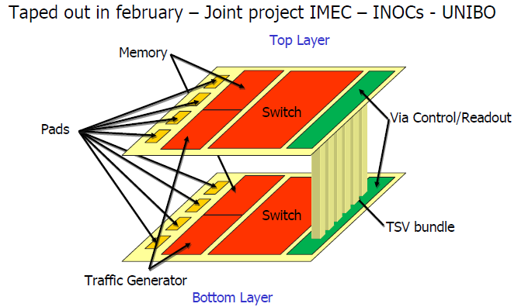
3D NoC test chip

Slide 26
Design challenges
Mesochronous Synchronization
Performance Analysis
Reliability Enhancement
3D NoC Topology Synthesis

Slide 27
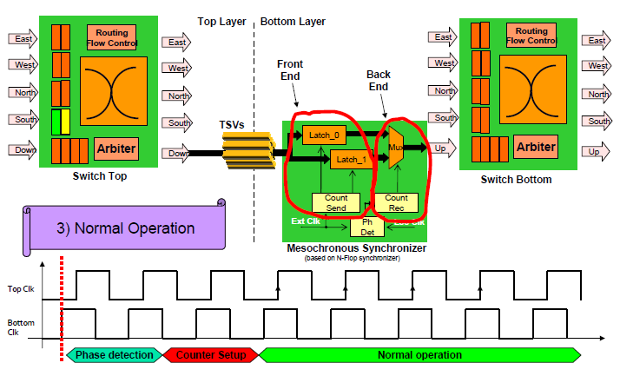
Mesochronous Synchronization

Slide 28
Performance Analysis

Slide 29
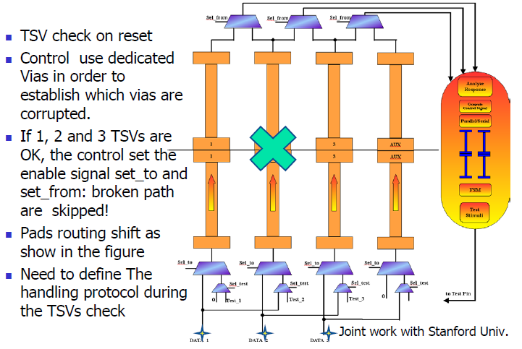
Reliability Enhancement

Slide 30
Reference NoC design flow

Slide 31
3D NoC Topology Synthesis

Slide 32
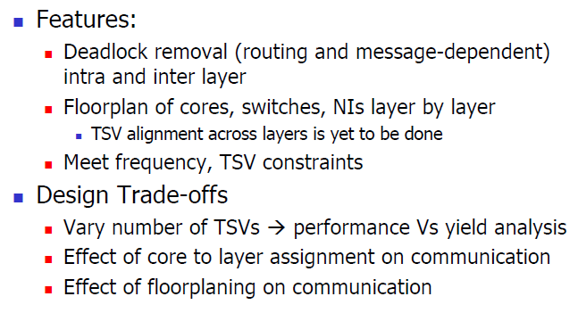
Topology Synthesis Algorithm

Slide 33
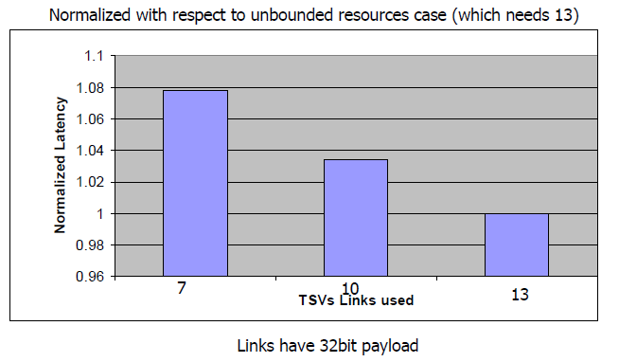
Effect of TSV Constraint

Slide 34
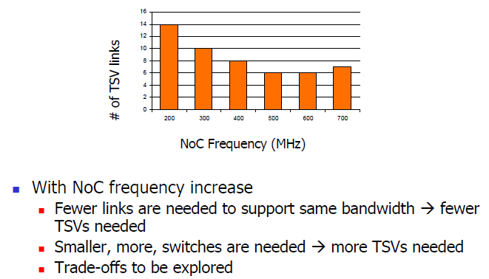
Effect of NoC Frequency

Slide 35
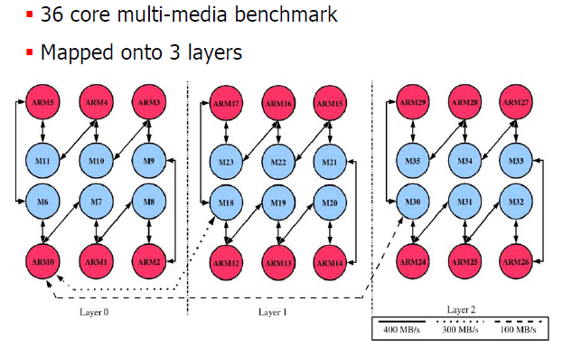
Case study

Slide 36
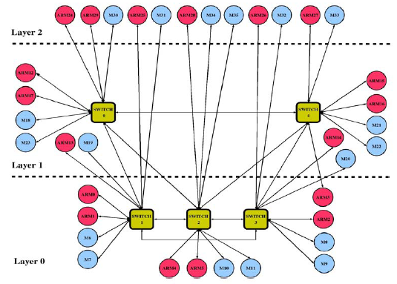
Generated 3D topology

Slide 37
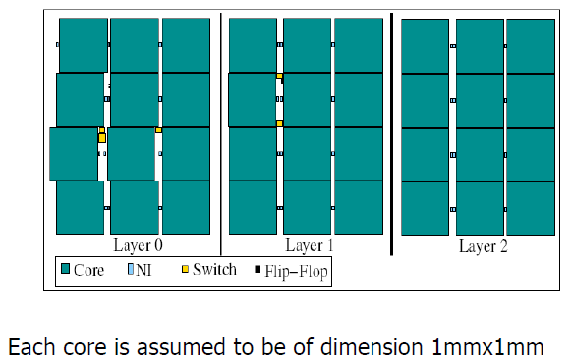
Design Floorplan

Slide 38
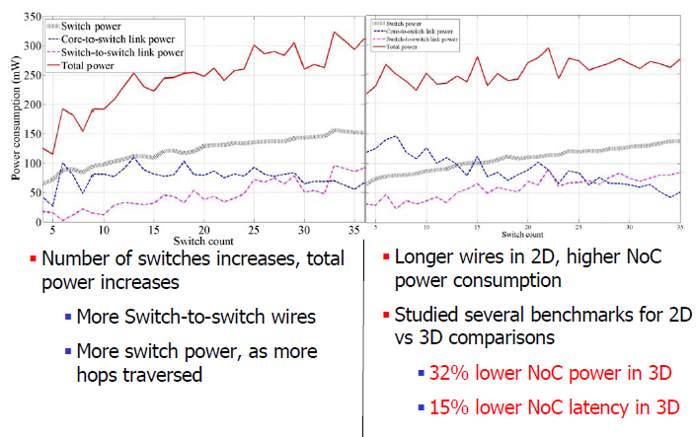
Comparison with 2D NoC

Slide 39
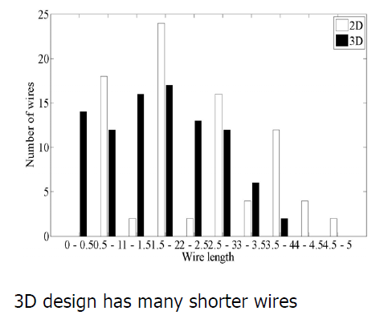
Wire Length Distribution

Slide 40
Other ideas/solutions: bus based

Slide 41
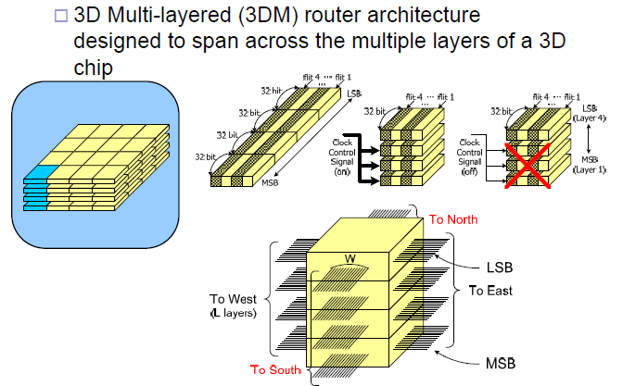
Multi-layer On-Chip Interconnect Router Architecture (MIRA)

Slide 42
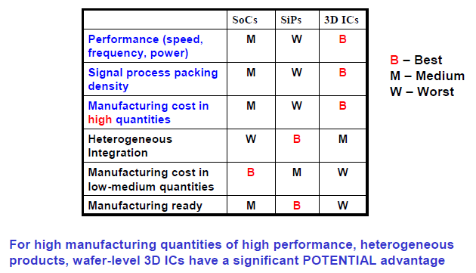
Summing up…

Slide 43
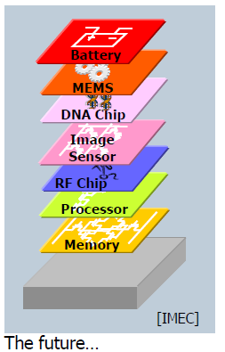
Summing up…

Slide 44
Outline
3D integration
Reconfigurability, FPGAs, and NoCs
FPGAs background
Configurable SoCs
NoCs prototyping
Reconfigurable NoCs
Testing of NoCs

Slide 45
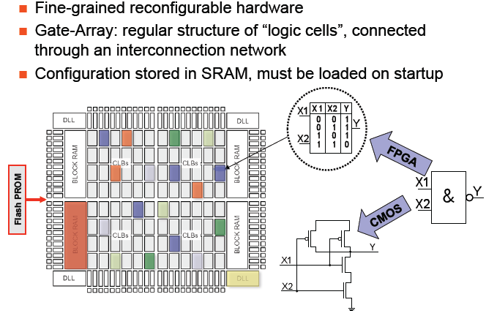
Field-Programmable Gate Arrays (FPGAs)

Slide 46
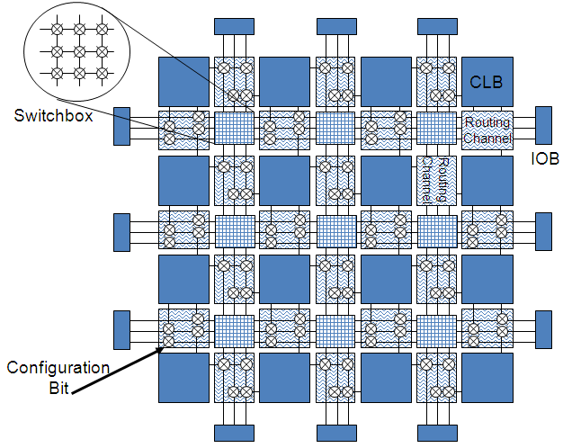
FPGAs

Slide 47
LUT
Program configuration bits for required functionality
Computes “any” 2-input function
2-LUT
Configuration Bit 0
In Out
00 0
01 0
10 0
11 1
Configuration Bit 1
C
A
C=AB
Configuration Bit 2
B
Configuration Bit 3
A
B

Slide 48
Programmable interconnects
Interconnect architecture
Fast local interconnect
Horizontal and vertical lines of various lengths
C L
B
C L
B
C L
B
Switch
Matrix
Switch Matrix
C L
B
C L
B
C L
B

Slide 49
Switchbox operation
Before Programming
After Programming
6 pass transistors per switchbox interconnect point
Pass transistors act as programmable switches
Pass transistor gates are driven by configuration memory cells

Slide 50
FPGA-based design flow

Slide 51
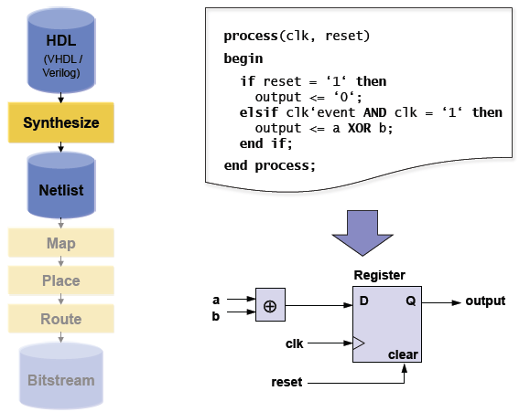
HDL Synthesis

Slide 52
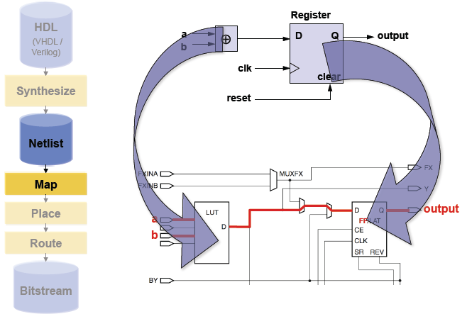
Technology mapping

Slide 53
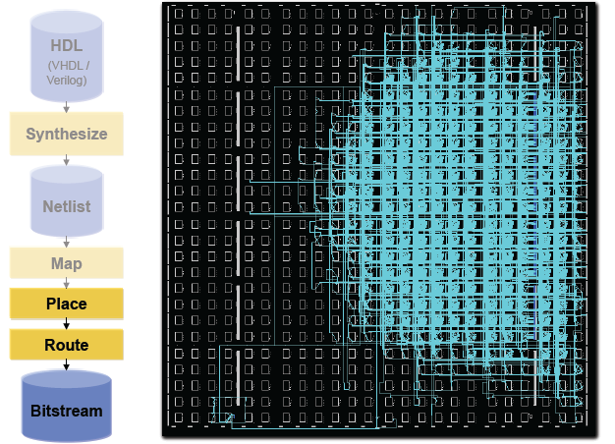
Place and route

Slide 54
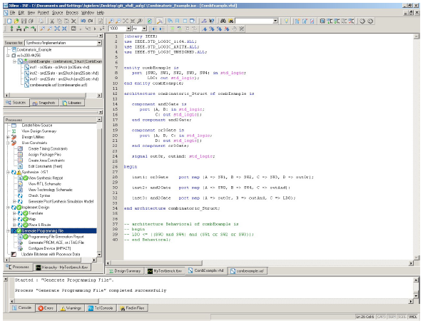
XILINX ISE

Slide 55
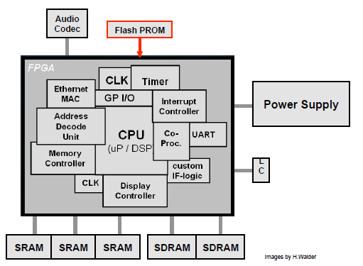
Configurable System on Chip (CSoC)

Slide 56
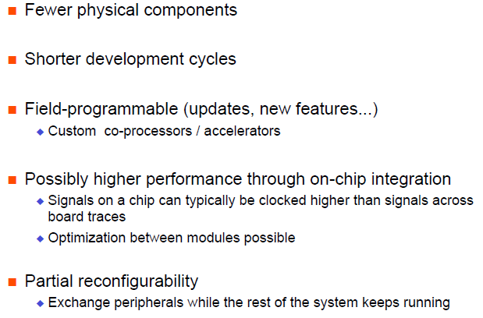
Advantages

Slide 57
NoC prototyping: CMU
Xilinx core generator
[] Umit Y. Ogras, Radu Marculescu, Hyung Gyu Lee, Puru Choudhary, Diana Marculescu, Michael Kaufman, Peter Nelson, "Challenges and Promising Results in NoC Prototyping Using FPGAs," IEEE Micro, vol. 27, no. 5, pp. 86-95, 2007.
Inv Quant.
& IDCT
Motion
Est. 2
in-house
DCT &
Quant.
Input
Buffer
R₁
R₂
VLE &
Out. Buffer
free
Motion
Est.
Frame
Buffer
Motion
Comp.
To build prototypes, we will likely use a mix
of free, commercial, and in-house IPs.
Synthesis for Xilinx Virtex II FPGA with CIF (352x288) frames
Point-to-point Implementation
Bus Implementation
Input
Buffer
DCT &
Quant.
VLE &
Out. Buffer
Input
Buffer
DCT &
Quant.
Inv Quant.
& IDCT
Bus Cont.
Unit
Inv Quant.
& IDCT
Motion
Comp.
Motion
Est.
Frame
Buffer
Motion
Est.
Motion
Est. 2
Frame
Buffer
Motion
Comp.
VLE &
Out. Buffer
Motion
Est. 2

Slide 58
Recore’s reconfigurable system
Recore Systems
http://www.recoresystems.com
Reconfigurable computing platforms

Slide 59
Programmable platform chips

Slide 60
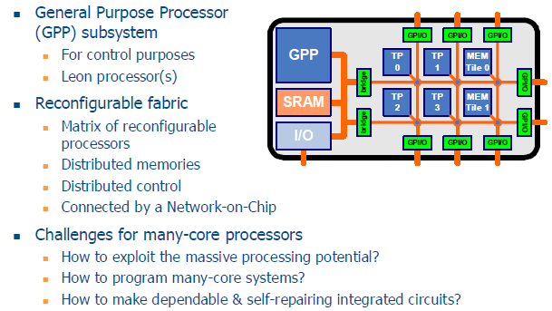
Many-core architecture

Slide 61
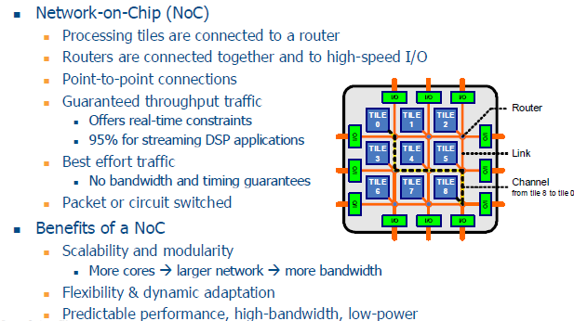
NoC instead of a bus

Slide 62
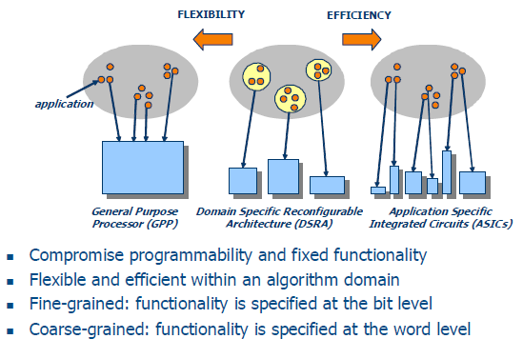
Reconfigurable architectures

Slide 63
Reconfigurable technology

Slide 64
Reconfiguration enables run-time mapping

Slide 65
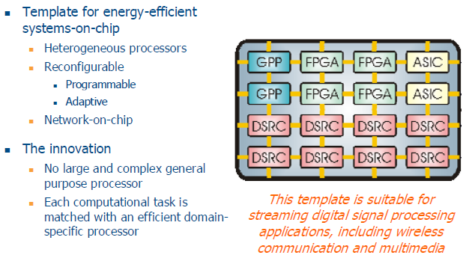
Montium technology: reconfigurable SoC approach

Slide 66
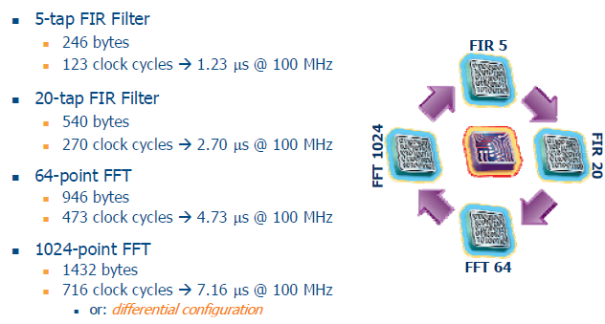
Dynamic reconfiguration examples

Slide 67
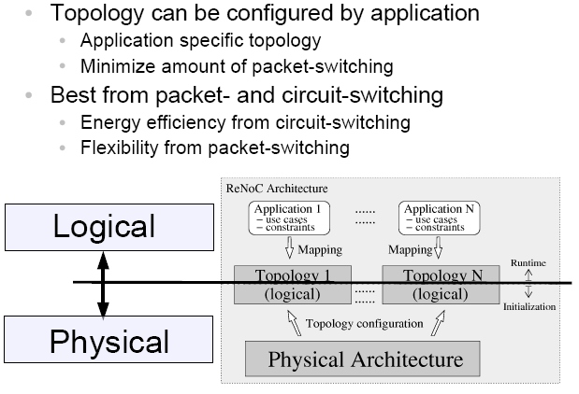
ReNoC: A Network-on-Chip Architecture with Reconfigurable Topology

Slide 68
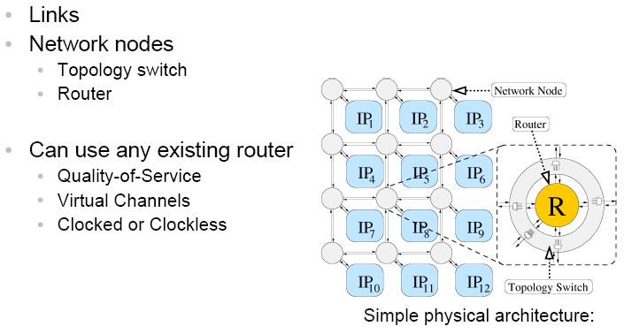
Physical architecture

Slide 69
Topology switches

Slide 70
Implementation

Slide 71
Logical topology

Slide 72
Generalization

Slide 73
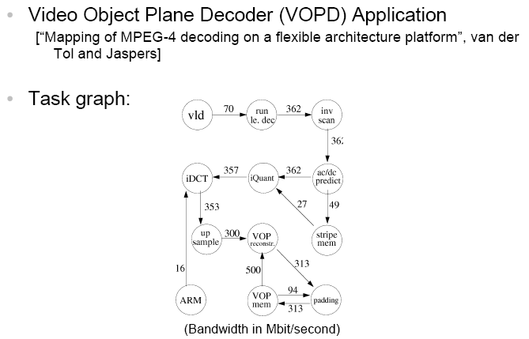
Case study

Slide 74
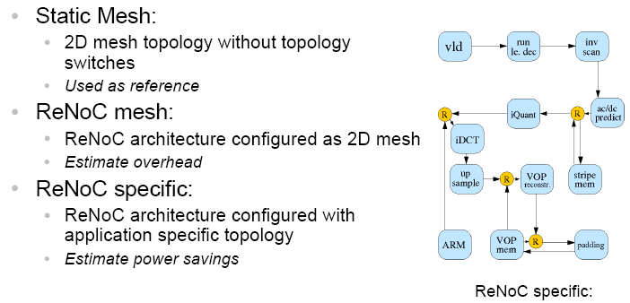
Architecture

Slide 75
Implementation

Slide 76
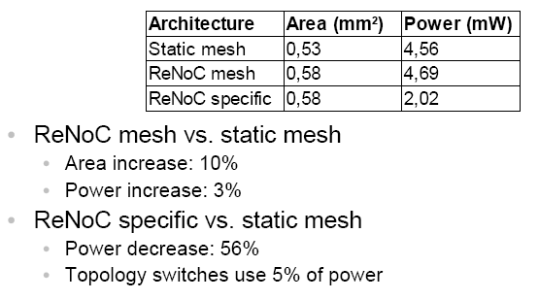
Results

Slide 77
Outline
3D integration
Reconfigurability, FPGAs, and NoCs
Testing of NoCs
References
Improving testing via compression schemes
Other testing techniques

Slide 78
NoC test references
1. C. Aktouf, "A complete strategy for testing an on-chip multiprocessor architecture," IEEE Design & Test of Computers, 19(1), pp. 18–28, January/February 2002.
2. A. M. Amory, E. Briao, E. Cota, M. Lubaszewski, and F. G. Moraes, "A scalable test strategy for network-on-chip routers," in Proc. Int. Test Conf., Nov., 2005, paper 25.1
3. A. M. Amory, K. Goossens, E. J. Marinissen, M. Lubaszewski, and F. Moraes, "Wrapper design for the reuse of networks-on-chip as test access mechanism," in Proc. European Test Symp., pp. 213–218, May 2006
4. K. Stewart and S. Tragoudas, "Interconnect testing for network on chips," in Proc. IEEE VLSI Test Symp., pp. 100–105, April 2006.
5. C. Grecu, P. Pande, A. Ivanov, and R. Saleh, "BIST for network-on-chip interconnect infrastructures," in Proc. IEEE VLSI Test Symp., pp. 30–35, April 2006.
6. T. Bengtsson, A. Jutman, S. Kumar, R. Ubar, Z. Peng, "Off-line Testing of Delay Faults in NoC Interconnects," in Proc. EUROMICRO Conf. on Digital System Design, 2006, pp.677 - 680
7. P. Bhojwani and R. N. Mahapatra, "An Infrastructure IP for online testing of network-on-chip based SoCs," in Proc. Int. Sym. on Quality Electronic Design (ISQED), March, 2007, pp.
8. K. Petersén and J. Öberg, "Toward a Scalable Test Methodology for 2D-mesh Network-on-Chips," in Proc. IEEE/ACM Design, Automation and Test in Europe (DATE), April, 2007, pp.
9. P.S. Bhojwani, R.N. Mahapatra, "Robust Concurrent Online Testing of Network-on-Chip-Based SoCs," Very Large Scale Integration (VLSI) Systems, IEEE Transactions on Volume 16, Issue 9, pp.1199 - 1209, Sep. 2008
10. Cota, Érika, Kastensmidt, Fernanda Lima, Cassel, Maico, Hervé, Marcos, Almeida, Pedro, Meirelles, Paulo, Amory, Alexandre, Lubaszewski, Marcelo, "A High-Fault-Coverage Approach for the Test of Data, Control and Handshake Interconnects in Mesh Networks-on-Chip, Computers," IEEE Transactions on Volume 57, Issue 9, pp. 1202 - 1215, Sep. 2008
11. O. J. Kuiken, X. Zhang, and H. G. Kerkhoff, "Built-In Self-Diagnostics for a NoC-Based Reconfigurable IC for Dependable Beamforming Applications," in Proc. IEEE Int. Symp. Defect and Fault Tolerance in VLSI Systems (DFT), Oct., 2008, pp.45-53

Slide 79
NoC test references
12. M. Sedghi, E. Koopahi, A. Alaghi, M. Fathy, and Z. Navabi, "An NoC Test Strategy Based on Flooding with Power, Test Time and Coverage Considerations," in Proc. Int. Conf. on VLSI Design, 2008, pp.409-414
13. X.-T. Tran, Y. Thonnart, J. Durupt, V. Beroulle, and C. Robach, "A Design-for-Test Implementation of an Asynchronous Network-on-Chip Architecture and its Associated Test Pattern Generation and Application," in Proc. Int. Symp. on Networks-on-Chip, 2008, pp. 149-158
14. J. Dalmasso1, É. Cota, M.-L. Flottes, and B. Rouzeyre, "Improving the Test of NoC-based SoCs with Help of Compression Schemes," in Proc. IEEE Computer Society Annual Symp. on VLSI, 2008, pp. 139-144
15. B.-G. Ahn, J.-M. Jung, and J.-W. Chong, "Power-Aware Test Framework for Network-on-Chip," in Proc., Int. Conf. on Systems, 2008, pp. 103-107
16. M. Hervé, É. Cota, F. L. Kastensmidt, and M. Lubaszewski, "Diagnosis of Interconnect Shorts in Mesh NoCs," in Proc. ACM/IEEE International Symposium on Network-on-Chip (NoCS), May 2009, pp. 256 - 265.
17. B. Vermeulen1, K. Goossens, "A Network-on-Chip Monitoring Infrastructure for Communication-centric Debug of Embedded Multi-Processor SoCs, "in Proc. International Symposium on VLSI Design, Automation and Test (VLSI-DAT), May 2009, pp. 183-186.
18. A. Eghbal, P. M. Yaghini, H. Pedram, and H. R. Zarandi, "Fault Injection-based Evaluation of a Synchronous NoC Router," in IEEE International On-Line Testing Symposium (IOLTS), June 2009, pp. 212-214.
19. J. Raik, V. Govind, and R. Ubar, "Design-for-testability-based external test and diagnosis of mesh-like network-on-a-chips," in IET Computers & Digital Techniques, vo. 3, no. 5, pp. 476 - 486, Sep. 2009.
20. X.-T. Tran, Y. Thonnart, J. Durupt, V. Beroulle and C. Robach, "Design-for-test approach of an asynchronous network-on-chip architecture and its associated test pattern generation and application," in IET Computers & Digital Techniques, vo. 3, no. 5, pp. 487 - 500, Sep. 2009.
21. H.-N. Liu, Y.-J. Huang, and J.-F. Li, "A built-in self-repair method for RAMs in mesh-based NoCs," in IEEE Int. Symp. on VLSI Design, Automation, and Test (VLSI-DAT), (Hsinchu), pp. -, Apr. 2009
22. S.-Y. Lin, C.-C. Hsu, and A.-Y. (Andy) Wu, "A Scalable Built-in Self-Test/Self-Diagnosis Architecture for 2D-mesh Based Chip Multiprocessor Systems," in Proc.IEEE International Symp. on Circuits and Systems (ISCAS), May, 2009, pp. 2317-2320 .

Slide 80
Improving NoC-based Testing Through Compression Schemes
ATE
Test wrapper
SoC
core
core
core
Router
core
core
core

Slide 81
NoC-based testing
Functional inputs and outputs are used during test, similarly standard SoC testing
The NoC will be used to transmit data from the ATE to the cores and vice-versa
Wrappers design
NoC protocol
1500-compliant

Slide 82
Approaches
Preemptive testing
One vector per message, non-reserved paths
Schedule next test-vector packet of a core as soon as a path is available
Length of the paths travelled by different tests to the same core can be different
Non-preemptive testing
All test-vectors in one message
Routing is done using dedicated paths, similar to circuit switching

Slide 83
Reuse Model: number of Test Ports
ATE = 2W channels
SoC
core
core
core
w
w
w
w
w
core
core
core
1 core under test

Slide 84
Observations
The main limitation for test time reduction is the number of test ports available
For non-preemptive testing, the problem is even more serious: the number of input and output test ports must be equal (so that a complete access path can be defined per core)
If extra pins can be added to the system to reduce test time, a more expensive ATE will be required

Slide 85
Reuse Model: number of Test Ports
ATE = 4W channels
SoC
w
w
w
w
core
core
core
w
w
w
w
w
core
core
core
2 cores under test

Slide 86
DFT Costs
Number of extra pins in the system grows much faster than the corresponding
decrease in test time
p93791
103 Inputs
79 Outputs
66 Bidirs
32 Cores
Test Time
Number of Extra Pins

Slide 87
ATE Costs
p93791
103 Inputs
79 Outputs
66 Bidirs
32 Cores
Test Time
Number of ATE Channels

Slide 88
Challenge
How to increase the number of test ports
Increase test parallelism
Maximize NoC channels usage
Without increasing the ATE cost?
Possible solution:
Combine a horizontal compression scheme with a non–preemptive test scheduling approach to reduce test time
Each test port needs less than W bits
Less ATE channels per port
Increase the number of possible test ports
Increase test parallelism

Slide 89
Compression Applied to NoC-based Test
Core
Core
W
input
wrapper
wrapper
W
router
W
router
Core
N
Core
W
wrapper
wrapper
W
router
W
router

Slide 90
Compression Applied to NoC-based Test
Functional
input pins
NoC
F_{i}
Core i
M
decompressor
wrapper
W
W
router
W
W
Communication
channels
M≤ F_{i} ≤ W

Slide 91
Compression Applied to NoC-based Test
Functional
output pins
NoC
F_{i}
Core i
M
compressor
wrapper
W
W
router
W
W
Communication
channels
M≤ F_{i} ≤ W

Slide 92
Compression Applied to NoC-based Test
Horizontal compression
Test width reduction is the primary goal
Test vectors compression
Implies extra hardware at NoC-level (decompressor sharing)
May increase cores test time
Test responses compression
Implies extra hardware at NoC-level
Does not affect core test time

Slide 93
Horizontal compression
Many published methods
Take advantage of Don’t Care bits (X’s) in test sequence
May increase core Test Time
✓
✓
✓
✓
✓
✓
✓
✓
✓

Slide 94
Decompressor architecture
M
From ATE
0
0
0
0
Add Cells
Output
Shift Register
W
To scan chains
[1] Julien Dalmasso, Marie-Lise Flottes, Bruno Rouzeyre: Fitting ATE Channels with Scan Chains: a Comparison between a Test Data Compression Technique and Serial Loading of Scan Chains - DELTA 2006: 295-300

Slide 95
Compression Applied to NoC Data
Test pattern: 011010110101110
Original test packet
(W= 5)
Compressed test packet
(M = 2)
Uncompressed test packet
(W = 5)
packet header
packet header
packet header
test header
packet header
test header
01101
packet header
01101
01101
test header
01101
01110
test header
01110
tail
test header
tail
01
10
compressor
decompressor
1X
00
01
tail

Slide 96
Compression Applied to NoC Data
Example for d695 ITC’02 benchmark
uncompressed and compressed data (#flits)
Core | Original Payload (32-bits) | Comp. 32 -> 12 | Comp. 32 -> 10
1 | 12 | 22 | 30
2 | 511 | 949 | 1198
3 | 2400 | 2400 | 2400
4 | 5670 | 5670 | 5670
5 | 6050 | 10976 | 14000
6 | 9594 | 11918 | 12171
7 | 3230 | 4069 | 5054
8 | 4462 | 4462 | 4462
9 | 768 | 1426 | 1791
10 | 370 | 6876 | 8780
Compression may increase test time of individual cores

Slide 97
Compression Applied to NoC Data
Conclusion:
Local increase in test time
Increase test parallelism
Global test time reduction
d695
32 Inputs
32 Outputs
10 Cores
System Configuration | Test time
1 32-bit input port | 36588 cycles
3 input ports of 12, 10, and 10 bits | 24395 cycles
32 ATE
channels
33%

Slide 98
Test Scheduling with Compression
Define test
packets
Define access paths
for each core
Packets sorted by probable test time
Select a packet
Select I/O pair that leads to minimal total test time
Find available
access path
If no path is found, try next core
Schedule
packet

Slide 99
Test Scheduling Using Dedicated Paths
6
5
4
8
10
7
3
9
2
1
d695 from ITC02 benchmark
Channel width=32
3 inputs
10, 10, 12 bits
3 outputs
I/O pairs
3/9
6/7
8/4
1
5
10
2
12
In
10
In
3
6
4
Out
Out
9
8
7
Out
In
10

Slide 100
6
5
4
8
10
7
3
9
2
1
1
5
10
2
10856
12
6
In
10856
10
In
3
6
4
Out
6
9869
6
Out
9
8
7
Out
In
10

Slide 101
5
4
8
10
7
3
9
2
1
1
5
10
2
6850
12
5
In
6826
10
In
3
6
4
Out
5
9869
15459
6
5
Out
9
8
7
Out
In
10

Slide 102
4
8
10
7
3
9
2
1
1
5
10
2
5829
12
4
In
6826
12655
10
In
3
6
4
Out
5
4
9869
15115
6
4
Out
9
8
7
Out
In
10

Slide 103
8
10
7
3
9
2
1
1
5
10
2
5829
10434
12
4
8
In
6826
11431
10
In
3
6
4
Out
5
8
9869
14013
6
8
Out
9
8
7
Out
In
10

Slide 104
10
7
3
9
2
1
1
5
10
2
5829
10434
12
4
8
In
6206
10069
10
In
3
6
4
Out
5
10
9869
6
Out
9
8
7
Out
In
10

Slide 105
7
3
9
2
1
1
5
10
2
5829
10434
12
4
8
In
6206
10069
10
In
3
6
4
Out
5
10
9869
13328
6
7
Out
9
8
7
Out
In
10

Slide 106
Experimental setup
SOCIN Network
developed at UFRGS
grid topology
32-bit channels
ITC’02 SoC Test Benchmarks
Cores’ placement from design
Random test vectors (80% X's)
Test time versus ATE cost

Slide 107
System D695: 3 ports example
System Configuration | Test time (cycles) | Number of ATE input channels
1 input port (32-bit) | 36588 | 32
3 input ports (32-bit each) | 15293 (-58.2%) | 96 (+200%)
3 input ports (12, 10, and 10 bits) | 24395 (-33.3%) | 32 (+0%)

Slide 108
Experimental Results – d695
d695
32 Inputs
32 Outputs
10 Cores
Test Time
Number of ATE Channels

Slide 109
Experimental Results – d695
System | Number of Inputs/ Outputs | No Compression |  | With Compression
 |  | Test time (cycles) | # of input ATE channels | Test time (cycles) | # of input ATE channels
d695 | 1/1 | 36588 | 32 | n/a | n/a
 | 2/2 | 19788 | 64 | 22737 | 32
 | 3/3 | 15293 | 96 | 20945 | 32
 | 4/4 | 9652 | 128 | 18067 | 32
 | 5/5 | 9652 | 160 | 12853 | 32
- Same ATE cost
- 65% test time reduction

Slide 110
System | Number of Inputs/ Outputs | No Compression |  | With Compression
 |  | Test time (cycles) | # of input ATE channels | Test time (cycles) | # of input ATE channels
d695 | 1/1 | 36588 | 32 | n/a | n/a
 | 2/2 | 19788 | 64 | 22737 | 32
 | 3/3 | 15293 | 96 | 20945 | 32
 | 4/4 | 9652 | 128 | 18067 | 32
 | 5/5 | 9652 | 160 | 12853 | 32
- Test time roughly equivalent
- 50% ATE cost reduction

Slide 111
Summing up…
Combination of NoC-based testing and horizontal compression
Reduces SoC test time
Reduces ATE costs
Compression technique
compliant with SoC Testing
Future works
seek for the best partition of ATE channels into test interfaces at NoC-level
test time reduction / area overhead trade-off

