Slide 1
ECE-777 System Level Design and Automation Introduction
Cristinel Ababei
Electrical and Computer Department, North Dakota State University
Spring 2012

Slide 2
Outline
Syllabus, focus of this course, topics covered, project
Complex embedded systems are becoming SoCs
SoCs: characteristics, applications, complexity, concurrency, heterogeneity
VLSI design flow vs. SoC design flow
Summary

Slide 3
Syllabus

Slide 4
Syllabus
Topics covered
No single textbook yet, research papers
Project
HW assignments and in-class presentations
Grading
Class website
www.dejazzer.com/ece777/index.html
BlackBoard for additional materials

Slide 5
SoC era has come Motivation is increase of “performance”, decrease of costs and time-to-market

Slide 6
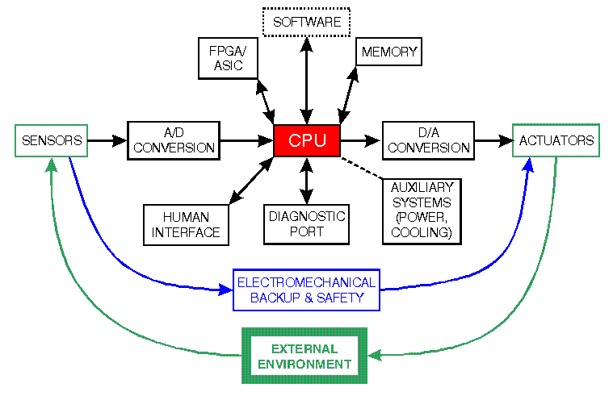
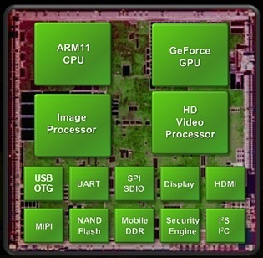
Increasing integration:
Complex embedded systems → SoCs

Slide 7
System-on-Chip (SoC)
SoC refers to integrating all components of an electronic system into a single chip (what motivates such integration?):
Microprocessors, microcontrollers, DSP’s
ASIC’s, FPGA’s
Memories, IO’s, A/D and D/C converters
Analog, mixed-signal, RF blocks, voltage regulators
Communication infrastructure: Bus based, Network-on-Chip (NoC).
System-level design (automation) and simultaneous optimization of numerous design metrics is key challenge.
A SoC is a complex embedded system.

Slide 8
Embedded systems characteristics
Computational
Interact (sense, manipulate, communicate) with the external world: sensors, actuators
Reactive: at the speed of the environment
Heterogeneity: hardware/software blocks, mixed architectures
Networked: shared, adaptive, sensor networks (buildings, environmental monitoring), smart products, wearable computing
Flexibility: can run/implement multiple applications sequentially or concurrently - concurrency
Reprogrammability/reconfigurability: flexibility in upgrading, bug fixing, product differentiation, product customization
Part of a larger system (system within system)
Performance and constraints:
Timing (frequency, latency, throughput)
Cost, power, area, weight, temperature, reliability

Slide 9
Key recent trends
Increasing computation demands, increasing complexity
e.g. multimedia processing in set-top boxes, HDTV
Increasingly networked
Increasing need for flexibility
time-to-market under ever changing standards
HW-SW co-design
Higher integration: more blocks on the same chip
IP reuse, platform based design, NoC vs. Bus
Systems are designed and built as “systems of systems”.
Diversity in design methodologies, platform dependent, lack of standards → quality risks, customer confusion

Slide 10
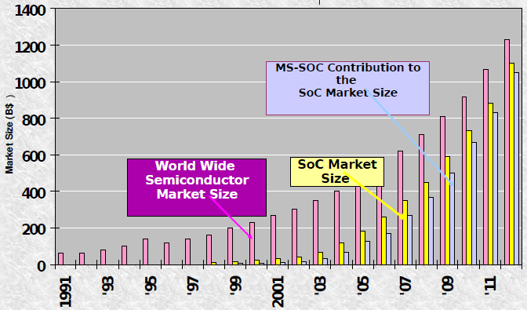
SoC market size

Slide 11
Complexity and heterogeneity
Complexity - handled by working at higher levels of abstraction, hierarchy
Heterogeneity - handled by sophisticated HW-SW co-design methodologies
control panel
controller
processes
ASIC
Real-time
OS
μcontroller
UI
processes
DSP
Assembly
Code
Programmable
DSP
Programmable
DSP
DSP
Assembly
Code
Dual-ported
RAM
CODEC

Slide 12
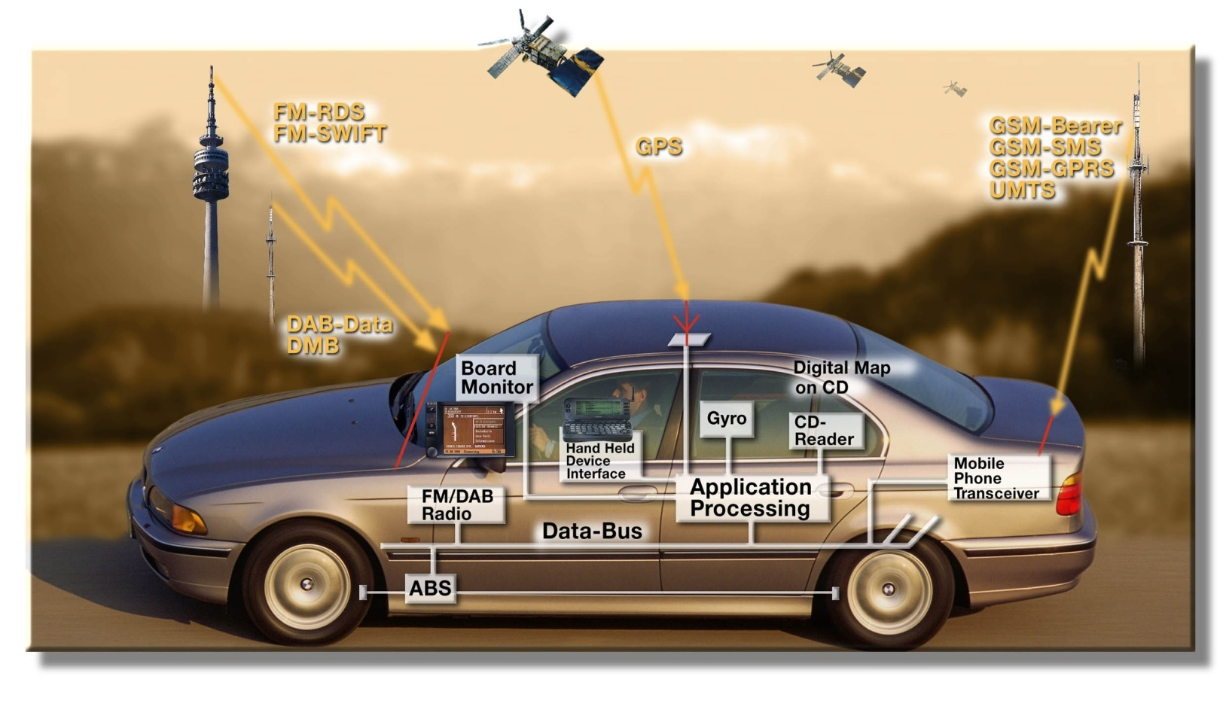
Application domains
Consumer electronics (HDTV, digital cameras, camcorders, game consoles), communications (cell phones), space, automotive (video, audio, control), military (radar, sonar), health.
More than 30% of the cost of a car is now in Electronics. 90% of all innovations will be based on electronic systems. Modern cars: up to ~100 processors running complex software.
Estimated 98% of 8 Billion CPUs produced in 2000 used for embedded apps.

Slide 13
More applications
Read (“IP reuse” – key concept in system level design – applies to course design too):
The Introduction presentation of ECE-249 at Berkeley:
http://chess.eecs.berkeley.edu/design/2010/lectures/IntroductionEE249_10.pdf
The introduction presentation of CSE-237D at UCSD:
http://haduken.ucsd.edu/cse237d/topic01.ppt

Slide 14
Design flows (i.e., methodologies)

Slide 15
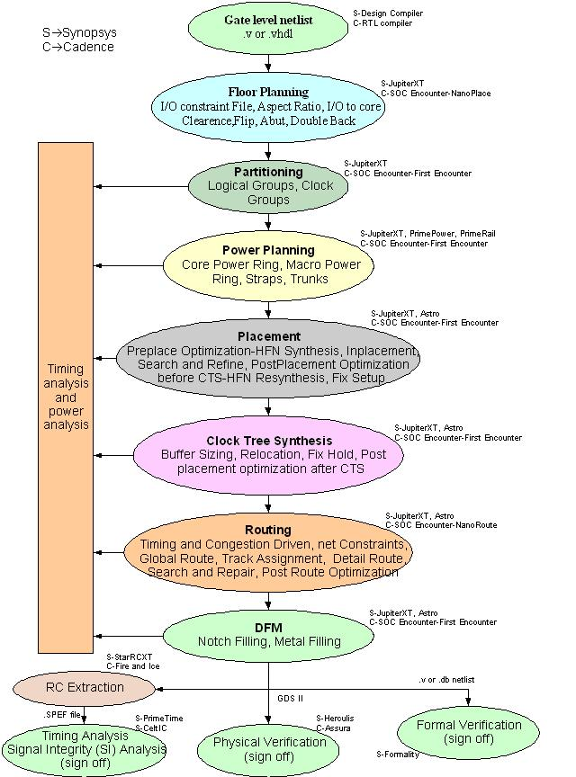
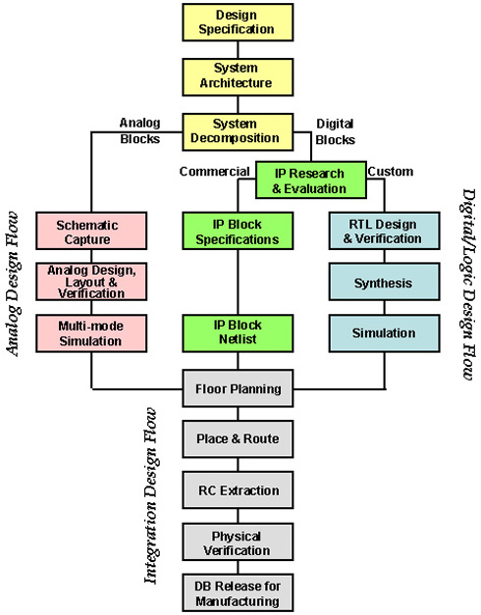
VLSI design flow examples

Slide 16
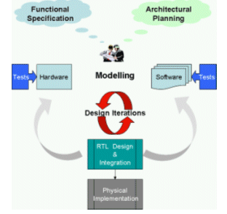
SoC design flow example

Slide 17
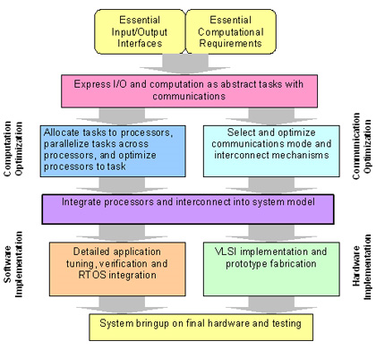
Example: Tensilica

Slide 18
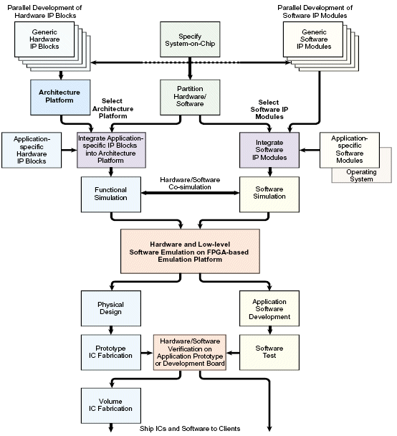
Example: ARM

Slide 19
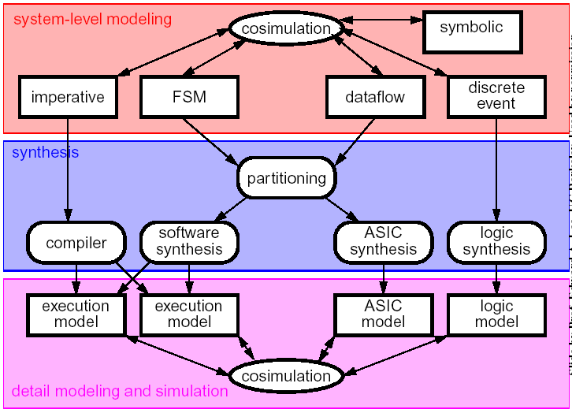
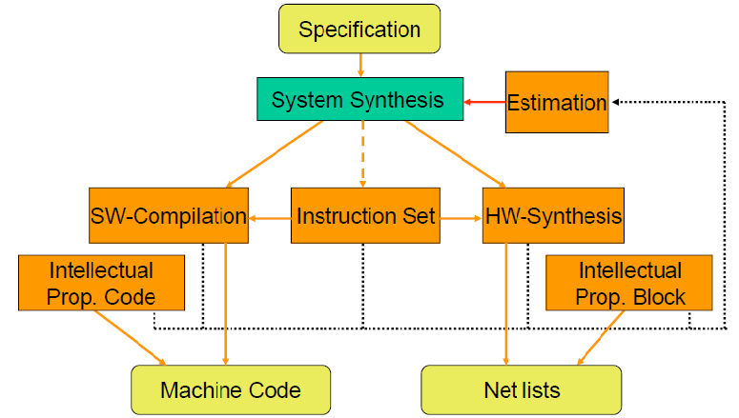
Handling heterogeneity: HW/SW co-design
Fixed Processor Architecture
Application Specific HW Block
Application-Specific Instruction Set Processor

Slide 20
SoC design flow
Various design methodologies
Computation centric: Bus based – past and present
Communication centric: Network-on-Chip based – more recent
Key design steps: Intertwined subtasks
Modeling/specification
Refining (or “functional/structural partitioning”) : the function to be implemented into smaller, interacting pieces → hierarchy
HW/SW partitioning: elements in the refined model to either (1) HW units, or (2) SW running on custom hardware or a suitable programmable processor
Allocation (platform design): select components/blocks/IPs
Binding (mapping = implementation): assign functions to HW/SW components
Scheduling: compute the times at which the functions are executed. This is important when several modules in the partition share a single hardware unit.
Verification & debugging
Crucial is the co-design and joint optimization of hardware and software
For NoC based approach: network synthesis step is crucial

Slide 21
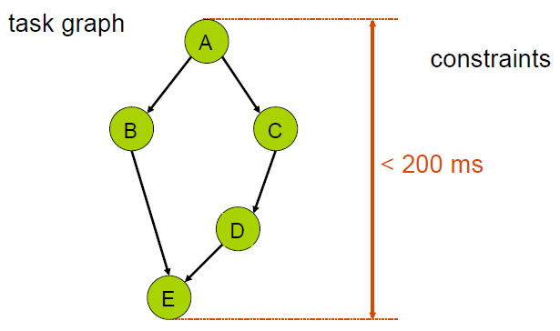
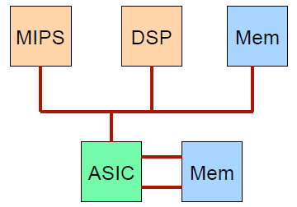
System specification, Allocation (platform design)

Slide 22
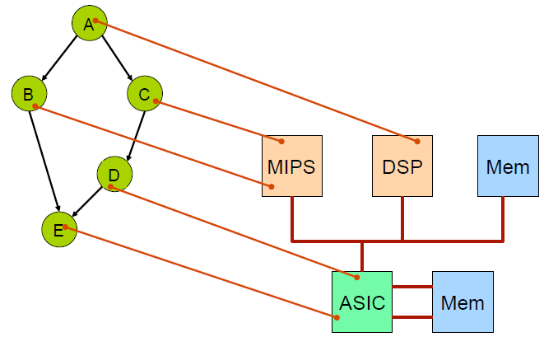
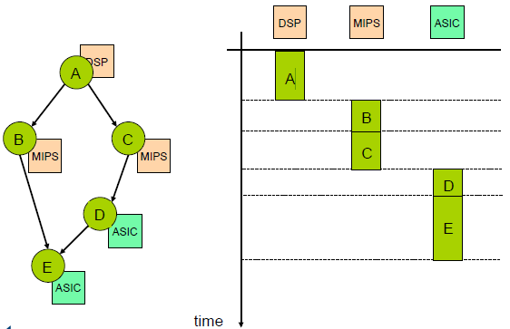
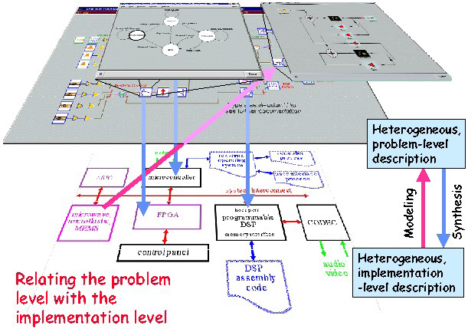
Binding (mapping), Scheduling

Slide 23
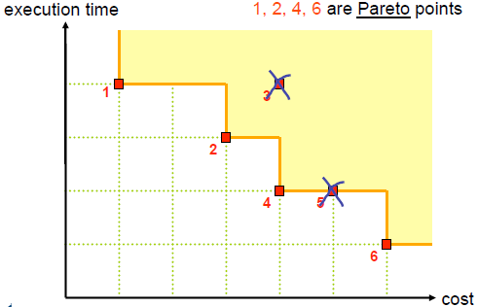
System level design
System-level design is a complex synthesis tasks
software synthesis and code generation
hardware synthesis
interface and communication synthesis
hardware/software partitioning and component selection
hardware/software scheduling
Major Components:
Application specification
Design space exploration and system optimization
Estimation: Synthesis based on abstraction only makes sense if there are powerful estimation methods available:
Estimate properties of the next layer(s) of abstraction.
Design decisions are based on these estimated properties.

Slide 24
Hardware vs. Software Modules
A significant part of the problem is deciding which parts should be in software on programmable processors, and which in specialized hardware.
Hardware = functionality implemented via a custom architecture (datapath + FSM)
Software = functionality implemented in software on a programmable processor
Key differences:
Multiplexing
software modules multiplexed with others on a processor
hardware modules are typically mapped individually on dedicated hardware
Concurrency
processors usually have one “thread of control”
dedicated hardware often has concurrent datapaths

Slide 25
Challenges
Increasing application complexity
large systems with legacy functions
mixture of event driven and data flow tasks
examples: multimedia, automotive, mobile communication
Increasing target system complexity: heterogeneity → HW/SW co-design
mixture of different technologies, processor types, and design styles
large SoCs combining components from different sources, distributed system implementations
Design chain integration:
Design steps role → Methodology → Tools
Parallel architectures
Embedded software and control
Numerous constraints and design objectives
examples: cost, power consumption, timing constraints, dependability/reliability

Slide 26
Design methodologies
Past and present:
Ad hoc approaches based on earlier experience with similar products, and on manual design.
HW-SW partitioning decided at the beginning, and then designs proceed separately.
Present and future:
HW-SW co-design
Design automation (CAD) tools: very challenging

Slide 27
Tools, companies, academia (open-source)
Design tools provided directly by SoC vendors or EDA companies
CAD tools for hardware
Software development environments for software
Implement a variety of design methodologies
SoC companies
http://en.wikipedia.org/wiki/List_of_system-on-a-chip_suppliers
Academia examples
http://ptolemy.eecs.berkeley.edu
http://www.cecs.uci.edu/~gajski/tools.html
http://vlsiarch.ecen.okstate.edu/?page_id=12
Other resources
http://embedded.com
http://www.design-reuse.com
http://www.soccentral.com
http://www.socconference.com
NoC Blog
http://networkonchip.wordpress.com

Slide 28
Observations
“We are in the middle of a revolution in the way electronics products are designed”
System design is the key (also for IC design!)
Start with the highest possible level of abstraction (e.g., control algorithms)
Establish properties at the right level
Use formal models
Leverage multiple “scientific” disciplines

Slide 29
Summary
Course syllabus, topics outline
SoC era has come: characteristics & applications
Design flows
System design is the key
Emphasis in this course will be put on design automation and on NoC design paradigm
Project (with milestones) is 50% of final grade
HW #1: “15-slides” style presentation

