Slide 1
ECE-777 System Level Design and Automation
Network-on-Chip (NoC)
Cristinel Ababei
Electrical and Computer Department, North Dakota State University
Spring 2012

Slide 2
Outline
Introduction
NoC Topology
Routing algorithms
Switching strategies
Flow control schemes
Clocking schemes
QoS
NoC Architecture Examples
NoC prototyping
Bus based vs. NoC based SoC
Design flow/methodology
Status and Open Problems
Trends
Companies, simulators

Slide 3
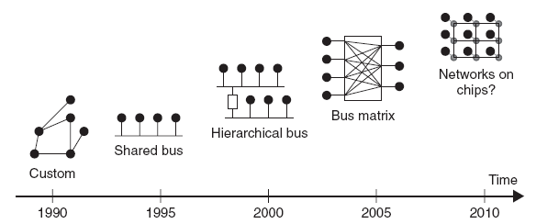
Introduction
Evolution of on-chip communication architectures
Network-on-chip (NoC) is a packet switched on-chip communication network designed using a layered methodology. NoC is a communication centric design paradigm for System-on-Chip (SoC).
Rough classification:
  Homogeneous
  Heterogeneous
uP
NI
DSP
FPGA
NI
NI
ASIC
NI
Mem
NI

Slide 4
NoCs borrow ideas and concepts from computer networks → apply them to the embedded SoC domain.
NoCs use packets to route data from the source PE to the destination PE via a network fabric that consists of
  Network interfaces/adapters (NI)
  Routers (a.k.a. switches)
  interconnection links (channels, wires bundles)
Physical link (channel)
e.g., 64 bits
Tile = processing element (PE) +
network interface (NI) + router/switch (R)
PE
R
N
Routing
N
VC alloc.
S
Arbiter
S
E
E
W
W
PE
PE
Router: 6.6-20% of Tile area
3x3 homogeneous NoC

Slide 5
Homogeneous vs. Heterogeneous
Homogenous:
  Each tile is a simple processor
  Tile replication (scalability, predictability)
  Less performance
  Low network resource utilization
Heterogeneous:
  IPs can be: General purpose/DSP processor, Memory, FPGA, IO core
  Better fit to application domain
  Most modern systems are heterogeneous
  Topology synthesis: more difficult
  Needs specialized routing

Slide 6
NoC properties
Reliable and predictable electrical and physical properties → Predictability
Regular geometry → Scalability
Flexible QoS guarantees
Higher bandwidth
Reusable components
  Buffers, arbiters, routers, protocol stack

Slide 7
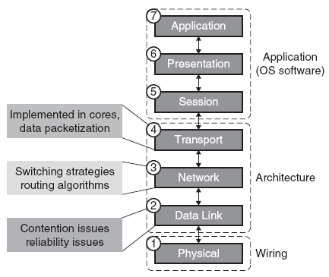
Introduction
ISO/OSI (International Standards Organization/Open Systems Interconnect) network protocol stack model
Read about ISO/OSI
  http://learnat.sait.ab.ca/ict/txt_information/Intro2dcRev2/page103.html#103
  http://www.rigacci.org/docs/biblio/online/intro_to_networking/c4412.htm

Slide 8
Building blocks: NI
Session-layer (P2P) interface with nodes
Back-end manages interface with switches
Decoupling logic & synchronization
Standard P2P Node protocol
Proprietary link protocol
Front end
Backend
PE
Node
Switches
Standardized node interface @ session layer Initiator vs. target distinction is blurred
Supported transactions (e.g. QoS read…)
Degree of parallelism
Session prot. control flow & negotiation
NoC specific backend (layers 1-4)
Physical channel interface
Link-level protocol
Network-layer (packetization)
Transport layer (routing)

Slide 9
Building blocks: Router (Switch)
Router: receives and forwards packets
Buffers:
  Queuing
  Decouple the allocation of adjacent channels in time
  Can be organized as virtual channels.
N
N
Routing
VC alloc.
S
Arbiter
S
E
E
W
W
PE
PE

Slide 10
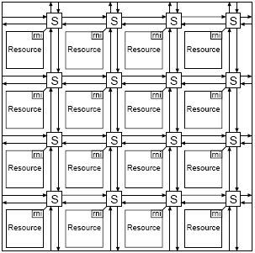
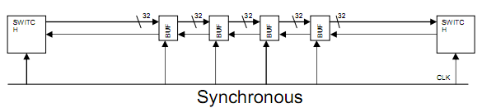
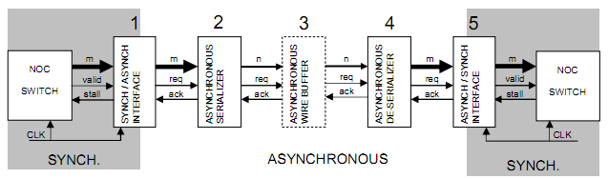
Building blocks: Links
Connects two routers in both directions on a number of wires (e.g., 32 bits)
In addition, wires for control are part of the link too
Can be pipelined (include handshaking for asynchronous)

Slide 11
Outline
Introduction
NoC Topology
Routing algorithms
Switching strategies
Flow control schemes
Clocking schemes
QoS
NoC Architecture Examples
Status and Open Problems

Slide 12
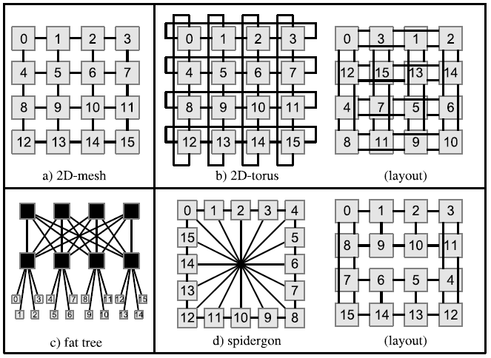
NoC topologies
“The topology is the network of streets, the roadmap”.

Slide 13
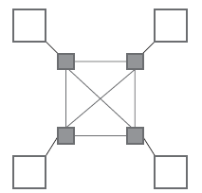
Direct topologies
Direct Topologies
  Each node has direct point-to-point link to a subset of other nodes in the system called neighboring nodes
  As the number of nodes in the system increases, the total available communication bandwidth also increases
  Fundamental trade-off is between connectivity and cost
Most direct network topologies have an orthogonal implementation, where nodes can be arranged in an
n-dimensional orthogonal space
  e.g. n-dimensional mesh, torus, folded torus, hypercube, and octagon

Slide 14
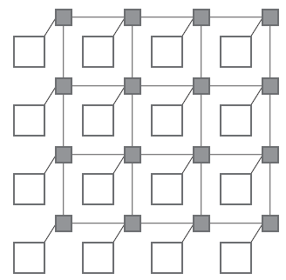
2D-mesh
It is most popular topology
All links have the same length
  eases physical design
Area grows linearly with the number of nodes
Must be designed in such a way as to avoid traffic accumulating in the center of the mesh

Slide 15
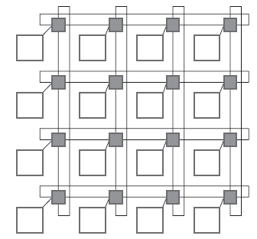

Torus
Torus topology, also called a k-ary n-cube, is an n-dimensional grid with k nodes in each dimension
k-ary 1-cube (1-D torus) is essentially a ring network with k nodes
  limited scalability as performance decreases when more nodes
k-ary 2-cube (i.e., 2-D torus) topology is similar to a regular mesh
  except that nodes at the edges are connected to switches at the opposite edge via wrap-around channels
  long end-around connections can, however, lead to excessive delays

Slide 16
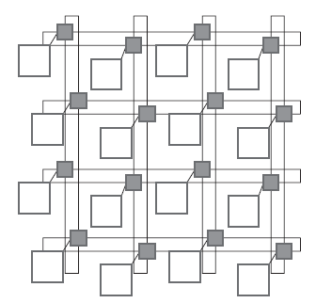
Folding torus
Folding torus topology overcomes the long link limitation of a 2-D torus links have the same size
Meshes and tori can be extended by adding bypass links to increase performance at the cost of higher area

Slide 17
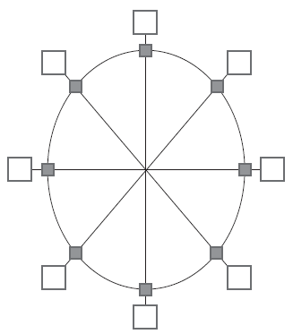
Octagon
Octagon topology is another example of a direct network
  messages being sent between any 2 nodes require at most two hops
  more octagons can be tiled together to accommodate larger designs by using one of the nodes as a bridge node

Slide 18
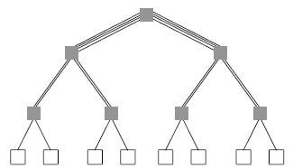
Indirect topologies
Indirect Topologies
  each node is connected to an external switch, and switches have point-to-point links to other switches
  switches do not perform any information processing, and correspondingly nodes do not perform any packet switching
  e.g. SPIN, crossbar topologies
Fat tree topology
  nodes are connected only to the leaves of the tree
  more links near root, where bandwidth requirements are higher

Slide 19
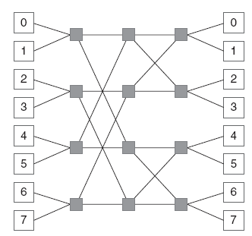
Butterfly
k-ary n-fly butterfly network
  blocking multi-stage network – packets may be temporarily blocked or dropped in the network if contention occurs
  kn nodes, and n stages of kn-1 k x k crossbar
  e.g., 2-ary 3-fly butterfly network

Slide 20
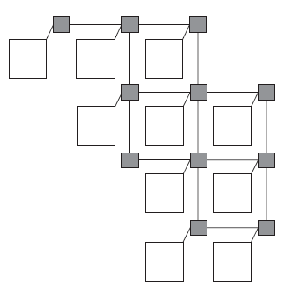
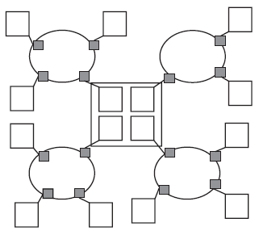
Irregular topologies
Irregular or ad-hoc network topologies
  customized for an application
  usually a mix of shared bus, direct, and indirect network topologies
  e.g., reduced mesh, cluster-based hybrid topology

Slide 21
Outline
Introduction
NoC Topology
Routing algorithms
Switching strategies
Flow control schemes
Clocking schemes
QoS
NoC Architecture Examples
NoC prototyping
Bus based vs. NoC based SoC
Design flow/methodology
Status and Open Problems
Trends
Companies, simulators

Slide 22
Routing algorithms
Routing is the route/path (a sequence of channels) of streets from source to destination. “The routing method steers the car”.
Routing determines the path followed by a message through the network to its final destination.
Responsible for correctly and efficiently routing packets or circuits from the source to the destination
  Path selection between a source and a destination node in a particular topology
Ensure load balancing
Latency minimization
Flexibility w.r.t. faults in the network
Deadlock and livelock free solutions
Routing schemes/techniques/algos can be classified/looked-at as:
  Static or dynamic routing
  Distributed or source routing
  Minimal or non-minimal routing

Slide 23
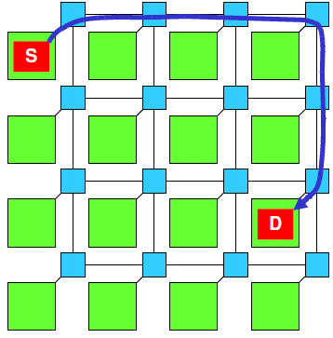
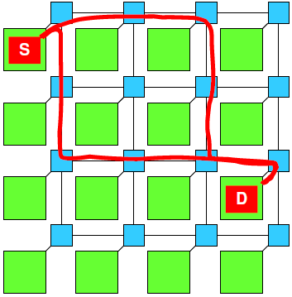
Static/deterministic vs. Dynamic/adaptive Routing
Static routing: fixed paths are used to transfer data between a particular source and destination
  does not take into account current state of the network
advantages of static routing:
  easy to implement, since very little additional router logic is required
  in-order packet delivery if single path is used
Dynamic/adaptive routing: routing decisions are made according to the current state of the network
  considering factors such as availability and load on links
path between source and destination may change over time
  as traffic conditions and requirements of the application change
more resources needed to monitor state of the network and dynamically change routing paths
able to better distribute traffic in a network

Slide 24
Example: Dimension-order Routing
Static XY routing (commonly used):
  a deadlock-free shortest path routing which routes packets in the X-dimension first and then in the Y-dimension
Used for tori and mesh topologies
Destination address expressed as absolute coordinates
It may introduce imbalance → low bandwidth
03
13
23
03
13
23
For torus, a preferred direction
may have to be selected.
For mesh, the preferred direction
is the only valid direction.
02
12
22
02
12
22
01
11
21
01
11
21
+y
00
10
-x
20
00
10
20

Slide 25
Example: Dynamic Routing
A locally optimum decision may lead to a globally sub-optimal route
03
13
23
02
12
22
01
11
21
00
10
20
To avoid slight congestion
in (01-02), packets then incur
more congested links

Slide 26
Routing mechanics: Distributed vs. Source Routing
Routing mechanics refers to the mechanism used to implement any routing algorithm.
Distributed routing: each packet carries the destination address
  e.g. XY co-ordinates or number identifying destination node/router
  routing decisions are made in each router by looking up the destination addresses in a routing table or by executing a hardware function
Source routing: packet carries routing information
  pre-computed routing tables are stored at NI
  routing information is looked up at the source NI and routing information is added to the header of the packet (increasing packet size)
  when a packet arrives at a router, the routing information is extracted from the routing field in the packet header
  does not require a destination address in a packet, any intermediate routing tables, or functions needed to calculate the route

Slide 27
Minimal vs. Non-minimal Routing
Minimal routing: length of the routing path from the source to the destination is the shortest possible length between the two nodes
  source does not start sending a packet if minimal path is not available
Non-minimal routing: can use longer paths if a minimal path not available
  by allowing non-minimal paths, the number of alternative paths is increased, which can be useful for avoiding congestion
  disadvantage: overhead of additional power consumption
03
13
23
02
12
22
Minimal adaptive routing
is unable to avoid congested links
in the absence of minimal path diversity
01
11
21
00
10
20

Slide 28
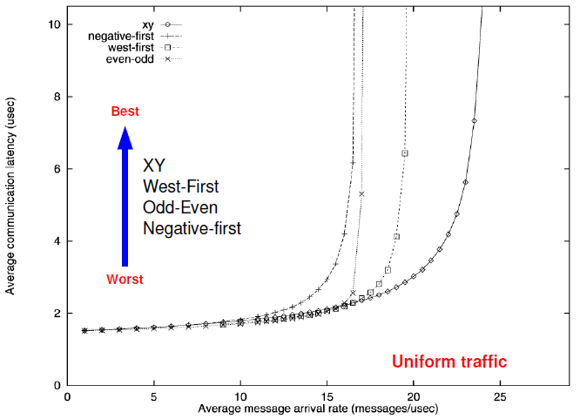
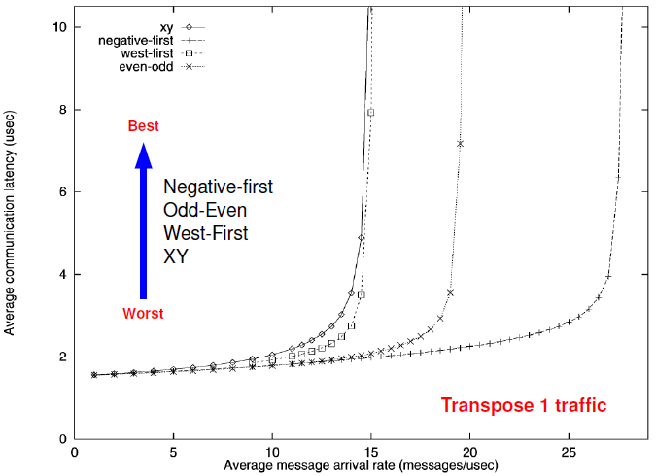
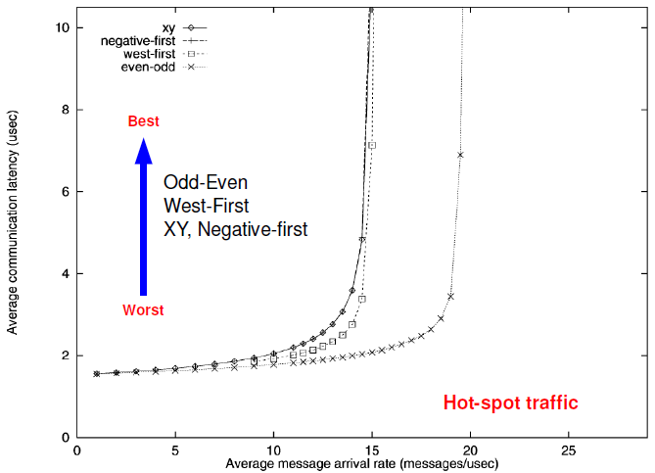
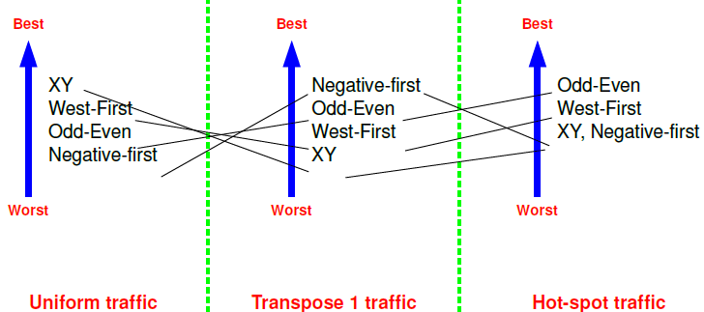
No winner routing algorithm

Slide 29
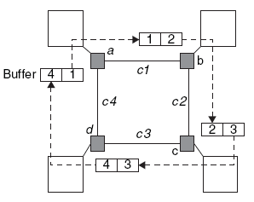
Routing Algorithm Requirements
Routing algorithm must ensure freedom from deadlocks
  Deadlock: occurs when a group of agents, usually packets, are unable to progress because they are waiting on one another to release resources (usually buffers and channels).
  common in WH switching
  e.g. cyclic dependency shown below
  freedom from deadlocks can be ensured by allocating additional hardware resources or imposing restrictions on the routing
  usually dependency graph of the shared network resources is built and analyzed either statically or dynamically

Slide 30
Routing Algorithm Requirements
Routing algorithm must ensure freedom from livelocks
  livelocks are similar to deadlocks, except that states of the resources involved constantly change with regard to one another, without making any progress
  occurs especially when dynamic (adaptive) routing is used
  e.g. can occur in a deflective “hot potato” routing if a packet is bounced around over and over again between routers and never reaches its destination
  livelocks can be avoided with simple priority rules
Routing algorithm must ensure freedom from starvation
  under scenarios where certain packets are prioritized during routing, some of the low priority packets never reach their intended destination
  can be avoided by using a fair routing algorithm, or reserving some bandwidth for low priority data packets

Slide 31
Outline
Introduction
NoC Topology
Routing algorithms
Switching strategies
Flow control schemes
Clocking schemes
QoS
NoC Architecture Examples
NoC prototyping
Bus based vs. NoC based SoC
Design flow/methodology
Status and Open Problems
Trends
Companies, simulators

Slide 32
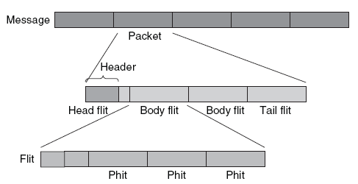
Switching strategies
Switching establishes the type of connection between source and destination. It is tightly coupled to routing. Can be seen as a flow control mechanism as a problem of resource allocation.
Allocation of network resources (bandwidth, buffer capacity, etc.) to information flows
  phit is a unit of data that is transferred on a link in a single cycle
  typically, phit size = flit size
Two main switching schemes:
  circuit (or “path”) switching
  packet switching

Slide 33
1. Pure Circuit Switching
It is a form of bufferless flow control.
Advantage: Easier to make latency guarantees (after circuit reservation)
Disadvantage: does not scale well with NoC size
  several links are occupied for the duration of the transmitted data, even when no data is being transmitted
03
13
23
03
13
23
02
12
22
02
12
22
01
11
21
01
11
21
00
10
20
00
10
20
Circuit set-up
Two traversals – latency overhead
Waste of bandwidth
Request packet can be buffered
Circuit utilization
Third traversal – latency overhead
Contention-free transmission
Poor resource utilization

Slide 34
Virtual Circuit Switching
Multiple virtual circuits (channels) multiplexed on a single physical link.
Virtual-channel flow control decouples the allocation of channel state from channel bandwidth.
Allocate one buffer per virtual link
  can be expensive due to the large number of shared buffers
Allocate one buffer per physical link
  uses time division multiplexing (TDM) to statically schedule usage
  less expensive routers
Node 1
Node 2
Node 3
Node 4
Node 5
Destination of B
Node 1
Node 2
Node 3
Node 4
Node 5
Destination of B
A
B
Block

Slide 35
2. Packet Switching
It is a form of buffered flow control
Packets are transmitted from source and make their way independently to receiver
  possibly along different routes and with different delays
Zero start up time, followed by a variable delay due to contention in routers along packet path
  QoS guarantees are harder to make

Slide 36
Three main packet switching scheme variants
1. Store and Forward (SAF) switching
  packet is sent from one router to the next only if the receiving router has buffer space for entire packet
  buffer size in the router is at least equal to the size of a packet
  Disadvantage: excessive buffer requirements
2. Virtual Cut Through (VCT) switching
  forwards first flit of a packet as soon as space for the entire packet is available in the next router
  reduces router latency over SAF switching
  same buffering requirements as SAF switching
3. Wormhole (WH) switching
  flit is forwarded to receiving router if space exists for that flit
Pipelining on a flit
(flow control unit) basis
A
B
After A receives a flit of the packet,
A asks B if B is ready to receive a flit
(2) B → A, ack
(3) A sends a flit to B.
flit size < packet size
Smaller data space
is needed than
store-and-forward

Slide 37
Wormhole Switching Issues
Wormhole switching suffers from packet blocking problems
An idle channel cannot be used because it is owned by a blocked packet…
  Although another packet could use it!
Using virtual channels helps address this
B
Blocked
Idle
A
X
Wormhole
B
A
2 virtual
channels

Slide 38
Outline
Introduction
NoC Topology
Routing algorithms
Switching strategies
Flow control schemes
Clocking schemes
QoS
NoC Architecture Examples
NoC prototyping
Bus based vs. NoC based SoC
Design flow/methodology
Status and Open Problems
Trends
Companies, simulators

Slide 39
Flow control
Flow control dictates which messages get access to particular network resources over time. It manages the allocation of resources to packets as they progress along their route. “It controls the traffic lights: when a car can advance or when it must pull off into a parking lot to allow other cars to pass”.
Can be viewed as either a problem of resource allocation (switching strategy) or/and one of contention resolution.
Recover from transmission errors
Commonly used schemes:
  STALL-GO flow control
  ACK-NACK flow control
  Credit based flow control
A
B
C
Block
“Backpressure”
Don’t
send
Buffer
full
Don’t
send
Buffer
full

Slide 40
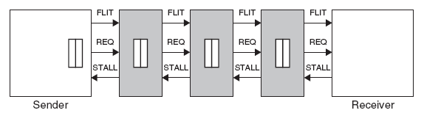
STALL/GO
low overhead scheme
requires only two control wires
  one going forward and signaling data availability
  the other going backward and signaling either a condition of buffers filled (STALL) or of buffers free (GO)
can be implemented with distributed buffering (pipelining) along link
good performance – fast recovery from congestion
does not have any provision for fault handling
  higher level protocols responsible for handling flit interruption

Slide 41
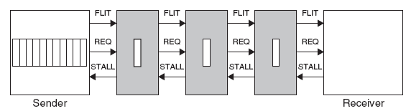
ACK/NACK
when flits are sent on a link, a local copy is kept in a buffer by sender
when ACK received by sender, it deletes copy of flit from its local buffer
when NACK is received, sender rewinds its output queue and starts resending flits, starting from the corrupted one
implemented either end-to-end or switch-to-switch
sender needs to have a buffer of size 2N + k
  N is number of buffers encountered between source and destination
  k depends on latency of logic at the sender and receiver
fault handling support comes at cost of greater power, area overhead

Slide 42
Credit based
Round trip time between buffer empty and flit arrival
More efficient buffer usage; error control pushed at a higher layer
No of credits
2
0
credit
Rx Buffer
B
Receiver gives N credits to sender
  Sender decrements count
  Stops sending if zero
  Receiver sends back
  credit as it drains its buffer
  Bundle credits to
  reduce overhead
1
H
1
credit
0
B
1
T
H
0
1
credit
B
H

Slide 43
Outline
Introduction
NoC Topology
Routing algorithms
Switching strategies
Flow control schemes
Clocking schemes
QoS
NoC Architecture Examples
NoC prototyping
Bus based vs. NoC based SoC
Design flow/methodology
Status and Open Problems
Trends
Companies, simulators

Slide 44
Clocking schemes
Fully synchronous
  single global clock is distributed to synchronize entire chip
  hard to achieve in practice, due to process variations and clock skew
Mesochronous
  local clocks are derived from a global clock
  not sensitive to clock skew
  phase between clock signals in different modules may differ
  deterministic for regular topologies (e.g. mesh)
  non-deterministic for irregular topologies
  synchronizers needed between clock domains
Pleisochronous
  clock signals are produced locally
Asynchronous
  clocks do not have to be present at all

Slide 45
Outline
Introduction
NoC Topology
Routing algorithms
Switching strategies
Flow control schemes
Clocking schemes
QoS
NoC Architecture Examples
NoC prototyping
Bus based vs. NoC based SoC
Design flow/methodology
Status and Open Problems
Trends
Companies, simulators

Slide 46
Quality of Service (QoS)
QoS refers to the level of commitment for packet delivery
  refers to bounds on performance (bandwidth, delay, and jitter=packet delay variation)
Two basic categories
  Best effort (BE)
    only correctness and completion of communication is guaranteed
    usually packet switched
    worst case times cannot be guaranteed
  Guaranteed service (GS)
    makes a tangible guarantee on performance, in addition to basic guarantees of correctness and completion for communication
    usually (virtual) circuit switched

Slide 47
Outline
Introduction
NoC Topology
Routing algorithms
Switching strategies
Flow control schemes
Clocking schemes
QoS
NoC Architecture Examples
NoC prototyping
Bus based vs. NoC based SoC
Design flow/methodology
Status and Open Problems
Trends
Companies, simulators

Slide 48
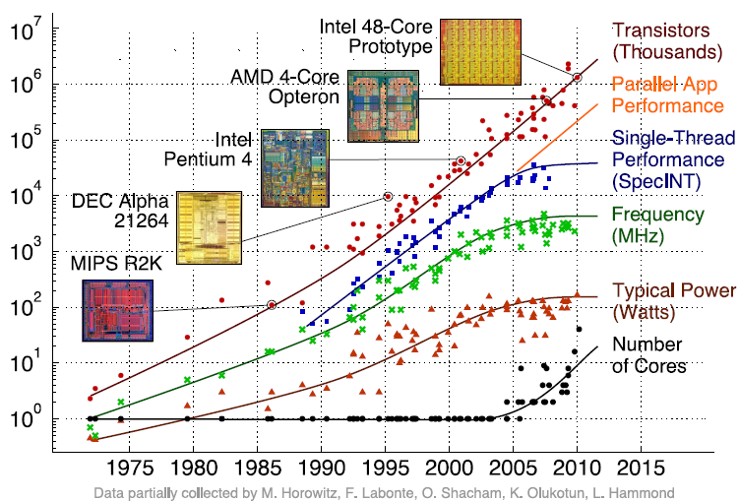
Why study chip-level networks now?

Slide 49
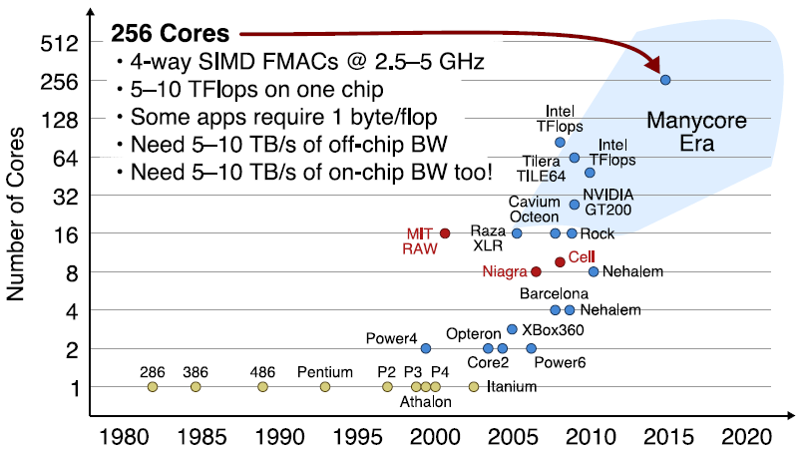
The future of multicore
Parallelism replaces clock frequency scaling and core complexity
Resulting Challenges…
  Scalability, Programming, Power

Slide 50
Examples
Æthereal
  Developed by Philips
  Synchronous indirect network
  WH switching. Contention-free source routing based on TDM
  GT as well as BE QoS. GT slots can be allocated statically at initialization phase, or dynamically at runtime
  BE traffic makes use of non-reserved slots, and any unused reserved slots
    also used to program GT slots of the routers
  Link-to-link credit-based flow control scheme between BE buffers
    to avoid loss of flits due to buffer overflow
HERMES
  Developed at the Faculdade de Informática PUCRS, Brazil
  Direct network. 2-D mesh topology
  WH switching with minimal XY routing algorithm
  8 bit flit size; first 2 flits of packet contain header
  Header has target address and number of flits in the packet
  Parameterizable input queuing
    to reduce the number of switches affected by a blocked packet
  Connectionless: cannot provide any form of bandwidth or latency GS

Slide 51
Examples
MANGO
  Developed at the Technical University of Denmark
  Message-passing Asynchronous Network-on-chip providing GS over open core protocol (OCP) interfaces
  Clockless NoC that provides BE as well as GS services
  NIs (or adapters) convert between the synchronous OCP domain and asynchronous domain
  Routers allocate separate physical buffers for VCs
    for simplicity, when ensuring GS
  BE connections are source routed
    BE router uses credit-based buffers to handle flow control
    length of a BE path is limited to five hops
  Static scheduler gives link access to higher priority channels
    admission controller ensures low priority channels do not starve
Nostrum
  Developed at KTH in Stockholm
  2-D mesh topology. SAF switching with hot potato (or deflective) routing
  Support for
    switch/router load distribution, guaranteed bandwidth (GB), multicasting
  GB is realized using looped containers
    implemented by VCs using a TDM mechanism
    container is a special type of packet which loops around VC
    multicast: simply have container loop around on VC having recipients
  Switch load distribution requires each switch to indicate its current load by sending a stress value to its neighbors

Slide 52
Examples
Octagon
  Developed by STMicroelectronics
  Direct network with an octagonal topology
  8 nodes and 12 bidirectional links. Any node can reach any other node with a max of 2 hops
  Can operate in packet switched or circuit switched mode
  Nodes route a packet in packet switched mode according to its destination field
    node calculates a relative address and then packet is routed either left, right, across, or into the node
  Can be scaled if more than 8 nodes are required: Spidergon
QNoC
  Developed at Technion in Israel
  Direct network with an irregular mesh topology. WH switching with an XY minimal routing scheme
  Link-to-link credit-based flow control
  Traffic is divided into four different service classes
    signaling, real-time, read/write, and block-transfer
    signaling has highest priority and block transfers lowest priority
    every service level has its own small buffer (few flits) at switch input
  Packet forwarding is interleaved according to QoS rules
    high priority packets able to preempt low priority packets
  Hard guarantees not possible due to absence of circuit switching
    Instead statistical guarantees are provided

Slide 53
Examples
SOCBus
  Developed at Linköping University
  Mesochronous clocking with signal retiming is used
  Circuit switched, direct network with 2-D mesh topology
  Minimum path length routing scheme is used
  Circuit switched scheme is
    deadlock free
    requires simple routing hardware
    very little buffering (only for the request phase)
    results in low latency
  Hard guarantees are difficult to give because it takes a long time to set up a connection
SPIN Micronetwork (2000)
  Université Pierre et Marie Curie, Paris, France
  Scalable programmable integrated network (SPIN)
  fat-tree topology, with two one-way 32-bit link data paths
  WH switching, and deflection routing. Link level flow control
  Virtual socket interface alliance (VSIA) virtual component interface (VCI) protocol to interface between PEs
  Flits of size 4 bytes. First flit of packet is header
    first byte has destination address (max. 256 nodes)
    last byte has checksum
  GS is not supported

Slide 54
Examples
Xpipes
  Developed by the Univ. of Bologna and Stanford University
  Source-based routing, WH switching
  Supports OCP standard for interfacing nodes with NoC
  Supports design of heterogeneous, customized (possibly irregular) network topologies
  Go-back-N retransmission strategy for link level error control
    errors detected by a CRC (cycle redundancy check) block running concurrently with the switch operation
  XpipesCompiler and NetChip compilers
    tools to tune parameters such as flit size, address space of cores, max. number of hops between any two network nodes, etc.
    generate various topologies such as mesh, torus, hypercube, Clos, and butterfly
CHAIN (Silistix who did not survive?)
  Developed at the University of Manchester
  Implemented entirely using asynchronous circuit techniques exploit low power capabilities
  Targeted for heterogeneous low power systems, in which the network is system specific
  It makes use of 1-of-4 encoding, and source routes BE packets
  It has been implemented in smart cards
  Recent work from the group involved with CHAIN concerns prioritization in asynchronous networks

Slide 55
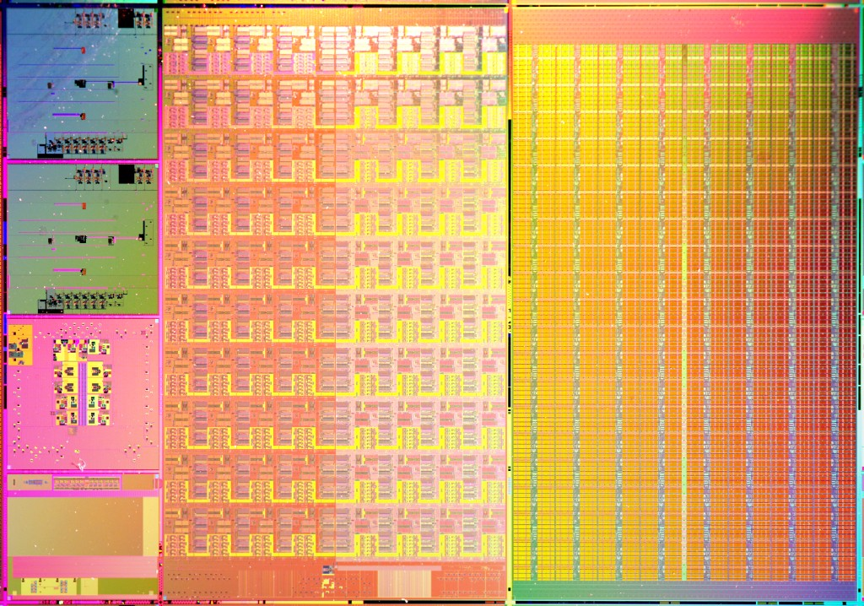
Intel’s Teraflops Research Processor
12.64mm
Goals:
Deliver Tera-scale performance
  Single precision TFLOP at desktop power
  Frequency target 5GHz
  Bi-section B/W order of Terabits/s
  Link bandwidth in hundreds of GB/s
Prototype two key technologies
  On-die interconnect fabric
  3D stacked memory
Develop a scalable design methodology
  Tiled design approach
  Mesochronous clocking
  Power-aware capability
I/O Area
single tile
1.5mm
2.0mm
21.72mm
PLL
PLL
TAP
TAP
I/O Area
I/O Area
[Vangal08]

Slide 56
Main Building Blocks
Special Purpose Cores
  High performance Dual FPMACs
2D Mesh Interconnect
  High bandwidth low latency router
  Phase-tolerant tile to tile communication
Mesochronous Clocking
  Modular & scalable
  Lower power
Workload-aware Power Management
  Sleep instructions
  Chip voltage & freq. control
Mesochronous Interface
MSINT
39
Crossbar Router
MSINT
MSINT
40 GB/s
39
MSINT
2KB Data memory (DMEM)
64
96
RIB
64
64
32
32
6-read, 4-write 32 entry RF
32
32
x
x
96
3KB Inst. memory (IMEM)
+
32
+
32
Normalize
Normalize
FPMAC0
FPMAC1
Tile
Processing Engine (PE)

Slide 57
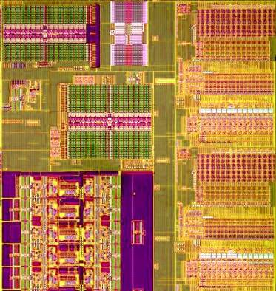
Fine-Grain Power Management
21 sleep regions per tile (not all shown)
FP
Engine 1
Data Memory
FP
Engine 1
Sleeping:
90% less
power
Data Memory
Sleeping:
57% less power
Instruction
Memory
Instruction
Memory
Sleeping:
56% less power
Dynamic sleep
STANDBY:
Memory retains data
50% less power/tile
FULL SLEEP:
Memories fully off
80% less power/tile
FP
Engine 2
FP
Engine 2
Sleeping:
90% less
power
Router
Router
Sleeping:
10% less power
(stays on to
pass traffic)
Scalable power to match workload demands

Slide 58
Router features
5 ports, wormhole, 5cycle pipeline
39-bit (32data , 6ctrl, 1str) bidirectional mesochronous P2P links per port
2 logical lanes each with 16 flit-buffers
Performance, area, power
  Freq 5.1GHz @ 1.2V
  102GB/s raw bandwidth
  Area 0.34mm2 (65nm)
  Power 945mW (1.2V), 470mW (1V), 98mW (0.75V)
Fine-grained clock-gating + sleep (10 regions)

Slide 59
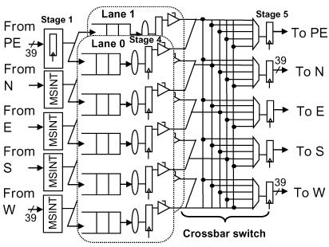
Router microarchitecture
16R Regfile operated as a FIFO
2-stage, per-port, RR arbitration, stablished once for entire packet
Xbar is fully nonblocking
Pipeline
Buffer
Write
Buffer
Read
Route
Compute
Port/lane
Arbitr.
Switch
Traversal
Link
Traversal

Slide 60
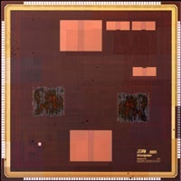
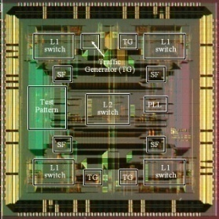
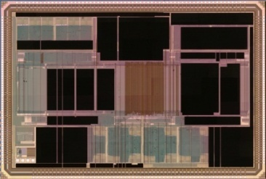
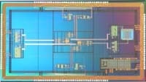
KAIST BONE Project
Slim Spider
- Hierarchical star
IIS
- Configurable
Memory Centric NoC
(Hierarchical star
+ Shared memory)
PROTONE
- Star topology
Star
2003
2004
2005
2006
2007
Mesh
80-Tile
NoC, Intel
RAW,
MIT
Baseband processor
NoC, STMicro, et. al.
[KimNOC07]

Slide 61
On-Chip Serialization
Reduced Link
Width
Reduced
X-bar Switch
Operation frequency
Driver size
Wire space
Capacitance load
Energy consumption
Coupling capacitance
Buffer resource
Switching energy
→ Proper level of On-chip Serialization improves NoC performance

Slide 62
Memory-Centric NoC Architecture
A
B
RISC
t
Dual Port
N
RISC
Mem
t
I
.
N
r
0
r
N
2
N
I
o
o
I
0
I
P
(
P
1
.
5
KB
)
N
RISC
Overall architecture
  10 RISC processors
  8 dual port memories
  4 Channel controllers
  Hierarchical-star topology packet switching network
  Mesochronous comm.
RISC
N
Dual Port
I
3
I
X
N
N
-
1
bar
I
I
X
-
Mem
bar
.
S
1
/
W
S
/
W
RISC
Dual Port
N
N
N
I
4
I
Mem
I
.
Channel
2
Contoller
0
Dual Port
N
N
Channel
I
Mem
I
.
3
Contoller
1
Control
36
36
Processor
Hierarchical
(
RISC
)
Star Topology
X
-
bar Switch
Network
-
on
-
Ext
Chip
.
(
Mem
400
MHz
)
I
.
36
36
/
F
N
Dual Port
N
Channel
Contoller
I
Mem
I
3
.
Channel
4
Contoller
2
N
Dual Port
N
N
RISC
I
Mem
I
I
7
.
5
X
-
X
bar
-
RISC
bar
S
/
S
W
/
N
W
RISC
5
I
N
Dual Port
N
N
I
Mem
I
I
.
6
8
RISC
N
6
I
N
Dual Port
N
N
RISC
I
Mem
I
I
.
7
9

Slide 63
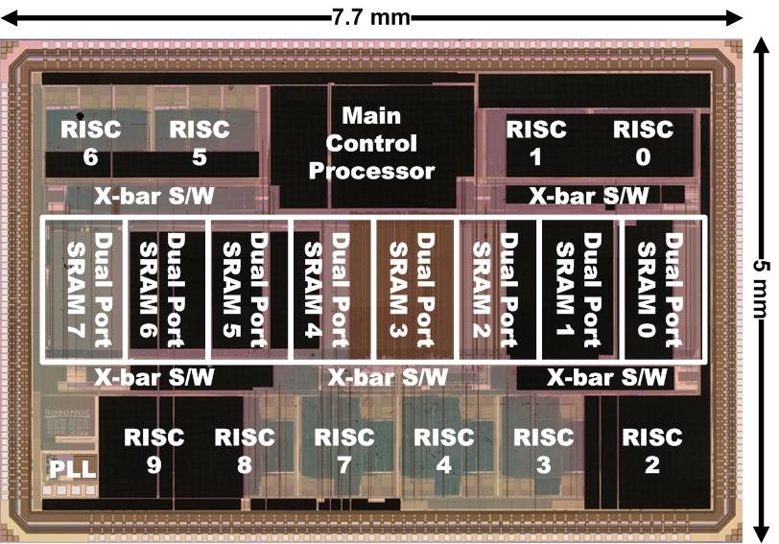
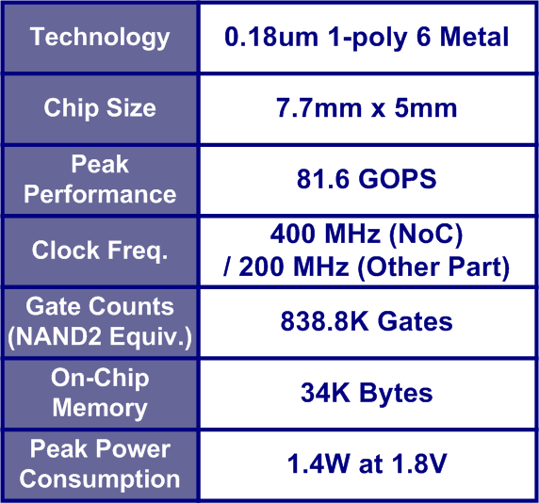
Implementation Results
Chip photograph & results
[Kim07]
Power Breakdown

Slide 64
MIT RAW architecture
Raw compute processor tile Array
8 stage pipelined MIPS-like 32-bit processor
Static and dynamic routers
Any tile output can be routed off the edge of the chip to the I/O pins.
Chip bandwidth (16-tile version).
  Single channel (32-bit) bandwidth of 7.2 Gb/s @ 225 MHz.
  14 channels for a total chip bandwidth of 201 Gb/s @ 225 MHz.

Slide 65
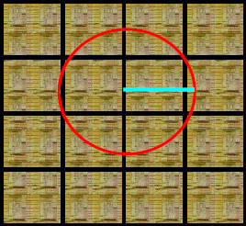
RAW architecture

Slide 66
RAW architecture
Compute
Processor
Routers
On-chip networks

Slide 67
Inside the compute processor
r24
r24
r25
r25
r26
r26
r27
r27
Local Bypass
Network
Input
FIFOs
from
Static
Router
Output
FIFOs
to
Static
Router
E
M1
M2
A
TL
TV
IF
D
RF
F
P
U
F4
WB

Slide 68
Static and dynamic networks
RAW’s static network
Consists of two tightly-coupled sub-networks:
Tile interconnection network
  For operands & streams between tiles
  Controlled by the 16 tiles’ static router processors
  Used to:
    route operands among local and remote ALUs
    route data streams among tiles, DRAM, I/O ports
Local bypass network
  For operands & streams within a tile
RAW’s dynamic network
Insert header, and < 32 data words.
Worms through network.
Enable MPI programming
Inter-message ordering not guaranteed.
RAW’s memory network
RAW’s general network
  User-level messaging
  Can interrupt tile when message arrives
  Lower performance; for coarse-grained apps
  For non-compile time predictable communication
    among tiles
    possibly with I/O devices

Slide 69
RAW → TILERA
http://www.tilera.com/products/processors

Slide 70
Outline
Introduction
NoC Topology
Routing algorithms
Switching strategies
Flow control schemes
Clocking schemes
QoS
NoC Architecture Examples
NoC prototyping
Bus based vs. NoC based SoC
Design flow/methodology
Status and Open Problems
Trends
Companies, simulators

Slide 71
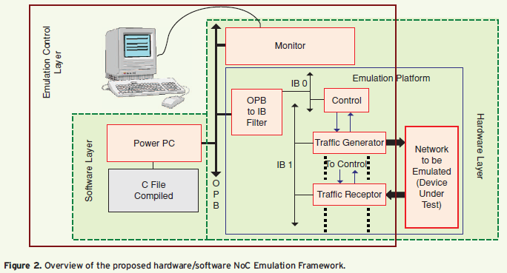
NoC prototyping: EPFL Emulation Framework
[] N, Genko, D. Atienza, G. De Micheli, L. Benini, "Feature-NoC emulation: a tool and design flow for MPSoC," IEEE Circuits and Systems Magazine, vol. 7, pp. 42-51, 2007.

Slide 72
NoC prototyping: CMU
Xilinx core generator
[] Umit Y. Ogras, Radu Marculescu, Hyung Gyu Lee, Puru Choudhary, Diana Marculescu, Michael Kaufman, Peter Nelson, "Challenges and Promising Results in NoC Prototyping Using FPGAs," IEEE Micro, vol. 27, no. 5, pp. 86-95, 2007.
Inv Quant.
& IDCT
Motion
Est. 2
in-house
DCT &
Quant.
Input
Buffer
R₁
R₂
VLE &
Out. Buffer
free
Motion
Est.
Frame
Buffer
Motion
Comp.
To build prototypes, we will likely use a mix
of free, commercial, and in-house IPs.
Synthesis for Xilinx Virtex II FPGA with CIF (352x288) frames
Point-to-point Implementation
Bus Implementation
Input
Buffer
DCT &
Quant.
VLE &
Out. Buffer
Input
Buffer
DCT &
Quant.
Inv Quant.
& IDCT
Bus Cont.
Unit
Inv Quant.
& IDCT
Motion
Comp.
Motion
Est.
Frame
Buffer
Motion
Est.
Motion
Est. 2
Frame
Buffer
Motion
Comp.
VLE &
Out. Buffer
Motion
Est. 2

Slide 73
Outline
Introduction
NoC Topology
Routing algorithms
Switching strategies
Flow control schemes
Clocking schemes
QoS
NoC Architecture Examples
NoC prototyping
Bus based vs. NoC based SoC
Design flow/methodology
Status and Open Problems
Trends
Companies, simulators

Slide 74
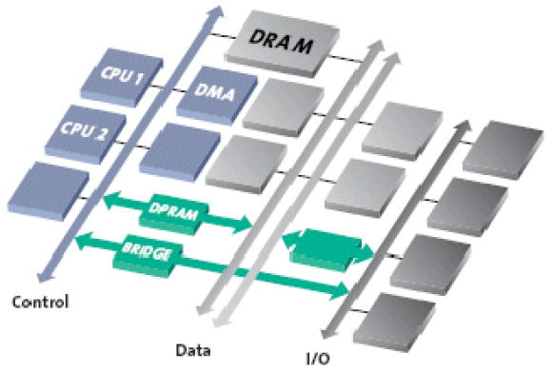
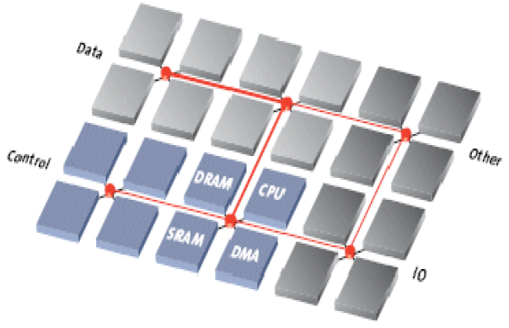
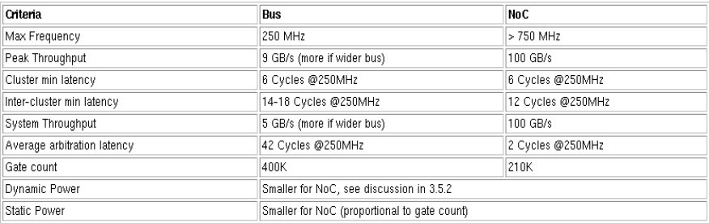
Bus based vs. NoC based SoC
[Arteris]

Slide 75
Bus based vs. NoC based SoC
Detailed comparison results depend on the SoC application, but with increasing SoC complexity and performance, the NoC is clearly the best IP block integration solution for high-end SoC designs today and into the foreseeable future.
Read Bus-based presentation:
  http://www.engr.colostate.edu/~sudeep/teaching/ppt/lec06_communication1.ppt

Slide 76
Outline
Introduction
NoC Topology
Routing algorithms
Switching strategies
Flow control schemes
Clocking schemes
QoS
NoC Architecture Examples
NoC prototyping
Bus based vs. NoC based SoC
Design flow/methodology
Status and Open Problems
Trends
Companies, simulators

Slide 77
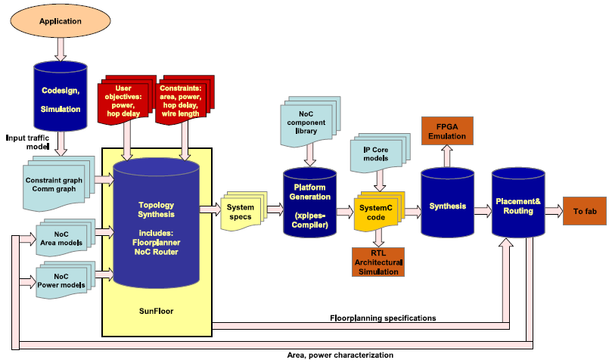
Example: Sunflower Design flow
David Atienza, Federico Angiolini, Srinivasan Murali, Antonio Pullini, Luca Benini, Giovanni De Micheli, "Network-on-Chip design and synthesis outlook,” Integration, the VLSI Journal, vol. 41 no. 3, pp. 340-359, May 2008.

Slide 78
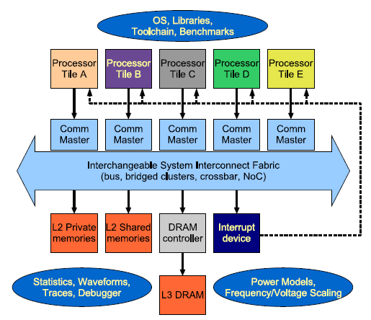
Front-end

Slide 79
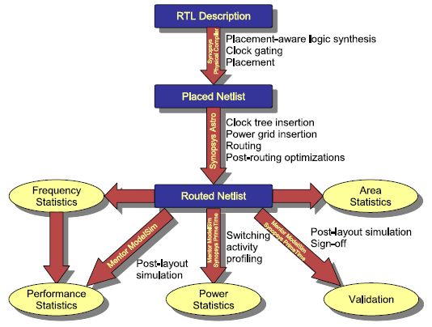
Back-end

Slide 80
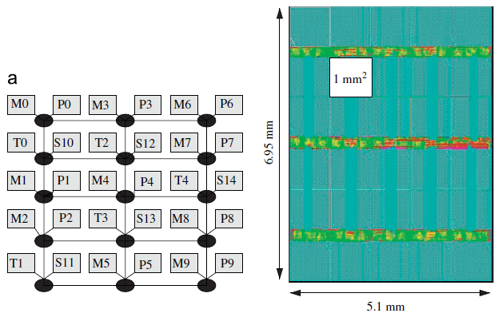
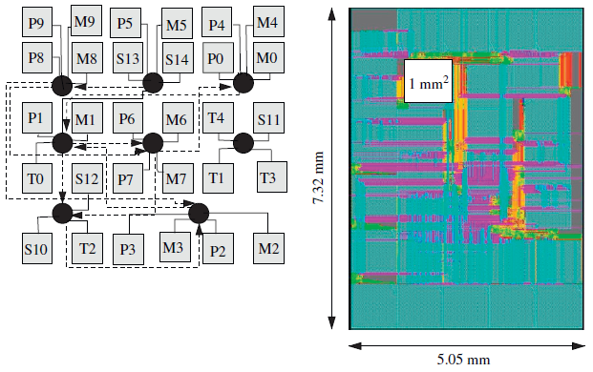
Manual vs. Design tool
Manual
Sunflower
1.33x less power
4.3% area increase

Slide 81
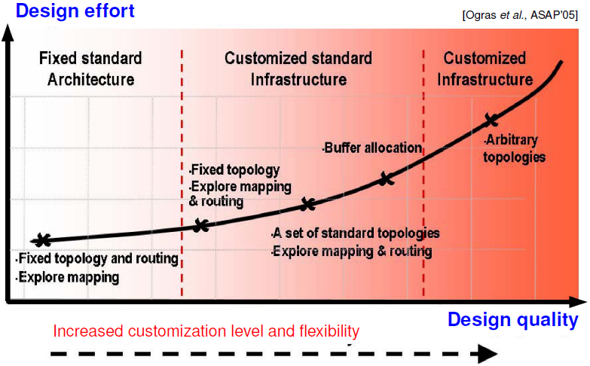
Design Space Exploration for NoC architectures

Slide 82
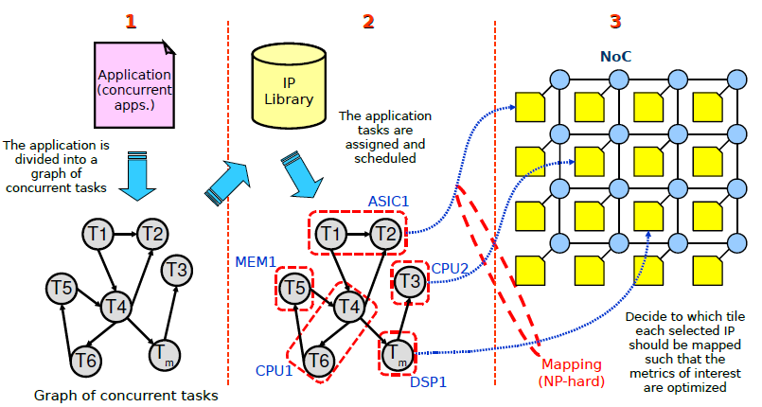
Mapping

Slide 83
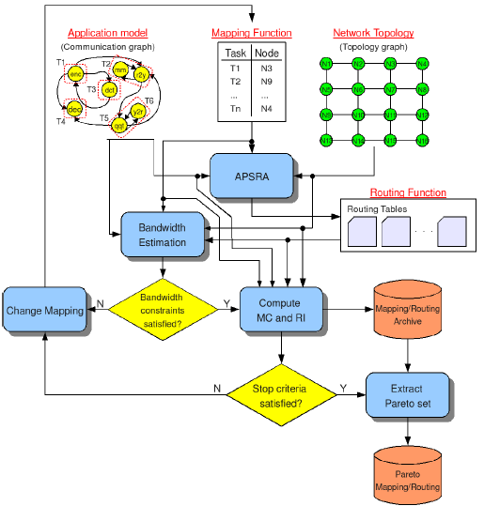
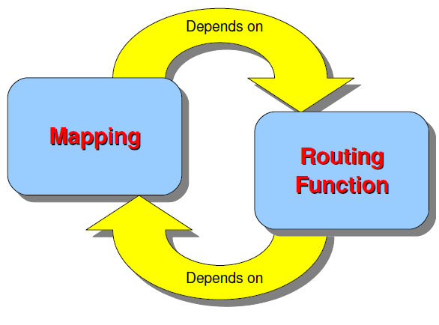
NOXIM DSE: concurrent mapping and routing

Slide 84
Problem formulation
Given
  An application (or a set of concurrent applications) already mapped and scheduled into a set of IPs
  A network topology
Find the best mapping and the best routing function which
  Maximize Performance (Minimize the mapping coefficient)
  Maximize fault tolerant characteristics (Maximize the robustness index)
Such that
  The aggregated communications assigned to any channel do not exceed its capacity

Slide 85
Outline
Introduction
NoC Topology
Routing algorithms
Switching strategies
Flow control schemes
Clocking schemes
QoS
NoC Architecture Examples
NoC prototyping
Bus based vs. NoC based SoC
Design flow/methodology
Status and Open Problems
Trends
Companies, simulators

Slide 86
Status and Open Problems
Design tools (GALS, DVFS, VFI) and benchmarks. HW/SW co-design
Power
  complex NI and switching/routing logic blocks are power hungry
  several times greater than for current bus-based approaches
Latency
  additional delay to packetize/de-packetize data at NIs
  flow/congestion control and fault tolerance protocol overheads
  delays at the numerous switching stages encountered by packets
  even circuit switching has overhead (e.g. SOCBUS)
  lags behind what can be achieved with bus-based/dedicated wiring
Simulation speed
  GHz clock frequencies, large network complexity, greater number of PEs slow down simulation
  FPGA accellerators: 2007.nocsymposium.org/session7/wolkotte_nocs07.ppt
Standardization → we gain:
  Reuse of IPs
  Reuse of verification
  Separation of Physical design issues, Communication design, Component design, Verification, System design
Prototyping

Slide 87
Outline
Introduction
NoC Topology
Routing algorithms
Switching strategies
Flow control schemes
Clocking schemes
QoS
NoC Architecture Examples
NoC prototyping
Bus based vs. NoC based SoC
Design flow/methodology
Status and Open Problems
Trends
Companies, simulators

Slide 88
Trends
Hybrid interconnection structures
  NoC and Bus based
  Custom (application specific), heterogeneous topologies
New interconnect paradigms
  Optical, Wireless, Carbon nanotubes?
3D NoC
Reconfigurability features
GALS, DVFS, VFI

Slide 89


3D NoC
Shorter channel length
Reduced average number of hops
Planar link
PE
PE
Router
PE
PE
TSV

Slide 90
Reconfigurability
HW #2 - 15-slides presentations on:
  Reconfigurability within NoC context
  NoC prototyping

Slide 91
Outline
Introduction
NoC Topology
Routing algorithms
Switching strategies
Flow control schemes
Clocking schemes
QoS
NoC Architecture Examples
NoC prototyping
Bus based vs. NoC based SoC
Design flow/methodology
Status and Open Problems
Trends
Companies, simulators

Slide 92
Companies, Simulators
For info on NoC related companies, simulators, other tools, conference pointers, etc. please see:
  http://networkonchip.wordpress.com/

Slide 93
Summary
NoC - a new design paradigm for SoC
Automated design flow/methodology – main challenge

Slide 94
References/Credits
http://www.engr.colostate.edu/~sudeep/teaching/schedule.htm
http://www.diit.unict.it/users/mpalesi/DOWNLOAD/noc_research_summary-unlv.pdf
http://eecourses.technion.ac.il/048878/HarelFriedmanNOCqos3d.ppt
Others:
  http://dejazzer.com/ece777/links.html

