Slide 1
ECE-777 System Level Design and Automation
System modeling, models of computation
Cristinel Ababei
Electrical and Computer Department, North Dakota State University
Spring 2012

Slide 2
Introduction
Describing embedded system behavior
  Can be extremely difficult
    Complexity increasing with increasing IC capacity
      Past: washing machines, small games, etc.
        Hundreds of lines of code
      Today: TV set-top boxes, Cell phone, etc.
        Millions of lines of code
    Desired behavior often not fully understood in beginning
      Many implementation bugs due to description mistakes/omissions
  English (or other natural language) common starting point
    Precise description difficult to impossible

Slide 3
Models, Levels of abstraction
Foundations of science and engineering
Key aspect: models
  Concrete representation of knowledge and ideas about a system being developed - specification
  Model deliberately modifies or omits details (abstraction) but concretely represents certain properties to be analyzed, understood and verified
  One of the few tools for dealing with complexity
  Formal description of selected properties of a system or subsystem
  A model consists of data and associated methods
Synthesis
  Linking adjacent levels of abstraction (refinement)
  Stepwise adding of structural information

Slide 4
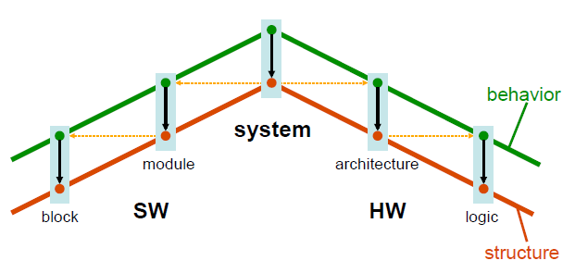
Abstraction layers
System
Task
Component
Instruction
Architecture
Logic
ISA
RTL
uArch
Gate
Gate-level models
Switch-level models
Circuit-level models
Device-level models
Layout models
Object code

Slide 5
Models and languages
How can we (precisely) capture behavior?
  We may think of languages (C, C++), but model of computation (MoC) is key
Models of computation can be described as:
  They define components (e.g. procedures, processes, functions, FSMs)
  They define communication protocols (e.g. asynchronous message passing, rendez-vous based communication)
  They possibly also define what components know about each other (e.g. sharing info via global variables)
Common models of computation:
  Communicating finite state machines – Collections of FSMs
    Used by StateCharts, StateFlow and SDL
  Discrete event model – Events carrying a totally ordered time-stamp
    Used by VHDL, Verilog, Simulink
  Differential equations
  Asynchronous message passing – Processes communicate through channels that can buffer messages
    Variants: Dataflow program, Synchronous dataflow (SDF)
  Synchronous message passing – Processes communicate in atomic, instantaneous actions called rendez-vous

Slide 6
Models vs. Specification Languages
Models
Poetry
Recipe
Story
State
machine
Sequent.
program
Data-
flow
Languages
English
Spanish
Japanese
C
C++
Java
Recipes vs. English
Sequential programs vs. C
Languages capture models. One can see languages as “incarnation” of models.
Variety of languages can capture one model. One language can capture variety of models.
  E.g., sequential program model → C,C++, Java
  E.g., C++ → sequential program model, object-oriented model, state machine model
Certain languages better at capturing certain computation models.
Different applications may require the use of different models.
Some languages allow a mix of models.
Distinction between model and language is sometimes blurry (e.g. StateCharts are viewed as model and graphical language; Petri Nets).
Specification languages facilitate – in a textual or visual/graphical way – description/capture of system behavior via models of computation.

Slide 7
Communication
Communication/ local computations | Shared memory | Message passing Synchronous | Asynchronous
Undefined components | Plain text, use cases | (Message) sequence charts
Communicating finite state machines | StateCharts |  | Specification and Description Lang. (SDL)
Data flow | (Not useful) |  | Kahn networks, SDF
Petri nets |  | C/E nets, P/T nets, …
Discrete event (DE) model | VHDL*, Verilog*, SystemC*, … | Only experimental systems, e.g. distributed DE in Ptolemy
Imperative (Von-Neumann) model | C, C++, Java | C, C++, Java with libraries CSP, ADA |
Computation

Slide 8
Outline
State-oriented models
  State Transition Diagrams (STD)/ Finite State Machines (FSM)
  Petri Nets (PN)
Activity oriented models
  Data flow graphs (DFG)
Process-based models
  Kahn Process Networks (KPN)
Heterogeneous models
  Synchronous dataflows (SDF)

Slide 9
State Transition Diagrams (STD)/
Finite State Machine (FSM)
Help understand the behavioral aspect of the system.
Simple directed graphs with nodes denoting states & arrows (labeled with triggers & conditions) denoting transitions.
State: Represents a combination of different input values for a particular moment of time.
Transitions: Change of state depending on the input received.

Slide 10
Finite State Machine
FSM = (Inputs, Outputs, States, InitialState, NextState)
Often suitable for controllers, protocols etc.
Rarely suitable for Memory and Datapaths
Easy to use with powerful algorithms for synthesis and verification

Slide 11
Example: Vending machine
Not enough
Money
Money not
enough
Idle/Start
State
Money
Input
Display
Amount
Display
Amount
Needed
Power On
Cancel
Power Off
Back to Idle
Cancel
Fake
Money
Return
Money
Deliver
Soda,
Return
Change
Enough
Money

Slide 12
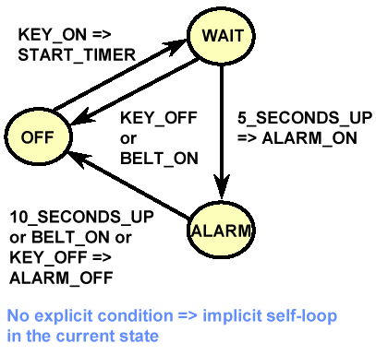
Example FSM
Informal specification:
If driver turns on the key and does not fasten seat belt within 5 seconds then sound the alarm for 5 seconds or until driver fastens the seat belt or turns off the key
Formal representation:
Inputs = {KEY_ON, KEY_OFF, BELT_ON, BELT_OFF, 5_SECONDS_UP, 10_SECONDS_UP}
Outputs = {START_TIMER, ALARM_ON, ALARM_OFF}
States = {Off, Wait, Alarm}
Initial State = off
NextState: CurrentState, Inputs -> NextState
e.g. NextState(WAIT, {KEY_OFF}) = OFF
Outs: CurrentState, Inputs -> Outputs
e.g. Outs(OFF, {KEY_ON}) = START_TIMER

Slide 13
Limitations
Scalability - Number of states & transitions increase exponentially as the system complexity increases
No concurrency support
Have an unstructured, unrealistic, and chaotic state diagram
To address these problems Harel proposed StateCharts (see next lecture)
  Extension of State Transition Diagram/Finite State Machines

Slide 14
Further info
http://chess.eecs.berkeley.edu/design/2010/lectures/mocFSM-CFSM.pdf
http://esd.cs.ucr.edu/slides/ch8_011702.ppt

Slide 15
Outline
State-oriented models
  State Transition Diagrams (STD)/Finite State Machines (FSM)
  Petri Nets (PN)
Activity oriented models
  Data flow graphs (DFG)
Process-based models
  Kahn Process Networks (KPN)
Heterogeneous models
  Synchronous dataflows (SDF)

Slide 16
Petri Nets (PN)
Model introduced by C.A. Petri in 1962
  Ph.D. Thesis: “Communication with Automata”
Applications: distributed computing, manufacturing, control, communication networks, transportation, …
Specifically designed to model systems that comprise interacting concurrent systems
PNs describe explicitly and graphically:
  sequencing/causality
  conflict/non-deterministic choice
  concurrency
Basic PN model
  Asynchronous model (partial ordering)
  Main drawback: no hierarchy

Slide 17
Petri Nets
An extension of state diagrams to allow arcs to flow from any number of states to any number of states. Makes sense if the system is allowed to be in multiple states at once, which implies that an individual state only describes a condition or other partial aspect of the overall, global state. The resulting formalism is known as a Petri Net.
Software synthesis from a concurrent functional specification is a problem in the design of embedded systems.
You don’t have pure data flow. If pure data flow you can apply a fully static scheduling technique (complete behavior is predicted at compile time).
If some data dependent structures (if-then-else, while-do) are present apply quasi static scheduling. The system can’t be predicted at compile time because some decisions are made at run-time.

Slide 18
Conclusion
PN Graph: places (buffers), transitions (actions), tokens (data)
Firing rule: transition enabled if there are enough tokens in each input place
Properties
  Structural (consistency, structural boundedness …)
  Behavioral (reachability, boundedness, liveness …)
Analysis techniques
  Structural (only CN or CS): State equations, Invariants
  Behavioral: coverability tree
Reachability
Subclasses: Marked Graphs, State Machines, Free-Choice PNs

Slide 19
Further info
http://chess.eecs.berkeley.edu/design/2010/lectures/mocPetri.pdf
http://www.informatik.uni-hamburg.de/TGI/PetriNets
http://ls12-www.cs.tu-dortmund.de/daes/media/documents/staff/marwedel/es-book/slides10/es-marw-2.04-petri.ppt

Slide 20
Outline
State-oriented models
  State Transition Diagrams (STD)/ Finite State Machines (FSM)
  Petri Nets (PN)
Activity oriented models
  Data flow graphs (DFG)
Process-based models
  Kahn Process Networks (KPN)
Heterogeneous models
  Synchronous dataflows (SDF)

Slide 21
Data flow network
Powerful formalism for data-dominated (transformational) system specification
Partially-ordered model (no over-specification)
Deterministic execution independent of scheduling
Used for: simulation, scheduling, memory allocation, code generation for Digital Signal Processors (HW and SW)
A DFN is a collection of functional nodes which are connected and communicate over unbounded FIFO queues
  Nodes are commonly called actors
  The bits of information that are communicated over the queues are commonly called tokens

Slide 22
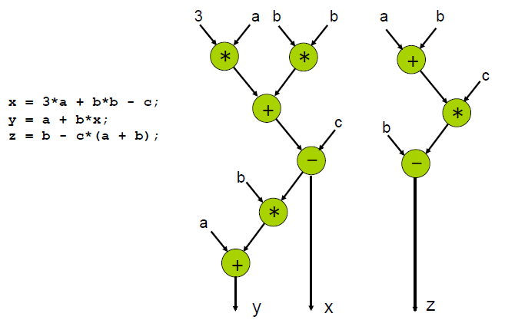
Data flow graph (DFG)

Slide 23
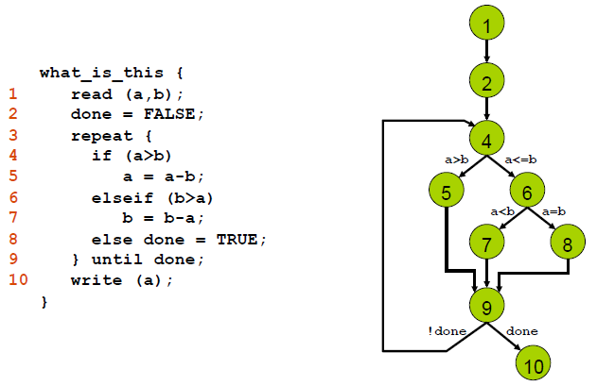
Control-flow graph (CFG)
Also known as Flowcharts

Slide 24
Sequence graph
Hierarchy of chained units
  units model data flow
  hierarchy models control flow
Special nodes
  start/end nodes: NOP (no operation)
  branch nodes (BR)
  iteration nodes (LOOP)
  module call nodes (CALL)
Attributes
  nodes: computation times, cost, ...
  edges: conditions for branches and iterations

Slide 25
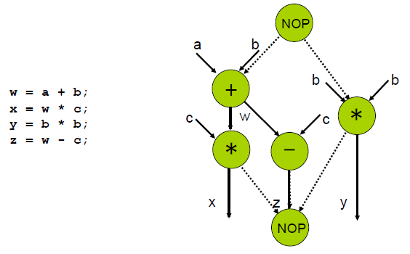
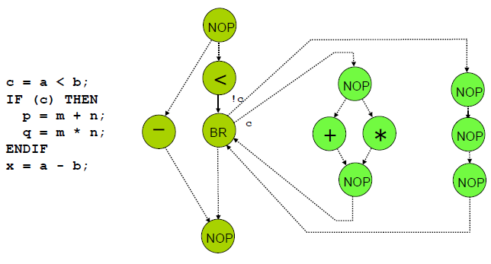
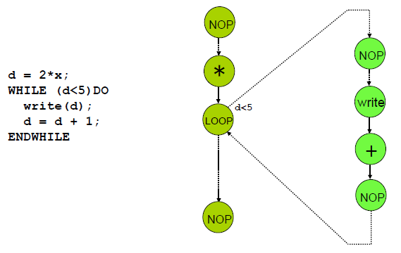
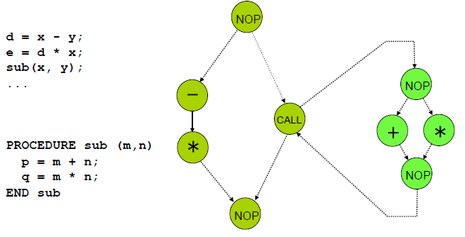
Sequence graph
Unit
Branch
Loop
Call

Slide 26
Remarks
Composition is achieved by input-output connection through communication channels (FIFOs)
The operational semantics dictates the conditions that must be satisfied to execute a function (actor)
Functions operating on streams of data rather than states evolving in response to traces of events (data vs. control)
Convenient to mix denotational and operational specifications

Slide 27
Summary of DF networks
Advantages:
  Easy to use (graphical languages)
  Powerful algorithms for
    verification (fast behavioral simulation)
    synthesis (scheduling and allocation)
  Explicit concurrency
Disadvantages:
  Efficient synthesis only for restricted models
    (no input or output choice)
  Cannot describe reactive control (blocking read)

Slide 28
Further info
  http://chess.eecs.berkeley.edu/design/2010/lectures/mocKPN-DF.pdf
  http://ls12-www.cs.tu-dortmund.de/daes/media/documents/staff/marwedel/es-book/slides10/es-marw-2.03-sdl-df.ppt

Slide 29
Outline
State-oriented models
  State Transition Diagrams (STD)/ Finite State Machines (FSM)
  Petri Nets (PN)
Activity oriented models
  Data flow graphs (DFG)
Process-based models
  Kahn Process Networks (KPN)
Heterogeneous models
  Synchronous dataflows (SDF)

Slide 30
Kahn process networks
Special case of process networks
Proposed by Kahn in 1974 as a general-purpose scheme for parallel programming
Laid the theoretical foundation for dataflow
Unique attribute: deterministic
Difficult to schedule
Too flexible to make efficient, not flexible enough for a wide class of applications
Key idea: Reading an empty channel blocks until data is available
No other mechanism for sampling communication channel’s contents
  Can’t check to see whether buffer is empty
  Can’t wait on multiple channels at once
…
_{Send();}
…
…
_{Wait();}
…

Slide 31
Kahn processes
A C-like function (Kahn used Algol)
Arguments include FIFO channels
Language augmented with send() and wait() operations that write and read from channels
process f(in int u, in int v, out int w)
{
int i; bool b = true;
for (;;) {
i = b ? wait(u) : wait(w);
printf("%i\n", i);
send(i, w);
b = !b;
}
u
f
w
v
Process alternately reads from u and v, prints the data value, and writes it to w

Slide 32
Kahn process
process f(in int u, in int v, out int w)
{
int i; bool b = true;
for (;;) {
i = b ? wait(u) : wait(w);
printf("%i\n", i);
send(i, w);
b = !b;
}
}
Process interface includes FIFOs
wait() returns the next token in an input FIFO, blocking if it’s empty
send() writes a data value on an output FIFO

Slide 33
Kahn process
process g(in int u, out int v, out int w)
{
int i; bool b = true;
for(;;) {
i = wait(u);
if (b) send(i, v); else send(i, w);
b = !b;
}
}
v
g
u
w
Process reads from u and alternately copies it to v and w
process h(in int u, out int v, int init)
{
int i = init;
send(i, v);
for(;;) {
i = wait(u);
send(i, v);
}
}
h
u
v
Process sends initial value, then passes through values.

Slide 34
Kahn system
Prints an alternating sequence of 0’s and 1’s
Emits a 1 then copies input to output
h
init = 1
g
f
h
init = 0
Emits a 0 then copies input to output

Slide 35
Determinacy
_{x1,x2,x3…}
_{F}
_{y1,y2,y3…}
Process: “continuous mapping” of input sequence to output sequences
Continuity: process uses prefix of input sequences to produce prefix of output sequences. Adding more tokens does not change the tokens already produced
The state of each process depends on token values rather than their arrival time
Unbounded FIFO: the speed of the two processes does not affect the sequence of data values

Slide 36
Proof of Determinism
Because a process can’t check the contents of buffers, only read from them, each process only sees sequence of data values coming in on buffers
Behavior of process:
  Compute … read … compute … write … read … compute
Values written only depend on program state
Computation only depends on program state
Reads always return sequence of data values, nothing more

Slide 37
Determinism
Another way to see it:
If I’m a process, I am only affected by the sequence of tokens on my inputs
I can’t tell whether they arrive early, late, or in what order
I will behave the same in any case
Thus, the sequence of tokens I put on my outputs is the same regardless of the timing of the tokens on my inputs

Slide 38
Adding Nondeterminism
Allow processes to test for emptiness
Allow processes themselves to be nondeterminate
Allow more than one process to read from a channel
Allow more than one process to write to a channel
Allow processes to share a variable

Slide 39
Scheduling Kahn Networks
Challenge is running processes without accumulating tokens
Apparent solution: only run a process whose outputs are being actively solicited
Not all systems can be scheduled without token accumulation
Tom Park’s algorithm:
  Schedules a Kahn Process Network in bounded memory if it is possible
  Start with bounded buffers
  Use any scheduling technique that avoids buffer overflow
  If system deadlocks because of buffer overflow, increase size of smallest buffer and continue

Slide 40
Further info
  http://chess.eecs.berkeley.edu/design/2010/lectures/mocKPN-DF.pdf
  http://ls12-www.cs.tu-dortmund.de/daes/media/documents/staff/marwedel/es-book/slides10/es-marw-2.03-sdl-df.ppt
  http://esd.cs.ucr.edu/slides/ch8_011702.ppt

Slide 41
Outline
State-oriented models
  State Transition Diagrams (STD)/ Finite State Machines (FSM)
  Petri Nets (PN)
Activity oriented models
  Data flow graphs (DFG)
Process-based models
  Kahn Process Networks (KPN)
Heterogeneous models
  Synchronous dataflows (SDF)

Slide 42
Synchronous Dataflow Model
With digital signal-processors (DSPs), data flows at fixed rate
Multiple tokens consumed and produced per firing
Synchronous dataflow model takes advantage of this
  Each edge labeled with number of tokens consumed/produced each firing
  Can statically schedule nodes, so can easily use sequential program model
    Don’t need real-time operating system and its overhead
Algorithms developed for scheduling nodes into “single-appearance” schedules
  SAS: 3(MC)4(T), (3M)(3C)4(T)
  Non-SAS: 3(MCT)T
  Only one statement needed to call each node’s associated procedure with SAS
    Allows procedure inlining without code explosion, thus reducing overhead even more
A
B
C
D
mA
mB
mC
mD
modulate
convolve
mt1
t1
t2
ct2
tt1
tt2
transform
tZ
Z
Synchronous dataflow

Slide 43
Further info
http://ls12-www.cs.tu-dortmund.de/daes/media/documents/staff/marwedel/es-book/slides10/es-marw-2.03-sdl-df.ppt

Slide 44
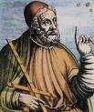
Models of Computation
Ptolemy (UC Berkeley) is an environment for simulating multiple models of computation
http://ptolemy.berkeley.edu

Slide 45
Summary
State machine models good for control
  Extensions like HCFSM provide additional power
  Program-State Machine (PSM) combines state machines and sequential programs
Concurrent process model for multi-task systems
  Communication and synchronization methods exist
  Scheduling is critical
Dataflow model good for signal processing
Usefulness of a Model of Computation
  Expressiveness
  Generality
  Simplicity
  Compilability/ Synthesizability
  Verifiability
One way to get all of these is to mix diverse, simple models of computation, while keeping compilation, synthesis, and verification separate for each MoC. To do that, we need to understand these MoCs relative to one another, and understand their interaction when combined in a single system design.

Slide 46
Levels of Hardware Modeling
System level
Algorithmic level
Instruction set level
Register-transfer level (RTL)
Gate-level models
Switch-level models
Circuit-level models
Device-level models
Layout models
Process and device models

Slide 47
Abstraction layers
System
Task
Component
Instruction
Architecture
Logic
ISA
RTL
uArch
Gate
Gate-level models
Switch-level models
Circuit-level models
Device-level models
Layout models
Object code

Slide 48
System level
Generally, “system level” is not clearly defined
It may be used to denote the entire embedded system and possibly also the environment
Such models may include mechanical as well as information processing aspects
Simulator solutions include VHDL-AMS, SystemC or MATLAB
Challenge to model information processing parts of the system in such a way that the simulation model can also be used for the synthesis of the system

Slide 49
Algorithmic Level
Simulating the algorithms that we intend to use within the embedded system
No reference is made to processors or instruction sets
Data types may still allow a higher precision than the final implementation
If data types have been selected such that every bit corresponds to exactly one bit in the final implementation, the model is said to be bit-true. Translating non-bit-true into bit-true models should be done with tool support
May consist of single processes or of sets of cooperating processes

Slide 50
MPEG-4 Full Motion Search
for (z=0; z<20; z++)
for (x=0; x<36; x++) {x1=4*x;
for (y=0; y<49; y++) {y1=4*y;
for (k=0; k<9; k++) {x2=x1+k-4;
for (l=0; l<9; ) {y2=y1+l-4;
for (i=0; i<4; i++) {x3=x1+i; x4=x2+i;
for (j=0; j<4;j++) {
y3=y1+j; y4=y2+j;
if (x3<0 || 35<x3||y3<0||48<y3)
then_block_1;
else else_block_1;
if (x4<0|| 35<x4||y4<0||48<y4)
then_block_2;
else else_block_2;
}}}}}}

Slide 51
Instruction Level
Algorithms have already been compiled for the instruction set of the processor(s) to be used.
Simulations at this level allow counting the executed number of instructions.
Variations:
  Simulation only the effect of instructions
  Transaction-level modeling: each read/write is one transaction, instead of a set of signal assignments
  Cycle-true simulations: exact number of cycles
  Bit-true simulations: simulations using exactly the correct number of bits

Slide 52
Instruction Level: Example
Assembler (MIPS) | Simulated Semantics
and $1,$2,$3 | Reg[1]:=Reg[2] ∧ Reg[3]
or $1,$2,$3 | Reg[1]:=Reg[2] ∨ Reg[3]
andi $1,$2,100 | Reg[1]:=Reg[2] ∧ 100
sll $1,$2,10 | Reg[1]:=Reg[2] << 10
srl $1,$2,10 | Reg[1]:=Reg[2] >> 10

Slide 53
Register Transfer Level (RTL)
At this level, we model all the components at the register-transfer level, including
  arithmetic/logic units (ALUs),
  registers,
  memories,
  muxes and
  decoders.
Models at this level are always cycle-true.
Automatic synthesis from such models is not a major challenge.

Slide 54
Register transfer level: (MIPS)
Controller
PCWrite
PCWriteC
IorD
ALUOp
RegDest
RegWrite
ALUSelA
MemWrite
ALUSelB
PCSource
B
MemRead
MemToReg
TargetWrite
§
IRWrite
PC
0
0
1
31:26
1
ALU
25:21
0
i2 a2 a1
Memory
T
o2 o1
20:16
Speicher
Instruction register IR
Reg
1
0
0
i3 a3 a2 a1
1
2
4
1
alu_ control
15:11
sign_
extend
2
§
31: 28
*
15:0
"00“
25:0
1
0
3
<<2
*

Slide 55
Gate-level Models
Models contain gates as the basic components
Provide accurate information about signal transition probabilities and can therefore also be used for power estimations
Delay calculations can be more precise than for the RTL. Typically no information about the length of wires (still estimates)
Term sometimes also used to denote Boolean functions (No physical gates; only considering the behavior of the gates). Such models should be called “Boolean function models”?

Slide 56
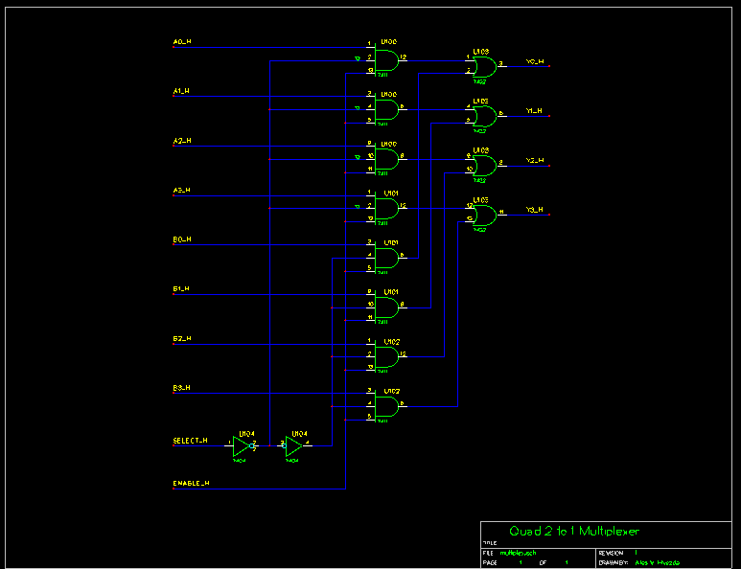
Gate-level Models: Example

Slide 57
Switch Level Models
Switch level models use switches (transistors) as their basic components
Switch level models use digital value models
In contrast to gate-level models, switch level models are capable of reflecting bidirectional transfer of information

Slide 58
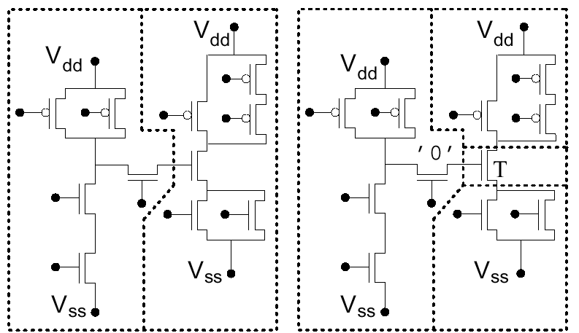
Switch Level Model: Example

Slide 59
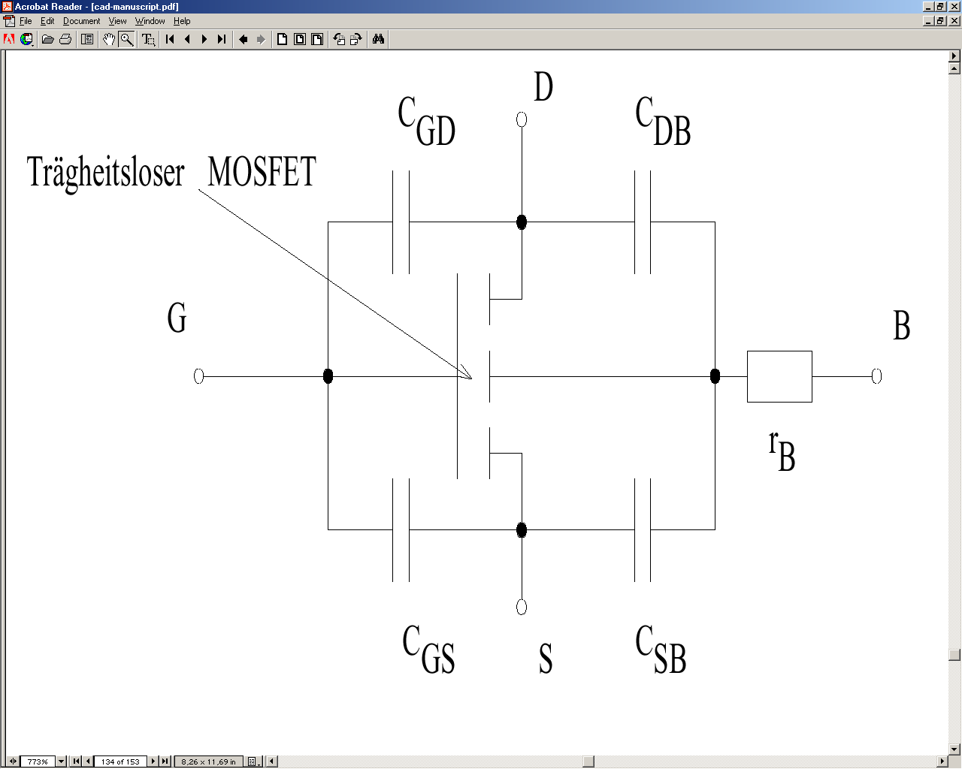
Circuit Level Models: Example
Models circuit theory and its components (current and voltage sources, resistors, capacitances, inductances and possibly macro-models of semiconductors) form the basis of simulations
Simulations involve partial differential equations.
Linear if and only if the behavior of semiconductors is linearized
Ideal MOSFET

Slide 60
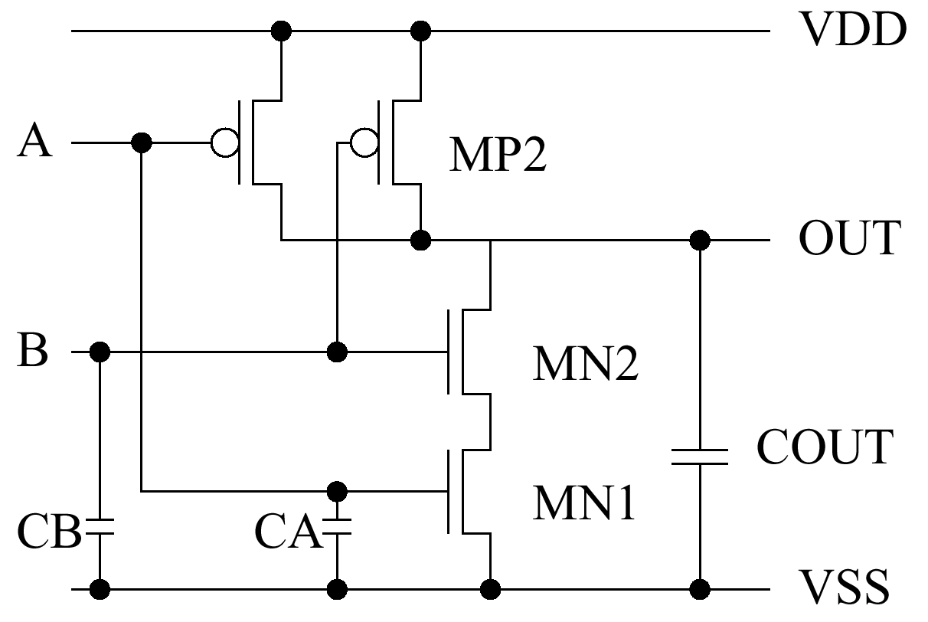
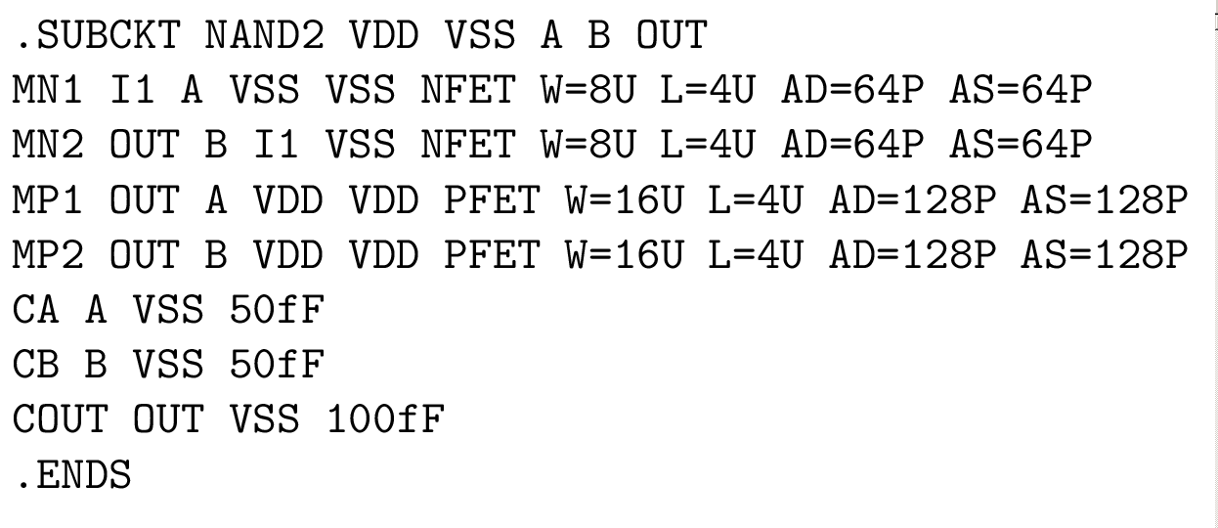
Circuit Level Models: SPICE
The most frequently used simulator at this level is SPICE [Vladimirescu, 1987] and its variants.
Example:

Slide 61
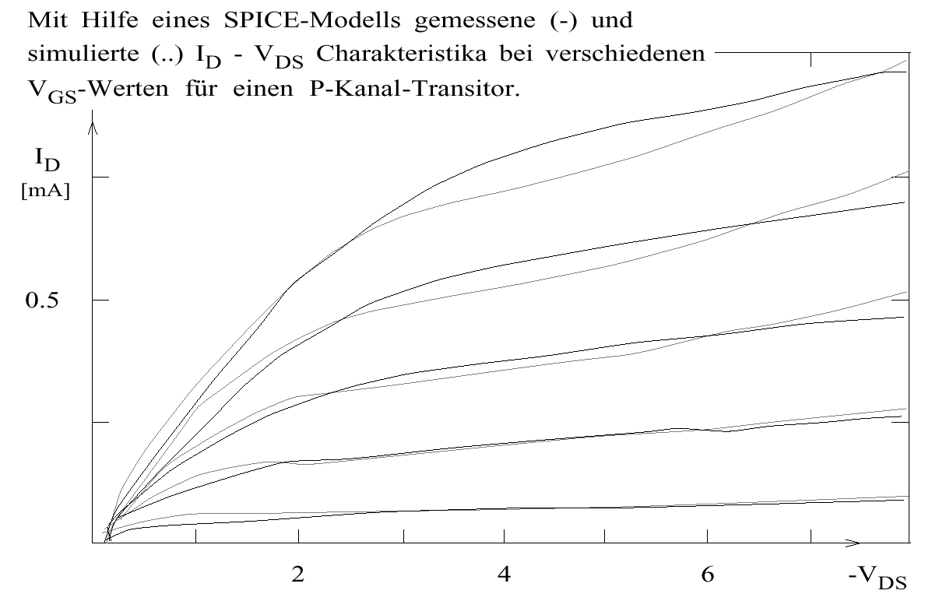
Device Level
Simulation of a single device (such as a transistor).
Example (SPICE simulation):
Measured and simulated currents

Slide 62
Layout Models
Reflects the actual circuit layout, includes geometric information,
Cannot be simulated directly: behavior can be deduced by correlating the layout model with a behavioral description at a higher level or by extracting circuits from the layout.
Length of wires and capacitances frequently extracted from the layout, back-annotated to descriptions at higher levels (more precision for delay and power estimations)

Slide 63
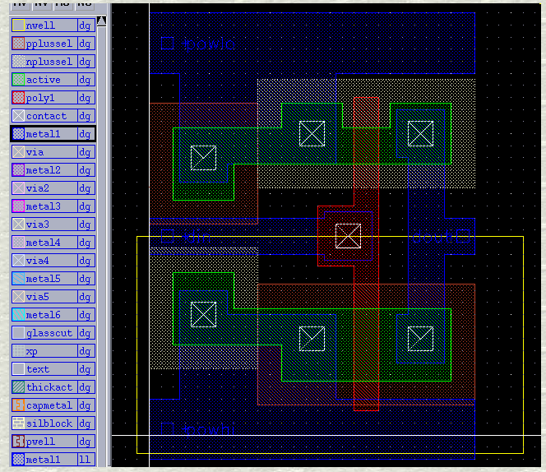
Layout Models: Example
powhi
dout
din
powlo
© Mosis (http://www. mosis.org/Technical/
Designsupport/
polyflowC.html);
Tool: Cadence

Slide 64
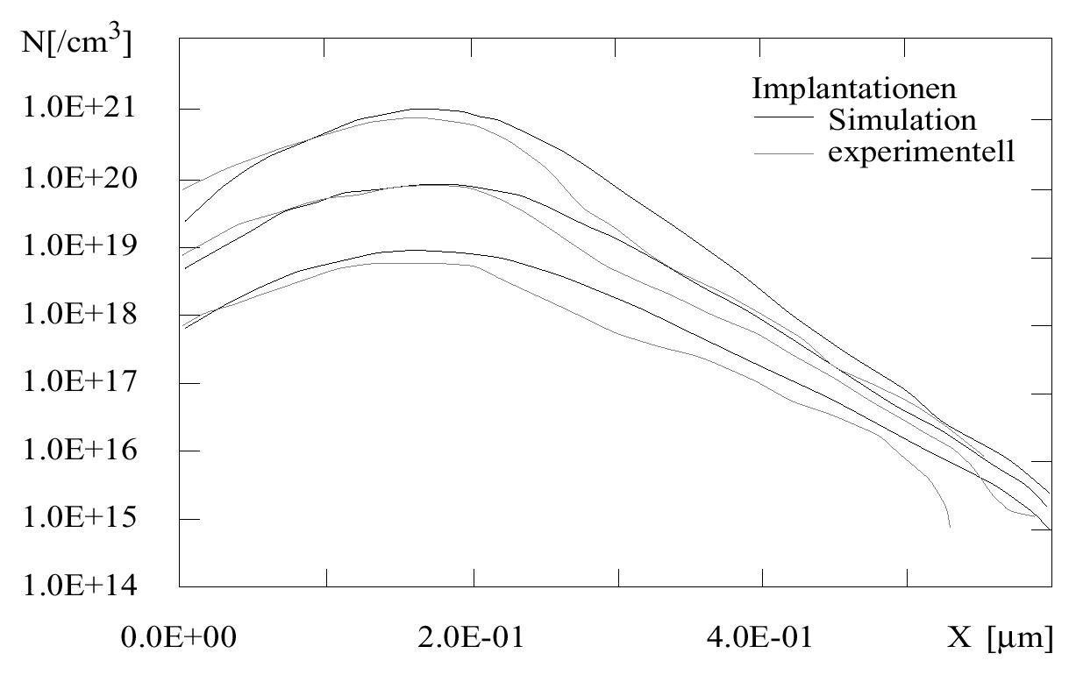
Process Models
Model of fabrication process
Example [IMEC]: Doping as a function of the distance from the surface
Simulated
Measured

