Slide 1
ECE-777 System Level Design and Automation Performance abstraction
Cristinel Ababei
Electrical and Computer Department, North Dakota State University
Spring 2012

Slide 2
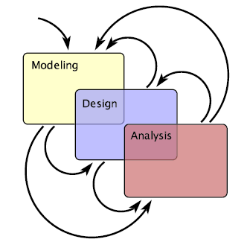

Slide 3
Performance analysis
Simulation based
Accurate but requires long CPU runtimes
Estimation based
Statistical and analytical methods
Less accurate but faster (orders of magnitude sometimes)
For NoCs, we need estimation of:
Latency, throughput
Power (router = crossbar switch + buffers, links/wires)
Area
Temperature

Slide 4
Outline
Latency, throughput
Power, area
Interconnect (wire delay)
Temperature

Slide 5
Articles
[] Jongman Kim, Dongkook Park, Chrysostomos Nicopoulos, N. Vijaykrishnan, Chita R. Das, Design and analysis of an NoC architecture from performance, reliability and energy perspective, ANCS, 2005. (average latency, energy)
[] Umit Y. Ogras, Radu Marculescu, Analytical router modeling for networks-on-chip performance analysis, DATE, 2007. (average latency, average buffer utilization, network throughput)
[] E. Krimer et al., Packet-level static timing analysis for NoCs, NoCS, 2009. (end-to-end latency)
[] Chapter 23. William James Dally, Brian Patrick Towles, Principles and Practices of Interconnection Networks, Morgan Kaufmann, 2004.
[] Nikita Nikitin, Jordi Cortadella, A performance analytical model for Network-on-Chip with constant service time routers, ICCAD, 2009. (worst case delay)
[] Mingche Lai, Lei Gao, Nong Xiao, Zhiying Wang, An accurate and efficient performance analysis approach based on queuing model for Network on Chip, ICCAD, 2009.
…

Slide 6
Average latency
Queuing theory
Average network latency: actual message transfer time + blocking time
Assumption: (header) flit arrivals at router inputs are governed by independent and identical Poisson processes
Contention probabilities is key
Markov chain based models
Reduced Markov chain model for individual flows

Slide 7
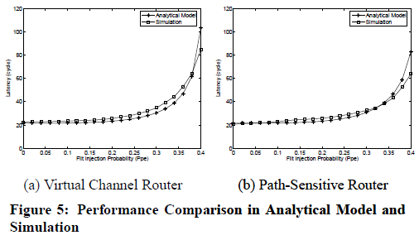
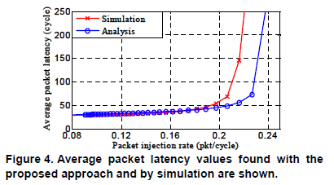
Latency Estimation vs. Simulation
Kim et al. (2005)
Ogras and Marculescu (2007)
For 1000 mappings:
22 h to find best mapping via simulation
7 seconds via estimation

Slide 8
Outline
Latency, throughput
Power, area
Interconnect (wire delay)
Temperature

Slide 9
Articles
[] Terry Tao Ye, Giovanni De Micheli, Luca Benini, Analysis of power consumption on switch fabrics in network routers, DAC, 2002. (switch/router power)
[] Andrew Kahng, Bin Li, Li-Shiuan Peh and Kambiz Samadi, ORION 2.0: A Fast and Accurate NoC Power and Area Model for Early-Stage Design Space Exploration, DATE, 2009.
[] Hangsheng Wang, Li-Shiuan Peh and Sharad Malik, A Power Model for Routers: Modeling Alpha 21364 and InfiniBand Routers, Proceedings of Hot Interconnects 10, Stanford, CA, August 2002.
[] Jongman Kim, Dongkook Park, Chrysostomos Nicopoulos, N. Vijaykrishnan, Chita R. Das, Design and analysis of an NoC architecture from performance, reliability and energy perspective, ANCS, 2005.
[] Li Shang, Li-Shiuan Peh and Niraj K. Jha, Dynamic Voltage Scaling with Links for Power Optimization of Interconnection Networks, 9th International Symposium on High-Performance Computer Architecture (HPCA), Anaheim, CA, January 2003. (router components, physical links)
[] J. Chan, S. Parameswaran, NoCEE: energy macro-model extraction methodology for network on chip routers, ICCAD, 2005.
[] Haytham Elmiligi, Ahmed A. Morgan, M. Watheq El-Kharashi and Fayez Gebali, Power Optimization for Application-Specific Networks-on-Chips: A Topology-Based Approach, Journal of Microprocessors and Microsystems, 2009.
[] D. Brooks, R. P. Dick, R. Joseph, L. Shang, Power, Thermal, and Reliability Modeling in Nanometer-Scale Microprocessors, MICRO, 2007.
…

Slide 10
Power estimation
What is the power consumption of different switch fabric architectures under different traffic patterns/loads?
How does the power consumption scale with different numbers of input/output ports?

Slide 11
Challenges
Simulation based methods become very slow
Power consumption of buffers depends on the dynamic contention between packets
Power components
Switch
Buffers
Wires (internal to the switch/router)
Physical links

Slide 12
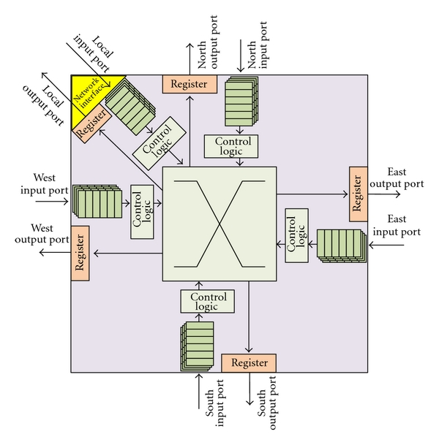
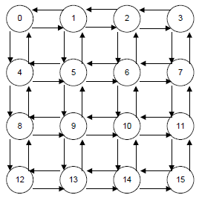
Block diagram of a switch/router
The Bit Energy: E_bit – the summation of the energy consumed for each bit on crossbar switches, internal buffers, and interconnect wires

Slide 13
Power: switch/router
Bit energy on switch fabrics
Input state-dependent (e.g., switch will consume more power to process 2 packets at the same time, but power consumption is not necessarily double)
For a router with n input ports → 2^n input vectors
One idea: use look-up tables pre-computed using for example Synopsys Power Compiler

Slide 14
Power: buffers
Contention
Destination contention (two or more packets requesting the same output port) – application dependent. Not considered.
Interconnect contention (the same link is shared between packets with different destinations) – depends of architecture.
Sources of energy consumption
Data access energy: consumed by read/write
Refreshing energy

Slide 15
Power: interconnects
Energy consumed when the signal on the wire will toggle between logic “0” and logic “1”
Energy dissipated in the charging and discharging process
C_wire: wire capacitance – estimated using Thompson model (as global wire estimation)
C_input: total capacitance of the input gates connected to the interconnect

Slide 16
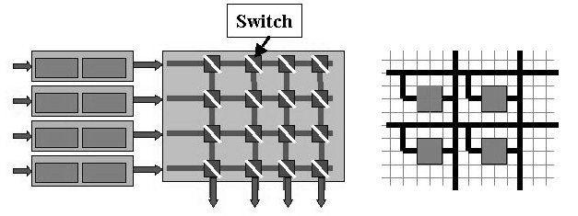
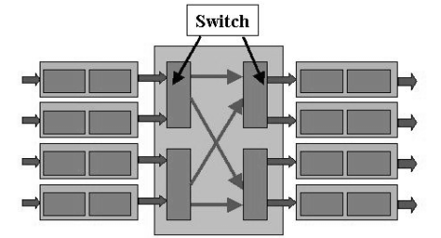
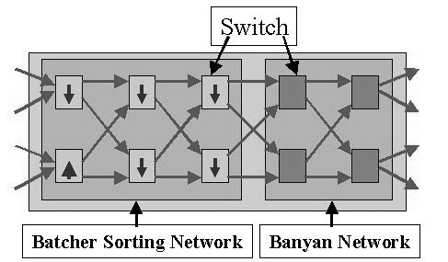
Interconnection fabric architectures
Crossbar switch fabrics
Fully connected network
Banyan network
Batcher-Banyan network

Slide 17
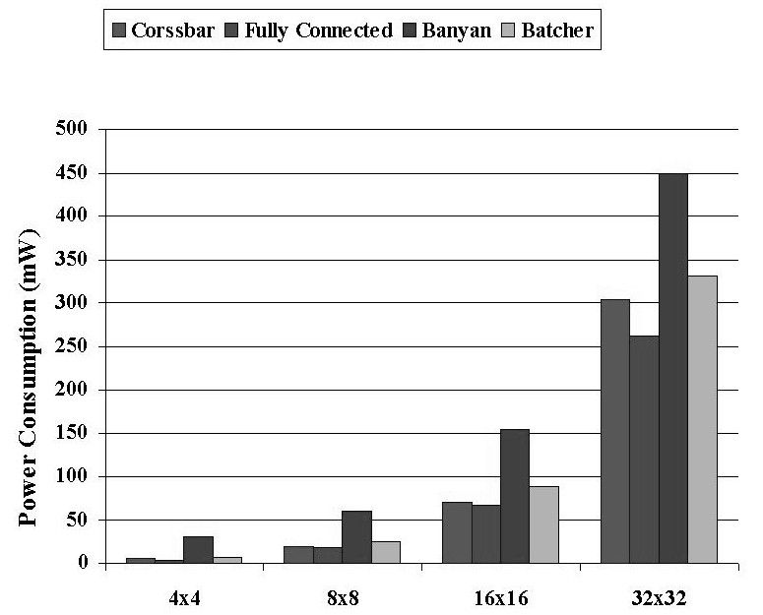
Power consumption for different number of ports

Slide 18
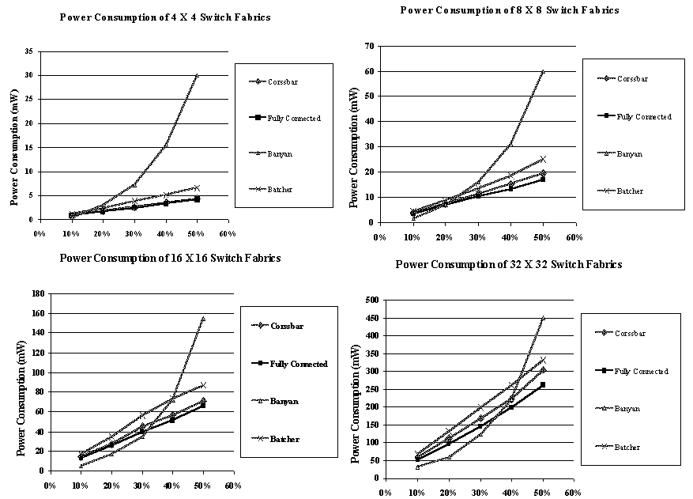
Power consumption for different switch fabric sizes and under different traffic

Slide 19
Remarks
Interconnect contention induces significant power consumption on internal buffers, and the power consumption on buffers will increase sharply as throughput increases
For switch fabrics with a small number of ports, internal node switches dominate the power consumption. For large number of ports interconnect wires will gradually dominate the power consumption.

Slide 20
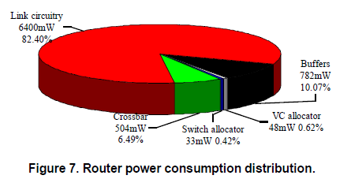
Router power consumption
Shang et al. (2003)
TSMC 0.25 um technology

Slide 21
Outline
Latency, throughput
Power, area
Interconnect (wire delay)
Temperature

Slide 22
Articles
[] Luca Carloni, Andrew B. Kahng, Swamy Muddu, Alessandro Pinto, Kambiz Samadi, Puneet Sharma, Interconnect modeling for improved system-level design optimization, ASP-DAC, 2008. (wire delay, buffer delay, wire power)

Slide 23
Key factors that delay models must address
Accuracy
Transition time (slew) dependence
Interconnect resistivity
Coupling capacitance
Design styles and buffering schemes
Wire shielding, wire sizing
Buffering
Model inputs and technology capture
Should be derivable from standard tech files

Slide 24
Delay models
Repeater delay
Intrinsic delay
Drive resistance
Repeater out slew
Repeater input capacitance
Wire delay
Scattering-aware resistivity
Interconnect barrier

Slide 25
Carloni et al. (2008)

Slide 26
Outline
Latency, throughput
Power, area
Interconnect (wire delay)
Temperature

Slide 27
Articles
[] Li Shang, Li-Shiuan Peh, Amit Kumar, Niraj K. Jha, Thermal Modeling, Characterization and Management of On-Chip Networks, MICRO, 2004.
[] Giacomo Paci, Francesco Poletti, Luca Benini, Paul Marchal, Exploring temperature-aware design in low-power MPSoCs, International Journal of Embedded Systems, 2007.
[] Srinivasan Murali et al., Temperature-aware processor frequency assignment for MPSoCs using convex optimization, ICCAD 2007.

Slide 28
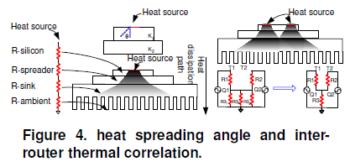
Thermal modeling of NoCs
Inter-router thermal correlation modeling
Heat dissipation path
Inter-block thermal correlation

Slide 29
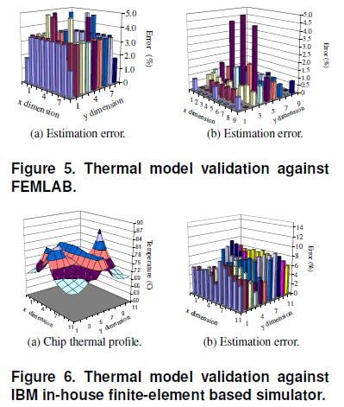
Model validation

Slide 30
Thermal modeling of links
Given the length of link segments, the temperature along each segment can be calculated using the following equation:

Slide 31
Others: outline
Stochastic communication
Workload/traffic characterization

Slide 32
Stochastic communication
Article
[] P. Bogdan, T. Dumitras, R. Marculescu, Stochastic Communication: A New Paradigm for Fault-Tolerant Networks-on-Chip, Hindawi VLSI Design, Special Issue on Networks-on-Chip, Feb. 2007.
…
Novel communication paradigm
Separation between computation and communication
Fault-tolerance
Extremely low latency
Low production costs
Design flexibility
Probabilistic analysis

Slide 33
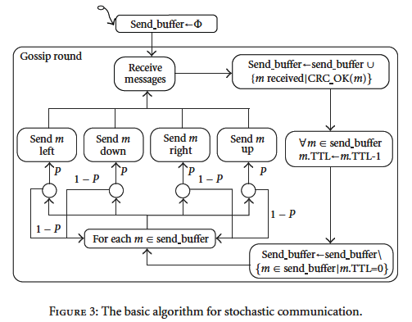
Algorithm executed concurrently by all nodes in the network

Slide 34
Others: outline
Stochastic communication
Workload/traffic characterization
Reading assignment: select a paper on workload/traffic characterization and read it; be prepared to discuss it in class

