Slide 1
ECE-777 System Level Design and Automation
Hardware/Software Co-design
Cristinel Ababei
Electrical and Computer Department, North Dakota State University
Spring 2012

Slide 2
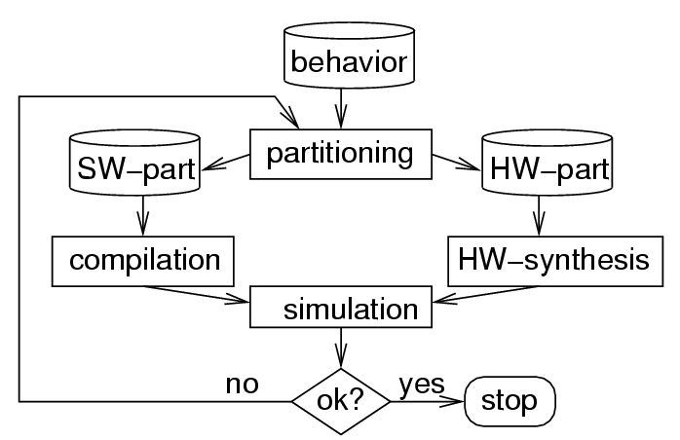
Simplified design flow: part in HW, part in SW
Decision based on hardware/software partitioning, a special case of hardware/software co-design.
HW/SW Co-design
Task concurrency management
High-level transformations
Design space exploration
HW/SW partitioning
Compilation, scheduling
co

Slide 3
HW/SW Co-design
HW/SW Co-design means the design of a special-purpose system composed of a few application-specific ICs that cooperate with software procedures on general-purpose processors (1994)
HW/SW Co-design means meeting system-level objectives by exploiting the synergism of hardware and software through their concurrent design (1997)
HW/SW Co-design tries to increase the predictability of embedded system design by providing analysis methods that tell designers if a system meets its performance, power, and size goals and synthesis methods that let designers rapidly evaluate many potential design methodologies (2003)
It moved from an emerging discipline (early ‘90s) to a mainstream technology (today)

Slide 4
Outline
HW/SW Co-design
  Hardware/Software partitioning
  Scheduling
  Hardware exploration
  Software optimization
HW/SW Co-synthesis

Slide 5
Design flow
Informal Specification
System
Model
System Simulation
Algorithmic Design
Hardware/Software Partitioning
Partitioned
Model
Schedule
Refine
System
synthesis
Partitioned
Model & Sch.
Communication
Synthesis
Software
Model
HW/SW
Co-simulation
Hardware
Model
Compilation
Synthesis
Binary Exec.
Model
Gate-level
Model
Binary Exec.
Model
Gate-level
Model
Emulate or
Prototype
Fabrication

Slide 6
Design objectives
Cost
Performance
Power
Area
Scalability and reusability
Fault tolerance
Thermal characteristics
…

Slide 7
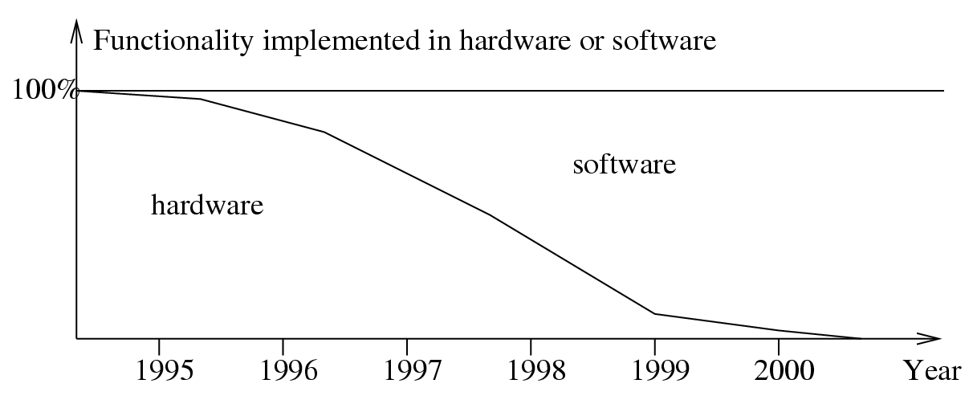
Hardware/Software Partitioning
No need to consider special purpose hardware in the long run?
Specialized hardware needed for
  Low power operation
  High performance
Increasing application complexity
  “By the time MPEG-n can be implemented in software, MPEG-n+1 has been invented” [de Man]

Slide 8
Partitioning: Levels of Abstractions
Low level: at the register transfer (RTL) level, at the netlist level
  split a digital circuit and map it to several devices (FPGAs, ASICs)
  system parameters are relatively well-known (area, delay)
High level: at the system level
  comparison of design alternatives mandatory (design space exploration)
  system parameters are unknown
  importance of estimation (analysis, simulation, rapid prototyping)

Slide 9
Hardware/Software Partitioning
Decompose (i.e., partition) the function F of the system into N sub-functions F₁, F₂, F₃ … F_{N}
Decompose the constraints and design objectives of the system into sub-constraints and design sub-objectives
Cluster F₁, F₂, F₃, …, F_{n} into M partitions to run on M PEs (can be all processors): aka mapping
Optimize (usually minimization) a cost function c(M)
F
{F₁, F₂, F₃ … F_{n}}
…
P₁
P₂
P₃
…
P_{M}

Slide 10
General Partitioning Methods
Exact methods:
  Enumeration
  Integer Linear Programs (ILP)
Heuristic methods:
  Constructive methods
    Random mapping
    Hierarchical clustering
  Iterative methods
    Kernighan-Lin Algorithm
    Simulated Annealing
    Evolutionary Algorithms (EA)

Slide 11
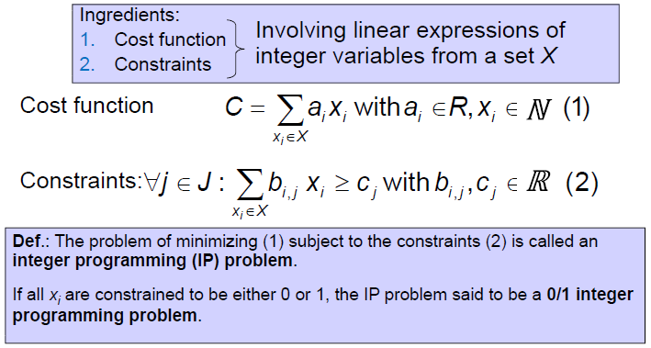
Integer Programming Models

Slide 12
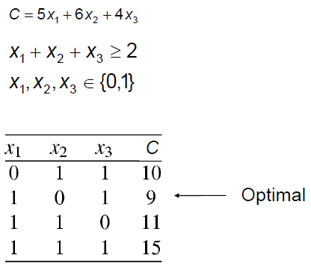
Example

Slide 13
Remarks
Maximizing the cost function can be done by setting C‘=-C
Integer programming is NP-complete
In practice, running times can increase exponentially with the size of the problem, but problems of some thousands of variables can still be solved with commercial solvers, depending on the size and structure of the problem
IP models can be a good starting point for modeling, even if in the end heuristics have to be used to solve them

Slide 14
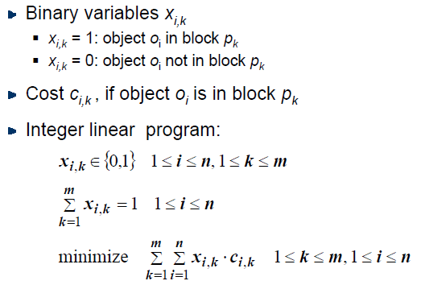
ILP for partitioning

Slide 15
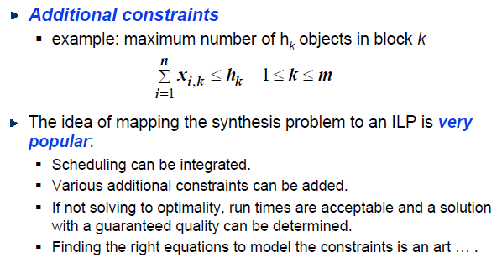
ILP for partitioning

Slide 16
Example of HW/SW partitioning: COdesign toOL (COOL)
Inputs to COOL:
  1. Target technology : available HW platform components
  2. Design constraints : required throughput, latency, maximum memory size or maximum area for ASIC
  3. Required behavior : required overall behavior. Hierarchical task graphs
Specification
Mapping
Processor P1
Processor P2
Hardware
[Niemann, Hardware/Software Co-Design for Data Flow Dominated Embedded Systems, Kluwer Academic Publishers, 1998 (Comprehensive mathematical model)]

Slide 17
Steps of the COOL partitioning algorithm
  Translation of the behavior into an internal graph model
  Translation of the behavior of each node from VHDL into C
  Compilation
    All C programs compiled for the target processor,
    Computation of the resulting program size,
    Estimation of the resulting execution time
    (simulation input data might be required)
  Synthesis of hardware components:
  ∀ leaf nodes, application-specific hardware is synthesized.
  High-level synthesis sufficiently fast.
  Flattening of the hierarchy:
    Granularity used by the designer is maintained.
    Cost and performance information added to the nodes.
    Precise information required for partitioning is pre-computed
  Generating and solving a mathematical model of the optimization problem:
    Integer programming IP model for optimization.
    Optimal with respect to the cost function (approximates communication time)

Slide 18
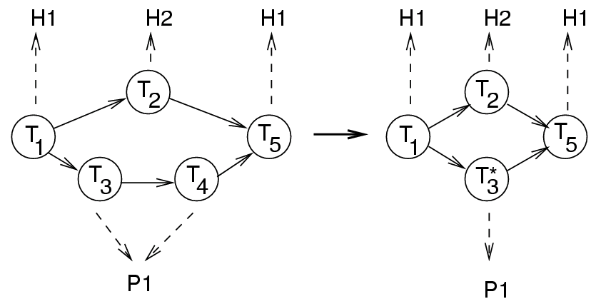
Steps of the COOL partitioning algorithm
  7. Iterative improvements:
  Adjacent nodes mapped to the same hardware component are now merged.
8. Interface synthesis:
After partitioning, the glue logic required for interfacing processors, application-specific hardware and memories is created.

Slide 19
General Partitioning Methods
Exact methods:
  enumeration
  Integer Linear Programs (ILP)
Heuristic methods:
  constructive methods
    random mapping
    hierarchical clustering
  iterative methods
    Kernighan-Lin Algorithm
    Simulated Annealing
    Evolutionary Algorithms (EA)

Slide 20
Constructive methods
A constructive approach:
  performed in several iterations
  with final goal to group a set of objects into partitions according to some measure of closeness
Bottom up approach
  each object initially belongs to its own cluster,
  and clusters are then gradually merged until the desired partitioning is found
  does not require a global view of the system
  relies only on local relations between objects (closeness metrics)

Slide 21
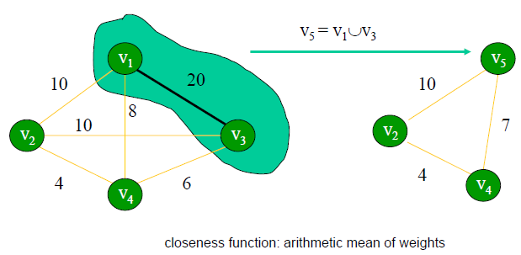
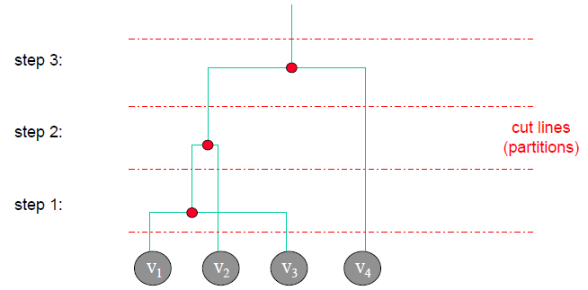
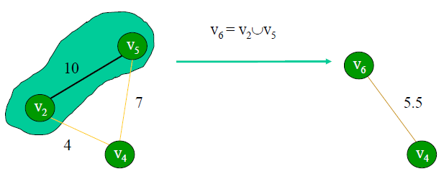
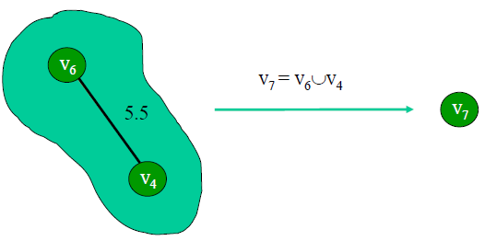
Example: Hierarchical Clustering

Slide 22
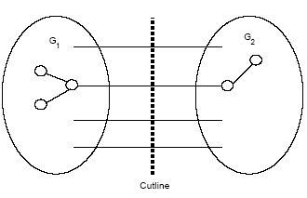
Iterative methods
Based on a design space exploration which is guided by an objective function that reflects the global quality of the partitioning
  a starting solution is modified iteratively, by passing from one candidate solution to another
  passing is based on evaluations of an objective function
Iterative algorithms differ from one another primarily in the ways in which they modify the partition and ways in which they accept or reject bad modifications

Slide 23
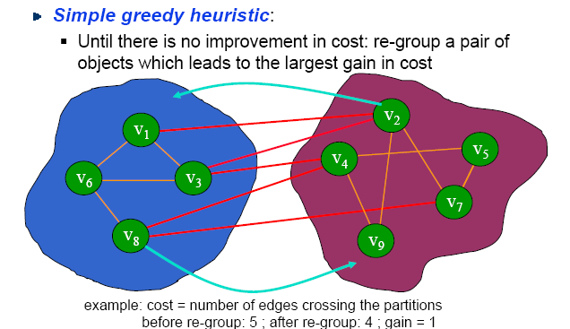
Example: Simple Greedy Heuristic

Slide 24
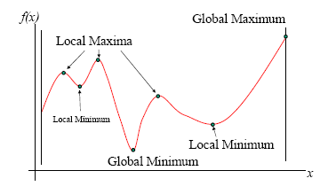
Example: Kernighan-Lin (Min-cut) Heuristic
Problem with Greedy Approach
  Simple greedy heuristic can get stuck in a local minimum
Improved algorithm (Kernighan-Lin):
  Algorithm allows moves between clusters that may not improve the cost – this allows the algorithm to escape from local optima
Goal of any optimization algorithm is to find:
global maxima, or
global minima
Cost function

Slide 25
Outline
HW/SW Co-design
  Hardware/Software partitioning
  Scheduling
  Hardware exploration
  Software optimization
HW/SW Co-synthesis

Slide 26
Design flow
Informal Specification
System
Model
System Simulation
Algorithmic Design
Hardware/Software Partitioning
Partitioned
Model
Schedule
Refine
System
synthesis
Partitioned
Model & Sch.
Communication
Synthesis
Software
Model
HW/SW
Co-simulation
Hardware
Model
Compilation
Synthesis
Binary Exec.
Model
Gate-level
Model
Binary Exec.
Model
Gate-level
Model
Emulate or
Prototype
Fabrication

Slide 27
Scheduling
Scheduling is to obtain an execution sequence such that all dependencies are obeyed
  A deadline D for the entire schedule
  An execution time T_{i} for each F_{i}
Approaches
  Static
    During design time the schedule is fixed (the common case)
  Dynamic
    During execution time, the schedule is determined (reconfigurable computing)
Scheduling of
  Computation
  Communication
3
F₁
3
F₂
F₄
6
F₅
4
2
F₆
F₇
3
F₃
1
F₈
3
P1: F1 → F2 → F8
P2: F4 → F5
P3: F3 → F6
P4: F7

Slide 28
Scheduling
v₁
v₂
v₃
v₄
Processor
p₁
ASIC h₁
FIR₁
FIR₂
e₃
e₄
v₅
v₆
v₇
v₈
Communication channel c₁
v₉
v₁₀
FIR₂ on h₁
p₁
c₁
v₁₁
...
v₃
...
v₄
...
v₇
...
v₈
...
...
e₃
e₄
or
or
or
...
v₄
...
v₃
...
v₈
...
v₇
...
...
t
t
e₄
e₃
t

Slide 29
Scheduling: precedence constraints
For all nodes v_{i1} and v_{i2} that are potentially mapped to the same processor or hardware component instance, introduce a binary decision variable b_{i1,i2} with
b_{i1,i2}=1 if v_{i1} is executed before v_{i2} and
= 0 otherwise.
Define constraints of the type
(end-time of v_{i1}) ≤ (start time of v_{i2}) if b_{i1,i2}=1 and
(end-time of v_{i2}) ≤ (start time of v_{i1}) if b_{i1,i2}=0
Ensure that the schedule for executing operations is consistent with the precedence constraints in the task graph
Approach just fixes the order of execution and avoids the complexity of computing start times during optimization
Other constraints
  Timing constraints: These constraints can be used to guarantee that certain time constraints are met

Slide 30
Example: Scheduling using ILP
HW types H1, H2 and H3 with costs of 20, 25, and 30.
Processors of type P.
Tasks T1 to T5.
Execution times:
T H1 H2 H3 P
1 20 100
2 20 100
3 12 10
4 12 10
5 20 100

Slide 31
Operation assignment constraints (1)
T H1 H2 H3 P
1 20 100
2 20 100
3 12 10
4 12 10
5 20 100
X_{1,1}+Y_{1,1}=1 (task 1 mapped to H1 or to P)
X_{2,2}+Y_{2,1}=1
X_{3,3}+Y_{3,1}=1
X_{4,3}+Y_{4,1}=1
X_{5,1}+Y_{5,1}=1

Slide 32
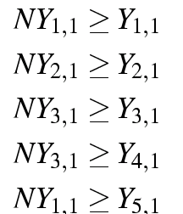
Operation assignment constraints (2)
Assume types of tasks are ℓ =1, 2, 3, 3, and 1.
∀ ℓ ∈L, ∀ i:T(v_{i})=c_{ℓ}, ∀ k ∈ KP: NY_{ℓ,k} ≥ Y_{i,k}
Functionality 3 to be implemented on processor if node 4 is mapped to it.

Slide 33
Notation used
Index set I denotes task graph nodes
Index set L denotes task graph node types
e.g. square root, DCT or FFT
Index set KH denotes hardware component types.
e.g. hardware components for the DCT or the FFT
Index set J of hardware component instances
Index set KP denotes processors
All processors are assumed to be of the same type

Slide 34
Other equations
Time constraints leading to: Application specific hardware required for time constraints under 100 time units.
T H1 H2 H3 P
1 20 100
2 20 100
3 12 10
4 12 10
5 20 100
Cost function:
C=20 #(H1) + 25 #(H2) + 30 # (H3) + cost(processor) + cost(memory)

Slide 35
Result
For a time constraint of 100 time units and cost(P)<cost(H3):
T H1 H2 H3 P
1 20 100
2 20 100
3 12 10
4 12 10
5 20 100
Solution (educated guessing) :
T1 → H1
T2 → H2
T3 → P
T4 → P
T5 → H1

Slide 36
Outline
HW/SW Co-design
  Hardware/Software partitioning
  Scheduling
  Hardware exploration
  Software optimization
HW/SW Co-synthesis

Slide 37

Hardware exploration. Software optimization.
Hardware Components
Hardware
Concept
HW/SW
Partitioning
Design
(Synthesis, Layout, …)
Specification
Design
(Compilation, …)
Estimation -
Exploration
Software Components
Software
Validation and Evaluation (area, power, performance, …)

Slide 38
Hardware exploration. Software optimization.
Hardware exploration
  Architecture Description Language (ADL) driven processor memory exploration. EXPRESSION toolkit:
    http://www.ics.uci.edu/~express/index.htm
  Communication architecture exploration (point to point, bus, hierarchical bus, bus matrix, NoC, etc.)
  More info:
    http://www.engr.colostate.edu/~sudeep/teaching/ppt/lec10_hw_explore.ppt
Software optimization
  Floating-point, fixed-point conversions
  Loop transformations, Array folding, Function inlining
  Compiler optimizations (low energy), exploiting memory hierarchies
  More info:
    http://www.engr.colostate.edu/~sudeep/teaching/ppt/lec11_sw_optimizations.ppt

Slide 39
Outline
HW/SW Co-design
  Hardware/Software partitioning
  Scheduling
  Hardware exploration
  Software optimization
HW/SW Co-synthesis

Slide 40
From HW/SW Co-design to HW/SW Co-synthesis!
Early approaches: HW/SW partitioning would be done first and then HW/SW blocks would be synthesized separately
Ideally system synthesis would do HW/SW partitioning, mapping, and scheduling in a unified fashion – very difficult
Design space exploration (estimation and refinement) would also be done in a unified fashion; by working at the same time with both HW and SW modules → Co-synthesis
Key: communication models

Slide 41
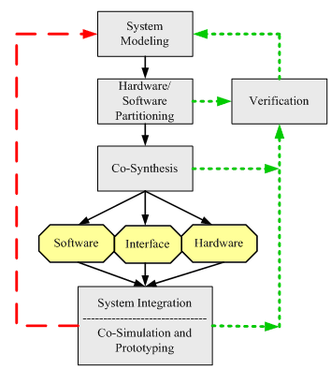
Co-synthesis
Co-synthesis: Synthesize the software, hardware and interface implementation in a unified fashion. This is done concurrently with as much interaction as possible between the three implementations.

Slide 42
Tools
POLIS – a framework for HW/SW co-design
  http://embedded.eecs.berkeley.edu/research/hsc
Hardware exploration: EXPRESSION toolkit
  http://www.ics.uci.edu/~express/index.htm
COOL - a HW/SW co-design tool
  http://ls12-www.cs.tu-dortmund.de/research/activities/codesign/cool/index.html
More tools:
  http://www.cs.hongik.ac.kr/~dspark/codesign-link.htm

