Slide 1
ECE-777 System Level Design and Automation
Mapping
Cristinel Ababei
Electrical and Computer Department, North Dakota State University
Spring 2012

Slide 2
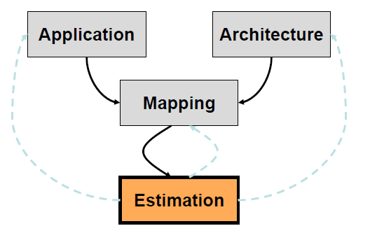
Design space exploration
Iterative process
  Find mapping
  Evaluate solution

Slide 3
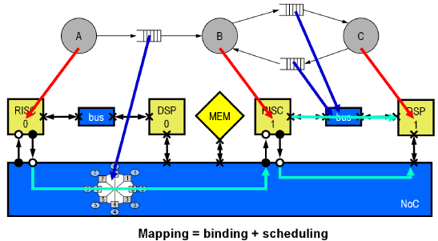
Mapping
Relates application and architecture specification:
  maps processes to computing resources
  maps communication between processes (in case of process networks) to communication paths of the architecture
  specifies resource sharing disciplines and scheduling

Slide 4
Application specification
Depends on the underlying model of computation
Examples:
  Task graphs (data flow graph, control flow graph)
  Process Networks (Kahn Process Network, Synchronous Dataflow)
  State Machine Representations (SpecCharts, StateCharts, Polis)
For the mapping, very often only the network structure and abstract properties of the processes are relevant (abstraction from detailed process function)

Slide 5
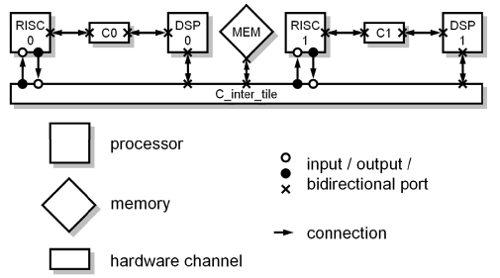
Architecture specification
Depends on the underlying model of the platform
Usually a graph notation is used. Properties of the underlying platform are usually attached to the elements

Slide 6
Mapping to multi-processor systems

Slide 7
Mapping of multiple applications to multi-processor systems
Given
  A set of applications
  Scenarios on how these applications will be used
  A set of candidate architectures comprising
    (Possibly heterogeneous) processors
    (Possibly heterogeneous) communication architectures
    Possible scheduling policies
Find
  A mapping of applications to processors
  Appropriate scheduling techniques (if not fixed)
  Possibly a target architecture if required
Objectives
  Keep deadlines and/or maximize performance
  Minimizing cost, energy consumption

Slide 8
Target platform
Communication
  micro-network on chip for synchronization and data exchange consisting of busses, routers, drivers
  some critical issues: topology, switching strategies (packet, circuit), routing strategies (static – reconfigurable – dynamic), arbitration policies (dynamic, TDM, CDMA, fixed priority)
  challenges: heterogeneous components and requirements, compose network that matches the traffic characteristics of a given application (domain)

Slide 9
Mapping
When it is done
  Static (off-line)
  Dynamic (on-line)
    Centralized
    Distributed
How many applications
  Single
  Multi-use cases
Target architecture
  Heterogeneous
  Homogeneous (multi-processor systems)

Slide 10
Objectives, Constraints
Performance
Energy, power, user-centric
Quality of service guarantees
Contention, bandwidth, communication cost
Task migration
Fault tolerance

Slide 11
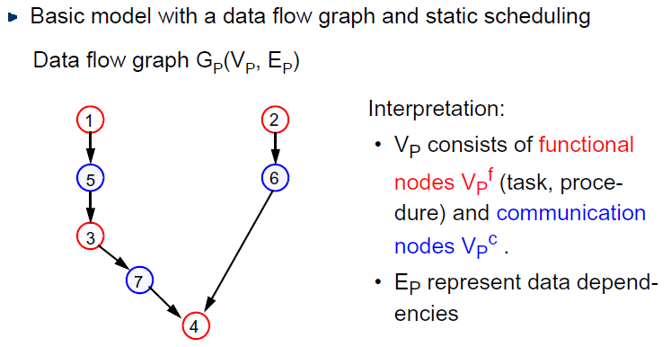
Example: problem graph

Slide 12
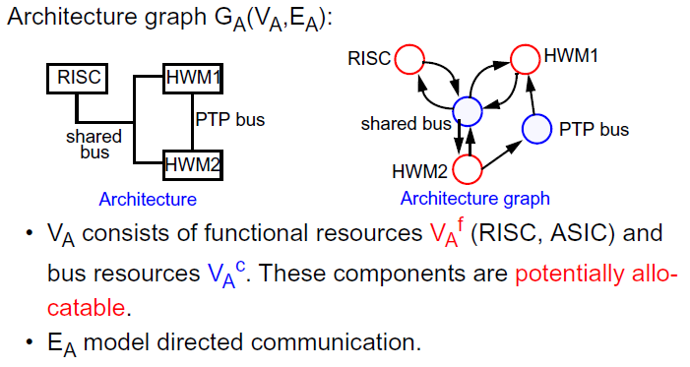
Example: architecture graph

Slide 13
Example: specification graph

Slide 14
Example: synthesis

Slide 15
Example: implementation

Slide 16
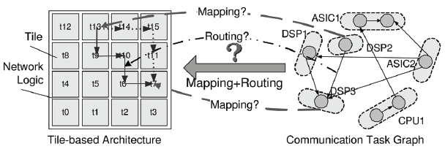
Example: homogeneous NoCs

Slide 17
Outline
Mapping approaches
  Multi-objective evolutionary algorithms (MOEAs)
    Genetic algorithms
    Simulated annealing
  Ant Colony Optimizations (ACO)
  Robust tabu search, force directed
  ILP
  Heuristics
  Branch and bound

Slide 18
Evolutionary Algorithms
Application represented as a Kahn Process Network (KPN)
Architecture represented as a graph
Mapping:
  Each KPN node mapped onto a single processor
  Each channel in the application model has to be mapped onto a processor or a memory
  If two communicating Kahn nodes are mapped onto the same processor, then the communication channel(s) between these nodes have to be mapped onto the same processor
  When two communicating Kahn nodes are mapped onto two separate processors, the channel(s) between these nodes are to be mapped onto an external memory
Three conflicting objective functions
  Minimize the maximum processing time in the system
  Minimize the power consumption of the whole system
  Minimize the total cost of the architecture model

Slide 19
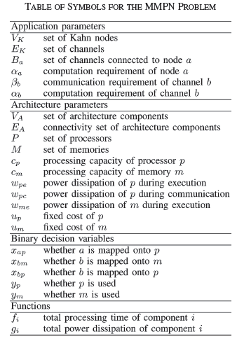
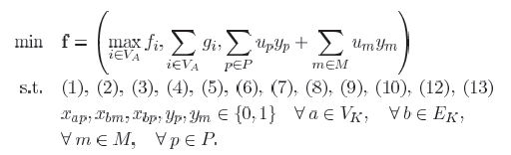
MMPN problem
(MMPN problem): The multiprocessor mappings of process networks (MMPN) problem is the multiobjective integer optimization problem:
[] Cagkan Erbas, Selin Cerav-Erbas, Andy D. Pimentel, Multiobjective optimization and evolutionary algorithms for the application mapping problem in multiprocessor system-on-chip design, IEEE Transactions on Evolutionary Computation, 2006.

Slide 20
Evolutionary Algorithms
for Design Space Exploration (DSE)

Slide 21
Challenges

Slide 22
Outline
Mapping approaches
  Multi-objective evolutionary algorithms (MOEAs)
    Genetic algorithms
    Simulated annealing
  Ant Colony Optimizations (ACO)
  Robust tabu search, force directed
  ILP
  Heuristics
  Branch and bound

Slide 23
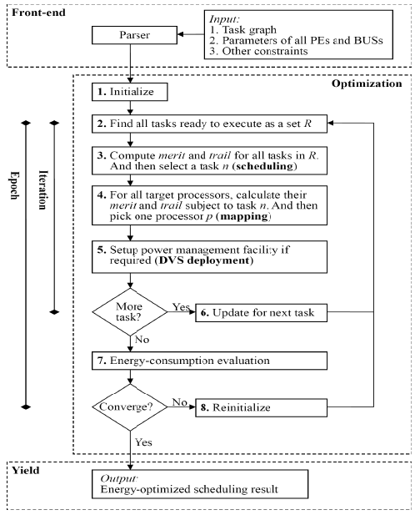
Ant colony optimization
Objective: energy
[] Po-Chun Chang, I-Wei Wu, Jyh-Jiun Shann, Chung-Ping Chung, ETAHM: an energy-aware task allocation algorithm for heterogeneous multiprocessor, DAC, 2008.

Slide 24
Outline
Mapping approaches
  Multi-objective evolutionary algorithms (MOEAs)
    Genetic algorithms
    Simulated annealing
  Ant Colony Optimizations (ACO)
  Robust tabu search, force directed
  ILP
  Heuristics
  Branch and bound

Slide 25
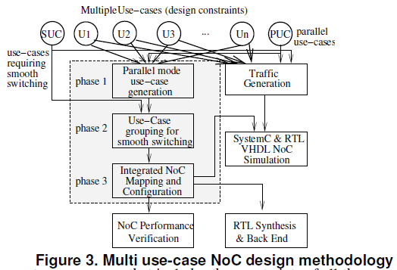
Heuristic 1: Mapping multiple use-cases
[] Srinivasan Murali, Martijn Coenen, Andrei Radulescu, Kees Goossens, Giovanni De Micheli, A methodology for mapping multiple use-cases onto networks on chips, DATE, 2006.

Slide 26
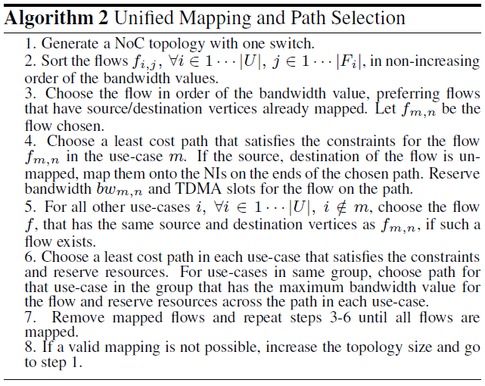
Heuristic 1: Mapping multiple use-cases

Slide 27
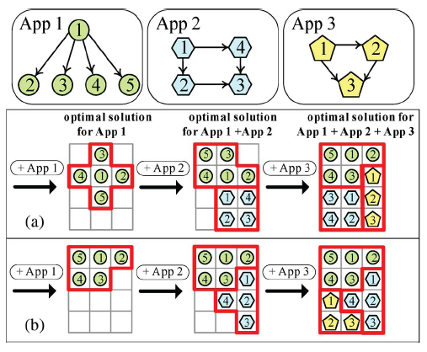
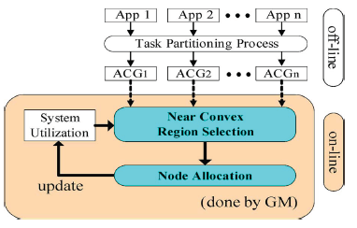
Heuristic 2
Incremental mapping with multiple voltage levels
Objective: energy
[] C.-L. Chou, U.Y. Ogras, R. Marculescu, Energy- and Performance-aware Incremental Mapping for Networks-on-Chip with Multiple Voltage Levels, TCAD, vol. 27, no. 10, pp. 1866-1879, Oct. 2008.

Slide 28
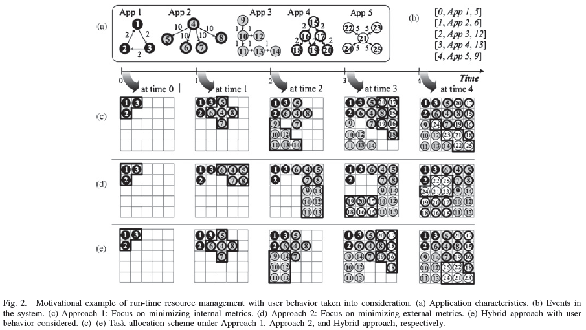
Heuristic 3: Run-Time Task Allocation Considering User Behavior

Slide 29
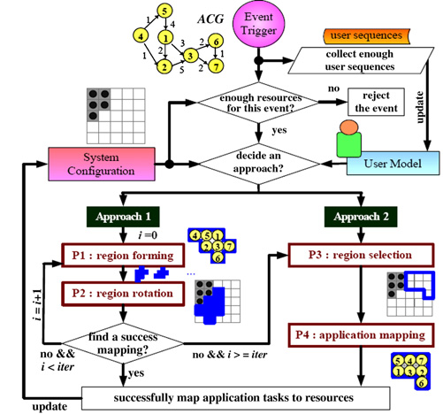
Heuristic 3: methodology
Objective: communication energy
Approach 1
  First form a region to minimize the internal contention for the incoming application (P1)
  Rotate/translate the resulting region to fit the current system configuration (P2)
Approach 2
  In order to minimize the external contention, first select a near convex region based on the current configuration (P3)
  Map the application tasks onto the selected region (P4)
[] C.-L. Chou, R. Marculescu, Run-Time Task Allocation Considering User Behavior in Embedded Multiprocessor Networks-on-Chip, IEEE TCAD, 2010.

Slide 30
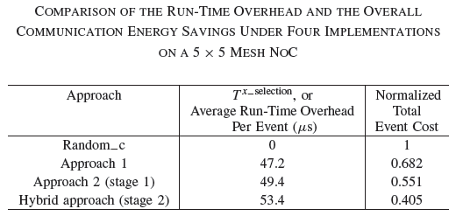
Results

Slide 31
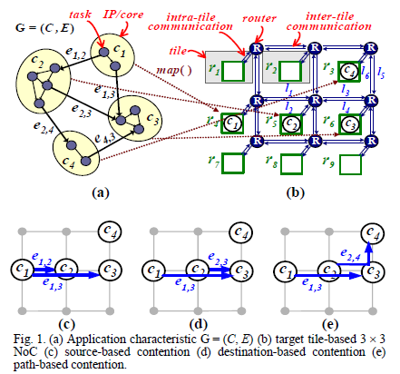
Heuristic 4: Contention-aware Application Mapping
[] C.-L. Chou, R. Marculescu, Contention-aware Application Mapping for Network-on-Chip Communication Architectures, Intl. Conf. on Computer Design (ICCD), Oct. 2008.

Slide 32
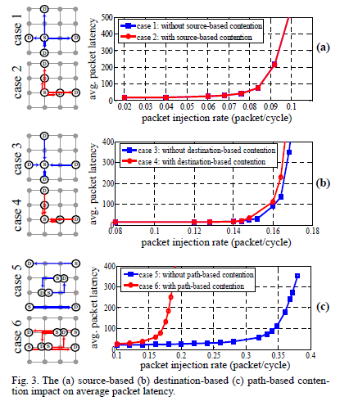
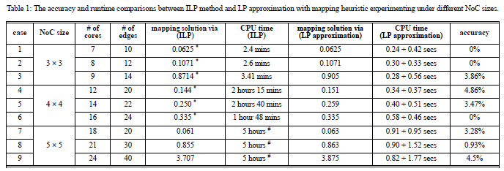
Results
Objective: contention, latency
ILP + heuristic

Slide 33
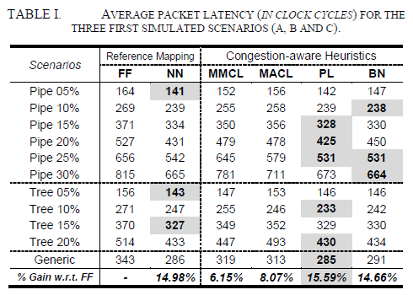
Comparison studies
Dynamic task mapping targeting congestion
  [] Ewerson Carvalho, Ney Calazans, Fernando Moraes, Investigating Runtime Task Mapping for NoC-based Multiprocessor SoCs, IFIP VLSI SoC, 2009.

Slide 34
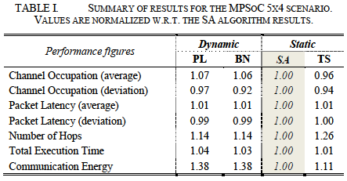
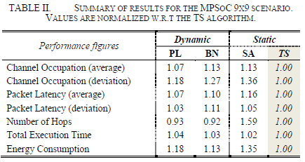
Comparison studies
Pros and cons of static and dynamic mapping
  [] Ewerson Carvalho, Cesar Marcon, Ney Calazans, Fernando Moraes, Evaluation of Static and Dynamic Task Mapping Algorithms in NoC-Based MPSoCs, SOC, 2009.

Slide 35
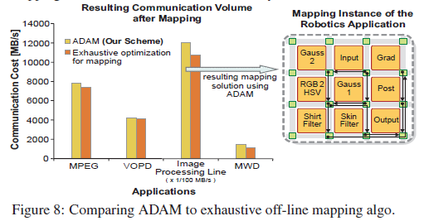
Heuristic 5: ADAM: Run-time Agent-based Distributed Application Mapping
Runtime application mapping in a distributed manner using agents targeting for adaptive NoC-based heterogeneous multi-processor systems
10.7 times lower monitoring traffic compared to a centralized mapping scheme for a 64x64 NoC
7.1 times lower computational effort for the run-time mapping algorithm compared to the simple nearest-neighbor (NN) heuristics on a 64x32 NoC
Results:

Slide 36
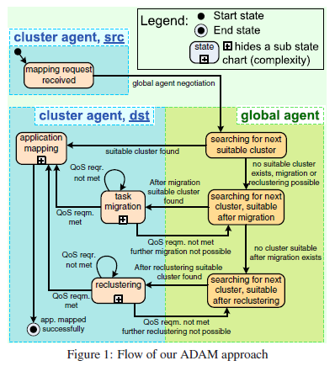
Mapping flow
[] M.A. Al Faruque, Rudolf Krist, Jorg Henkel, ADAM: run-time agent-based distributed application mapping for on-chip communication, DAC, 2008.

Slide 37
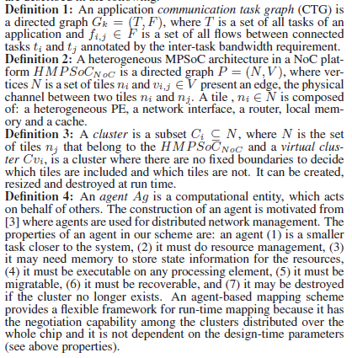
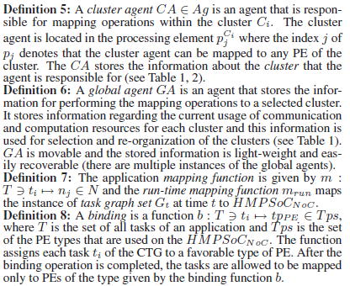
Definitions

Slide 38
Outline
Mapping approaches
  Multi-objective evolutionary algorithms (MOEAs)
    Genetic algorithms
    Simulated annealing
  Ant Colony Optimizations (ACO)
  Robust tabu search, force directed
  ILP
  Heuristics
  Branch and bound

Slide 39
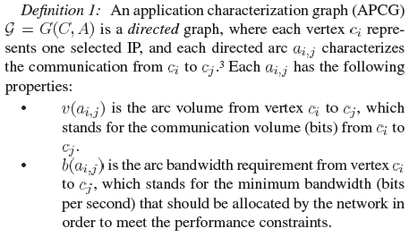
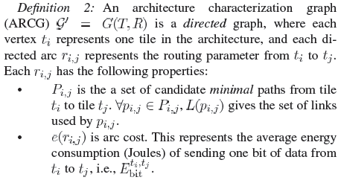
Definitions
[] J. Hu, R. Marculescu, Energy- and Performance-Aware Mapping for Regular NoC Architectures, TCAD, vol. 24, no. 4, Apr. 2005.

Slide 40


Definitions, Models
The average energy consumption for sending one bit of data between two tiles:

Slide 41
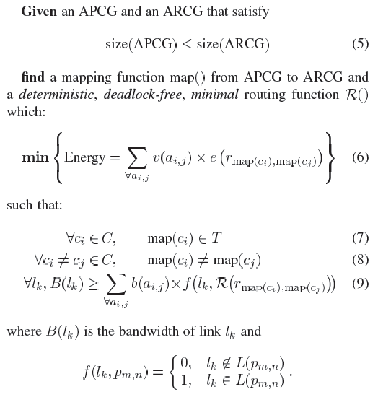
Problem formulation

Slide 42
Branch-and-Bound (BB) algorithm
General algorithm: consists of a systematic enumeration of all candidate solutions, where large sets of such solutions are discarded
Tree search of the solution space:
  Potentially exponential search
Use bounding function:
  If the lower bound on the solution cost that can be derived from a set of future choices exceeds the cost of the best solution seen so far: kill/prune the search
Good pruning can significantly reduce the CPU runtime

Slide 43
Illustrative example: traveling salesman problem (TSP)
Start A
9
B
5
4
5
3
F
8
Search tree
E
5
C
7
A
1
2
D
B
E
F
5+15
C
F
D
F
8+16
D
F
C
D
E
C
F
22+9
21+6
11+9
C
E
D
E
F
B
F
x
x
x
23+8
14+10
F
F
Prune
A
A
27
20: Best solution

Slide 44
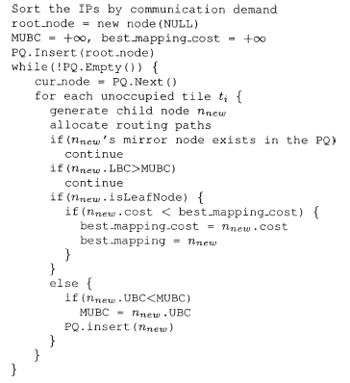
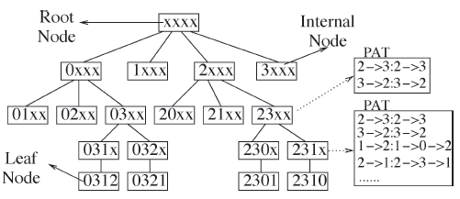
BB based mapping
Walks through the search tree that represents the solution space

Slide 45
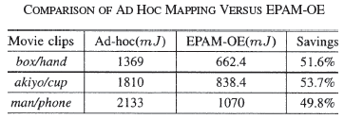
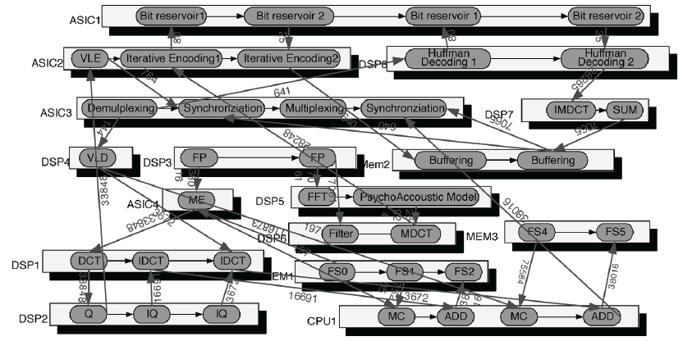
Results
MultiMedia System (MMS): MMS is an integrated video/audio system which includes an H263 video encoder, an H263 video decoder, an MP3 audio encoder, and an MP3 audio decoder
4x4 homogeneous NoC
Clustering of tasks during mapping

Slide 46
Scheduling

Slide 47
Scheduling
Aperiodic scheduling
    http://ls12-www.cs.tu-dortmund.de/daes/media/documents/staff/marwedel/es-book/slides10/es-marw-6.1-aperiodic.ppt
Periodic scheduling
    http://ls12-www.cs.tu-dortmund.de/daes/media/documents/staff/marwedel/es-book/slides10/es-marw-6.3-periodic.ppt

